Slide 1
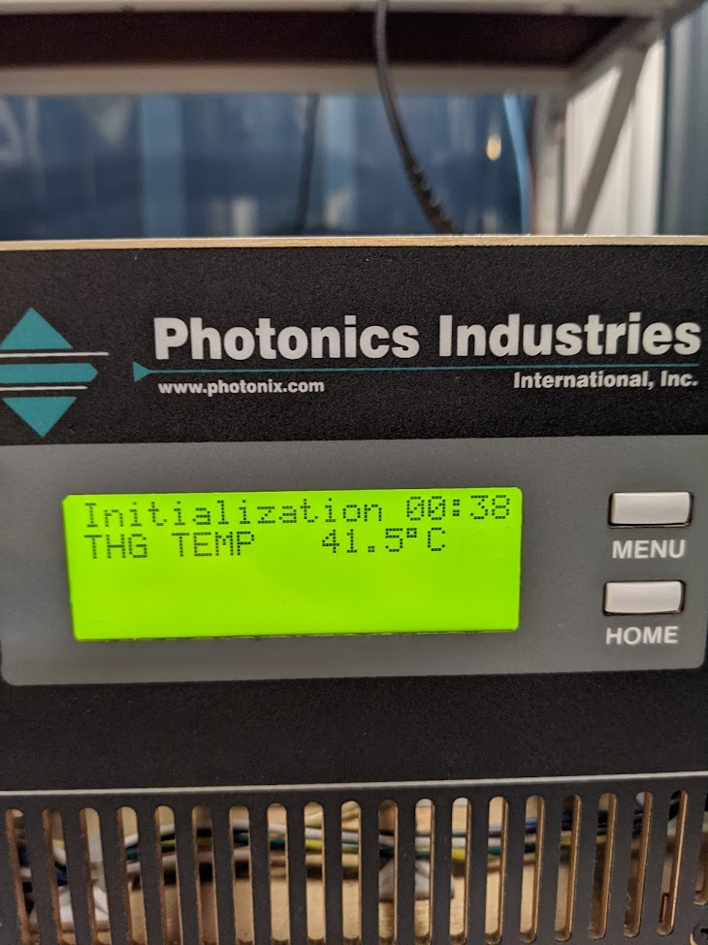
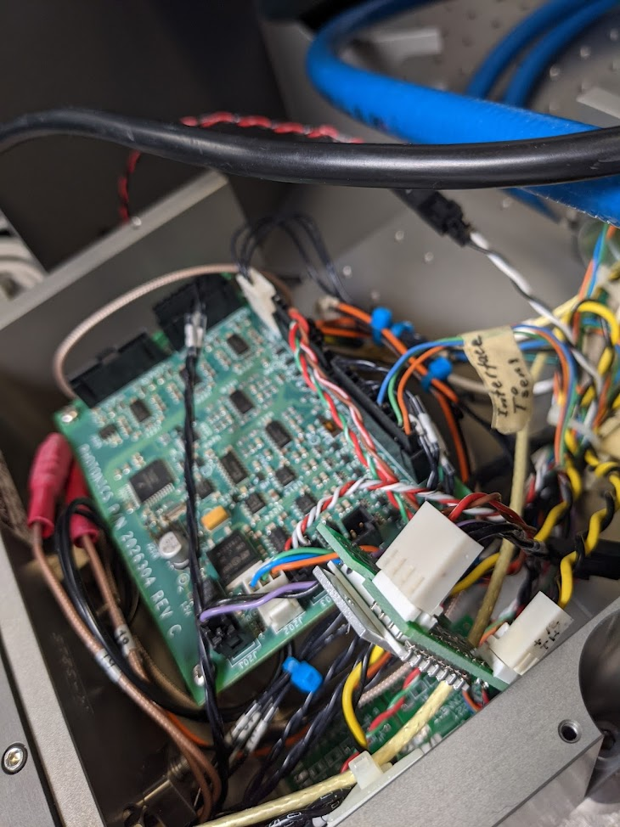
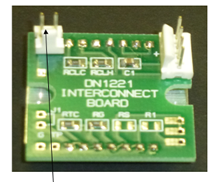
DP2-2: board replacement 11 November 2021
After the end of the CMS run, laser went into error when switching OFF.
”error Temp. THG 41.5C”
Laser was not able to initialize after that.
1. Test Voltage 12V OK
2. Test the spare board DN1221 by disconnecting the one on the left: OK
3. Replace the board
4. Power measurement: 80mW@35A OK

