Slide 1
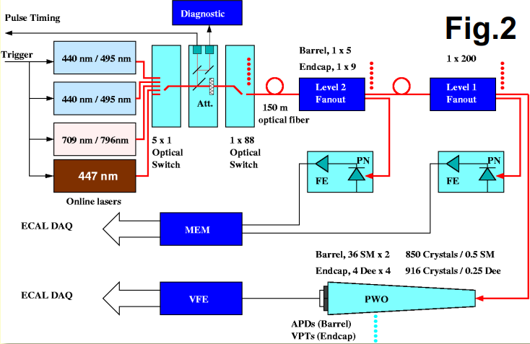
Long fiber test March 2018
Spare bundle ~105m: add FC connectors on each ribbon.
1)
1)Test the attenuation of each fibers with new new connectors:
200m after DP2-1 output (2 fibers of 100m connected together): lost= ~6 dB
2) Compare pulse with no fiber, with 100m and with 200m, using the slow monitoring
1
2
3
1
DP2-1 | NRJ (not calibrated) | FWHM (ns) | Pulsecenter(ns)
original | 50.5 | 21.8 | 86487
+100m | 17.2 | 22.2 | 87036
+200m | 9.8 | 22.55 | 87585
Overall ∆T=1098ns
2
Connect 200m after the 1x5 optical switch in order to tune the overall timing with the Matacq
After the 1x100 switch it is not possible to see and adjust the timing with Matacq
Adjust Blue laser timing from laser side. Delay A= 12.56us → new Delay A(200m)= 11.46us
Adjust Green timing with nimdelay : nimdelay= 7887 to nimdelay= 7800 → =-1087.5 ns
Pulse power can not be tuned with Matacq at this stage (only DQM) -> linear attenuator is AFTER the pin diode.
Only for the weekend : tune the remote attenuator from 9% to 25% by looking the DQM

Slide 2
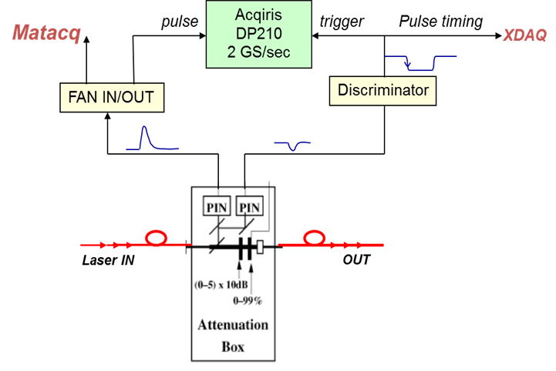
Long fiber test March 2018
Remote attenuator is placed after the pin diode of the Matacq.
(no effect on LightChecker when moving from EB to EE with #attenuator)
Tuning the attenuator of the laser itself is not enough (99% not sufficient)
3
Connect 200m on 3 Light Monitoring region LM as defined with Saclay. LM 69-72-73
For only 3 LM : need to adjust the delay and attenuation individually.
Table on dBGUI laser correction
1) The delay correction is low, can not remove 1087.5ns else negative value !! so we keep new delay A(200m) on blue laser and add 348 to all LM delay excepted the one with 200m.
348 because 348x(25/8)=1087.5ns
But not possible to see the pulse… need to go step by step ?
Max value that can be add on LM ? 348 ok ?
2) attenuation: LM attenuation = new/old= 1 for all EB, = 8 for EE
New LM attenuation = 3 for EB(200m) channel (attenuator from 9% to 27)
For EE not possible: 8x3=24, factor 24 of 9% = 216%.
But DON’T need to test EE !!!
3) For the Green: nimdelay= 7800 only for the 200m LM region.
LM to be tested : LM 69, 72, ? Propose 69-70 (FULL SM EB+17) + LM 71
# Revisions:
# July 31, 09: change fiber length delay correction.
# LMs 76,77,78,79,84,85,86,87 needed to be 1bx ahead:
# delay of 1bx added to every other LM.
#Fiber length delay corrections (in 1/8th bx unit):
# EB-
# LM1 LM2 LM3 LM4 LM5 LM6 LM7 LM8 LM9
68 68 68 68 68 68 68 68 72 \
#LM10 LM11 LM12 LM13 LM14 LM15 LM16 LM17 LM18
71 72 72 71 71 72 72 70 69 \
#LM19 LM20 LM21 LM22 LM23 LM24 LM25 LM26 LM27
70 70 72 72 72 72 68 68 68 \
#LM28 LM29 LM30 LM31 LM32 LM33 LM34 LM35 LM36
…
…
…
#EE+
#LM73 LM74 LM75 LM76 LM77 LM78 LM79 LM80
21 21 20 15 15 15 15 20 \
#EE-
#LM81 LM82 LM83 LM84 LM85 LM86 LM87 LM88
19 19 18 11 12 12 11 19
# Laser power correction per monitoring region (LM):
# EB-

Slide 3
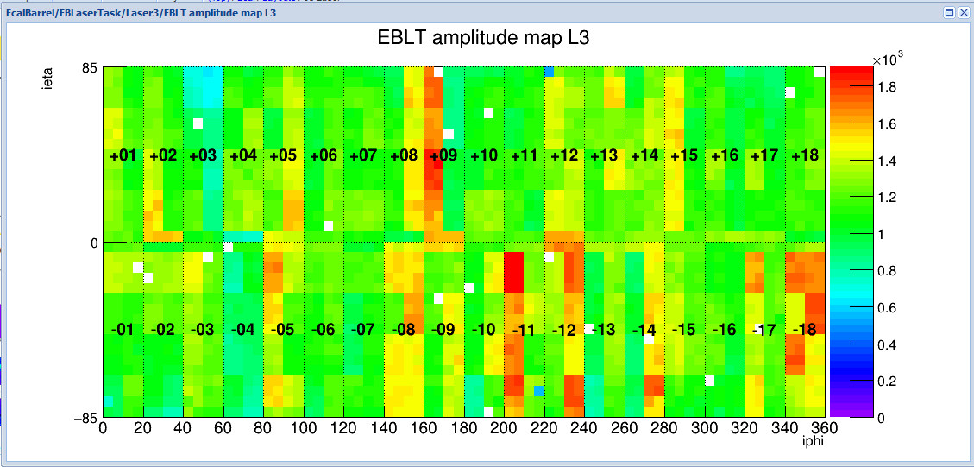
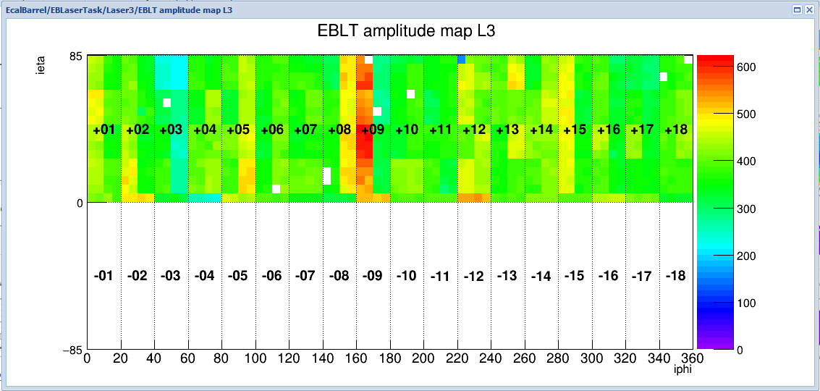
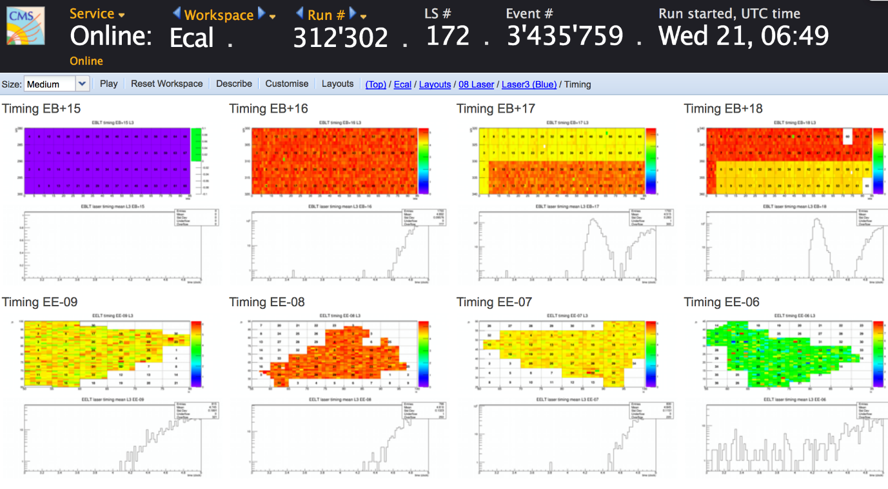
Long fiber test March 2018
* run 312003 avant l'ajout de la fibre supplémentaire. L'amplitude est autour de 1600/1800 pour EB+8/9
* run 312059 dernier pris cet après midi. L'amplitude est autour de 500/600 pour EB+8/9
Donc je propose de diminuer l'atténuation d'un facteur 3 pour voir ce que l'on obtient.
Hi All,
In fact, the light on EB+17 (LM69) and EB+18 (LM72) where 200m fibre connected is pretty much abnormal.
There exists a quite oddly post pulse in about 50% of cases. I attached timing from DQM for runs 312302
(the same as for David’s plots) and the old run 295463 without 200m fibre.
Cheers,
Serguei

Slide 4
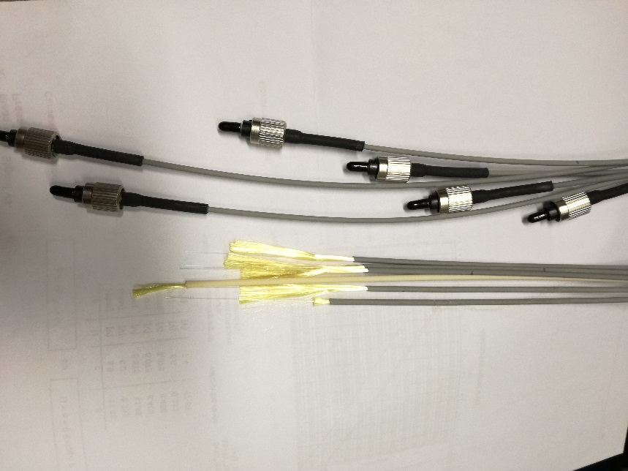
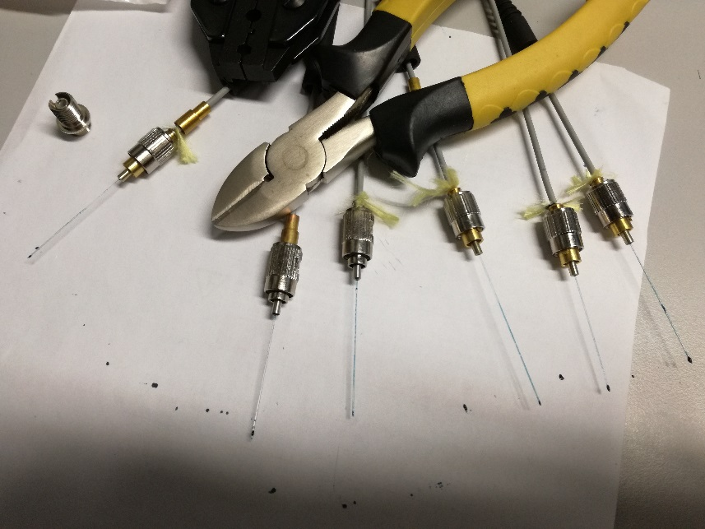
Annexes
The main delay of the calibration is done by:
delay = WTE_2_GREEN_LASER * 25ns + GREEN_LASER_PHASE * 3.125ns + delay Reg.28 * 12.5ns
The value WTE,ect are stored on the DBGui.
WTE=21 and green laser phase: 4
There is one setting called “nimdelay” = delay Reg.28 , on ~ecalpro/.lasercfg :
The registerd “28” for green timing is resetting after each new run to 1ED( (7897)
Last good value : write 28 4 0x1EDC (7885)
Making new connectors

Slide 5
Long fiber test March 2019
- Delays of individual LM regions can be set in 256 steps of 3.125 ns (1/8 of bx), i.e. up to 800 ns.
200m fibers induce1098 ns delay so we cannot run at the same time regions with and without 200m fibers.
Propose to run reference region (LM45) + 6 regions (LM46-51) with 100m fibers, then 3 regions (LM46-48) with 200m fibers.
EMTC wte_2_*laser delay is currently set to 21 bx (525 ns) and cannot be < 0. Need to change configuration of "delay A and NIM delay“
Proposal:
1) Run before any change
2) Confirm delay measured previously (1098 ns / 200m fiber). Subtract 1098 ns from delay A and NIM delay. Pulses should be delayed by -1100 ns in MATACQ and not visible in APDs
3) Add 550 ns to wte_2_* delay and add 550 ns delay of LM45 (config file sent to Giacomo Cucciati), used for reference later. Read LM45-51. In MATACQ, pulses should be centered for LM45 and delayed by -550 ns for LM46-51. Pulses in APDs should be visible again for LM45
4) Use 100m fibers on LM46-51. Pulses should be centered in APDs
5) Use 200m fibers on LM46-48. Back to original config of EMTC global and individual delays. Pulses should be delayed by -1098 ns in MATACQ and centered in APDs
Summary: first, test the delay with no fiber: Delay A -1100ns and WTE + 550ns, LM + 550ns
Delay A: A=12,56 us normal value. A=11,46us for 200m : -1100ns
WTE: 21 for the blue normal value. Or 21x25ns= 525ns. Adding 550ns we have 1075ns or WTE=43.
Adding 1100ns (we have 1625ns) or WTE=65
LM region(file): 71 for LM(45) original value. Adding 550ns: 71+550/25x8 = 247.
Nim Delay (only for green): original 7901. en base de 12.5ns donc 7901= 7901x12.5ns
we want to remove 1100ns: 7901 – (1100/12.5) = 7813
dBGui:
wte_2_blue_laser 43
wte_2_ir_laser 43
wte_2_blue2_laser 43
wte_2_green_laser 43
wte_2_blue_quant_laser 43
wte_2_phot1_laser 43
wte_2_phot2_laser 43
# EB+
#LM37 LM38 LM39 LM40 LM41 LM42 LM43 LM44 LM45
71 71 72 72 68 68 68 68 247 \
#LM46 LM47 LM48 LM49 LM50 LM51 LM52 LM53 LM54
71 71 71 68 68 68 68 72 72 \

Slide 6
Long fiber test March 2019
http://cmsonline.cern.ch/cms-elog/1080731
DP2-1 | Date run # | Delay A (us) | WTE (based x25ns) | LM(45) | result
Original value 18 March | 328437 | 12.56 | 21 | 71 | Pulse at 1490 on Matacq
 | 328439 | 11.46 | 65 | 247 | No pulse. On fast monitoring pulse at 98020 (-1100n)
 | 14h18 18/03 328444 | 11.46 | 65 | 71 | Matacq: no pulse on time. But on DQM OK → WTE not affecting the Matacq
 | 328447 | 11.46 | 65 | 71+ 1BX(8) = 79 | 1Bx=8. We see the pulse for LM(45) shifted by 1 Bx. OK !
 | 328452 | 11.46 | 43 | 247 | Try again. No pulse on DQM
 | 328454 | 11.46 | 64 | 79 | Moving WTE now: Pulse OK on DQM, on time , not shifted. WTE compensated LM(45) OK
 |  | 11.46 | 65-8=57 | 71+8x8=135 | Try LM>128 : no pulse ! Maximum value for LM is 128 !!!
19 March, | 328483 | 11.46 | 65 | 71 | No fibre. Reference run. -1100ns from A and + 1100ns from WTE.
+100m on LM 45-46-47-48-49-50 | 328485 | 11.46 | 43 | 71 | EB+5,6,7,8 (half of 7 and 8 no extra fibre) Fibre on the front panel spybox. Directly to the detector fibre
+200m fibre on LM45-46-47 | 328493 | 11.46 | 21 | 71 | EB+05 and half EB+06 with 200m
Marc change the scale for Matacq timing plot

Slide 7
Long fiber test March 2019
Run 328442: only LM 45 and LM46.
Why no light on the other side ? Need DQM…
Seems issue with LMF when the pulse on the matacq is out if range

Slide 8
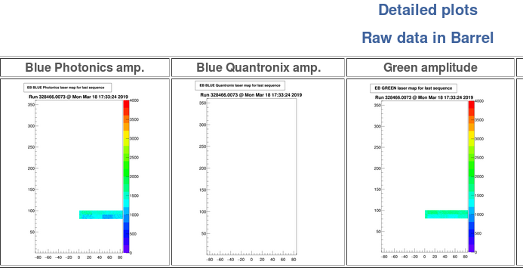
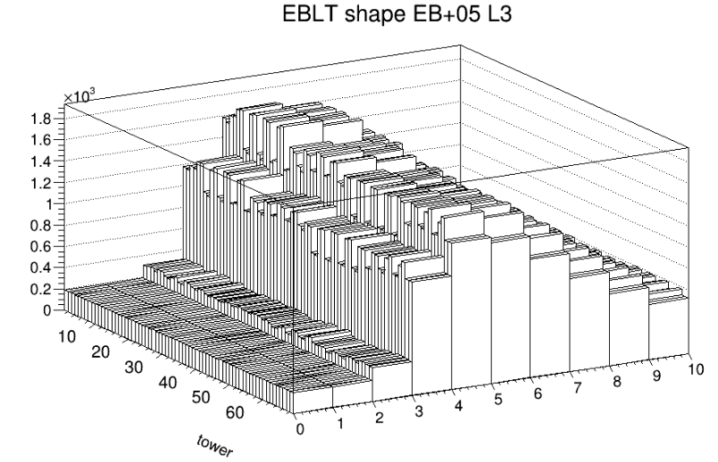
Long fiber test March 2019
Marc change the scale for Matacq timing plot → pulse visible , center around 390 → LMF OK ! (Raw date OK)
Amplitude to be adjusted ?
Original amplitude=1800

Slide 9
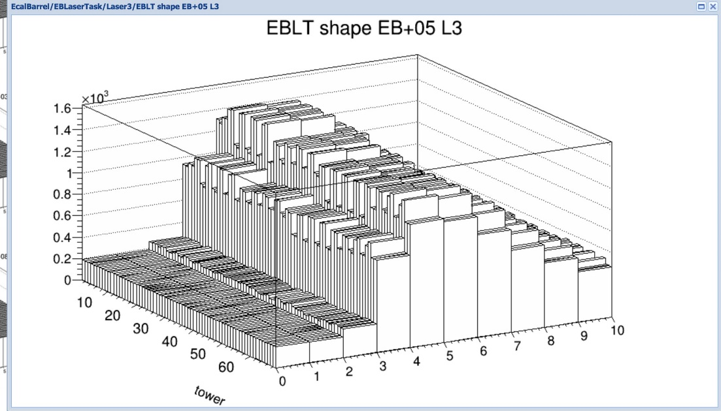
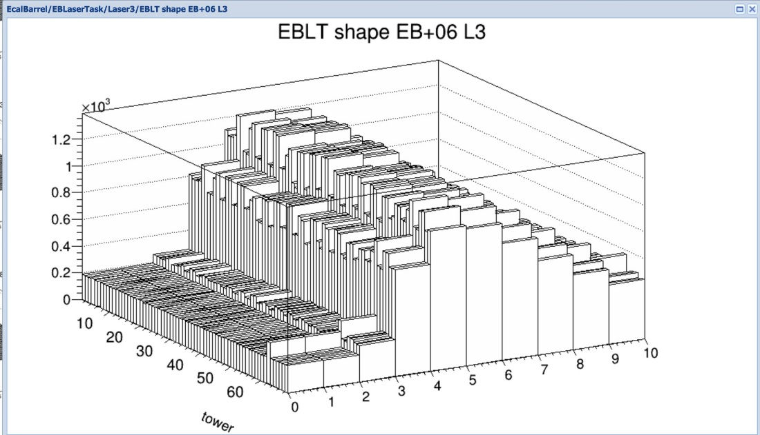
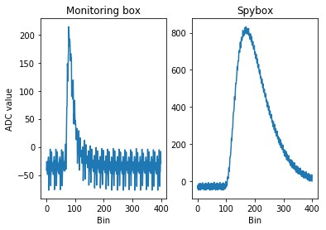
Long fiber test March 2019
20 March: Change fibre position. Put 200m fibre at the 1x5 switch to get the effect reflected on the Matacq and spy box.
put back original scale on matacq light checker, pulse center back to 1490.
Adjust the pulse amplitude as well : Blue_phot_power on dBGUI move from 9 to 30.
internal attenuation blue DP2: move from 35 to 99 : too much: 3000 ADC on DQM.
move from 99 to 50%. To be around 1800
clean / smart polish of fibre input monitoring box.
Run 328562: 50% internal attenuation, Blue_phot_power=30. Green power P=255 (max. was 240)
All OK so start run with full Barrel

Slide 10
Long fiber test March 2019
start run with full Barrel in global.
50% internal attenuation, Blue_phot_power=30. Green power P=255 (max. was 240)
Amplitude not reflected on Matacq, attenuator after the matacq. Amplitude a bit lower on DQM than before but OK from Bruno.

