Slide 1
ECAL LASER for New HCAL Laser Review
30 August 2018, https://indico.cern.ch/event/753448/
David Bailleux

Slide 2
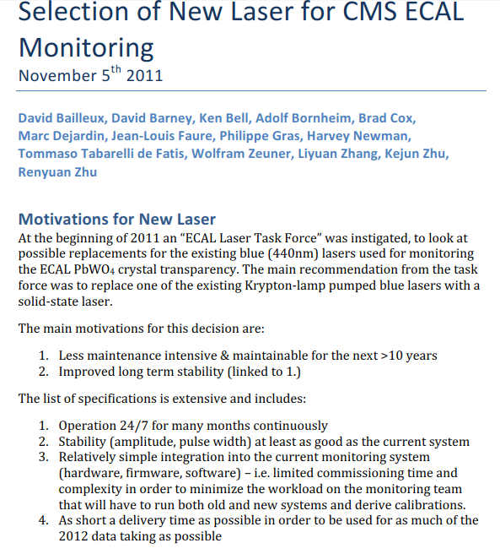
Laser choice 2012
Laser task force 2011
Ecal general meeting, https://indico.cern.ch/event/155389/
CMS week, https://indico.cern.ch/event/144440/
Technical Problems:
Blue Ti:S lasers are pumped by a laser pumped by a Kr-lamp
Kr-lamp is a very sensitive consumable – causes large maintenance effort
Pump laser is not available any more – spares are running out soon
The interruptions to maintain the pump laser causes the large majority of “jumps” in the APD/PN ratio
Blue Ti:S lasers show first signs of aging, long term availability not clear
Blue Ti:S lasers show some not understood pre-pulses
There is no spare optical switch of the correct size to feed all channels in parallel

Slide 3
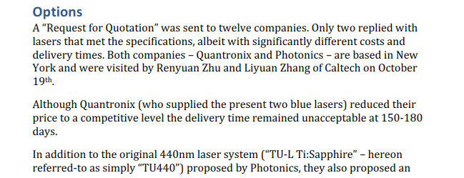
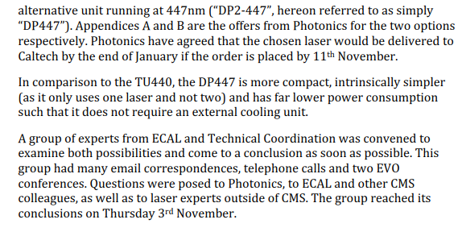
Laser choice 2012

Slide 4
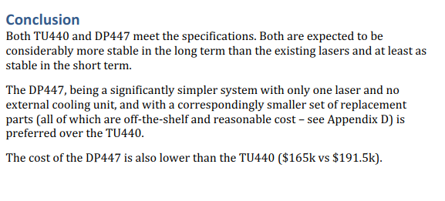
Laser choice 2012

Slide 5
Summary laser choice 2012

Slide 6
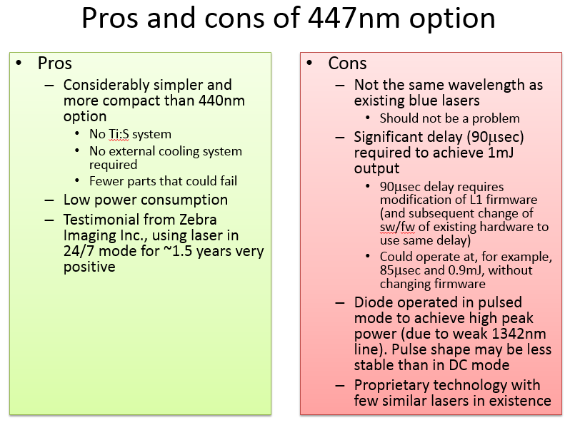
Summary laser choice 2012

Slide 7
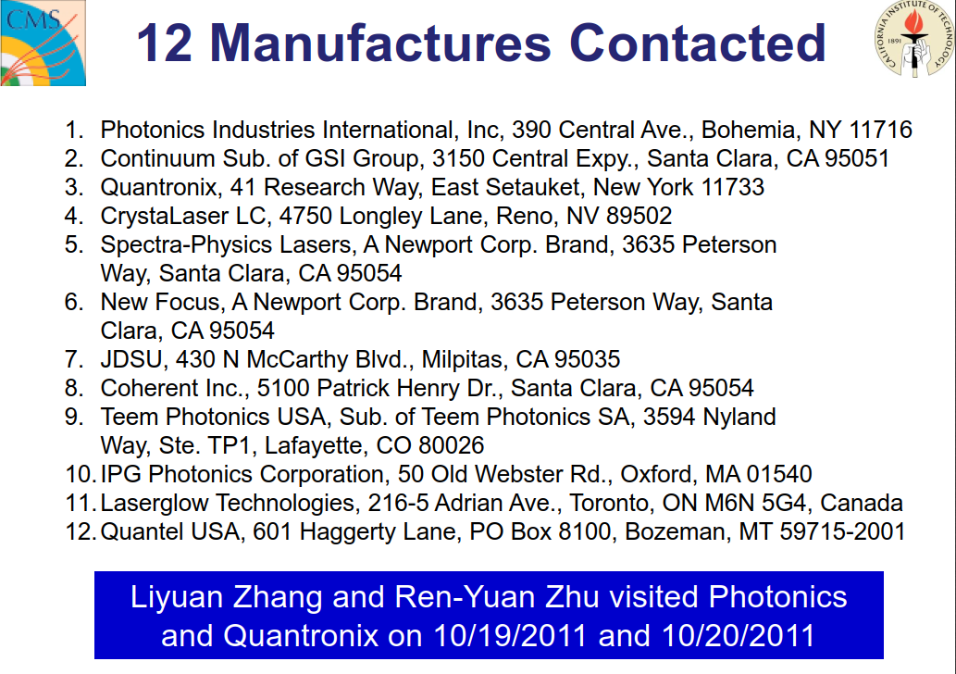
Summary laser choice 2012
MTBR Mean Time Between Replacement
MTBF Mean Time Between Failure

Slide 8
Summary laser choice 2012

Slide 9
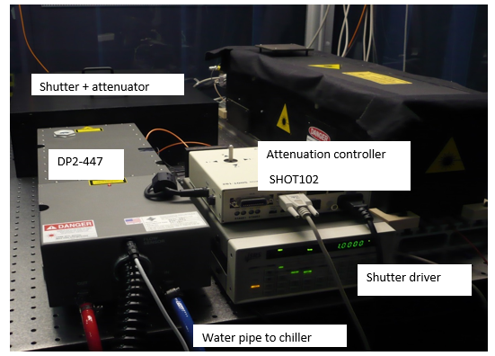

Slide 10
DP2 447nm performance

Slide 11
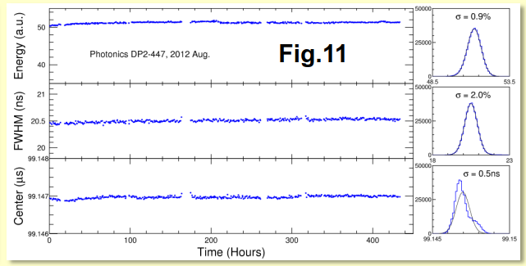
DP2 447nm performance
The DP2-447 laser system was installed in the CMS underground cavern on March 21, 2012. Its power was found to be consistent with that measured at Caltech, indicating no effect from the residual B field at a level of 30 Gauss.
Fig.11 shows a typical history plot for the DP2-447 pulse energy, width and center timing in situ at CMS over 400 hrs and their stabilities of 1%, 2% and 1 ns respectively, exceeding the 3%, 5% and 3 ns specifications.

Slide 12
DP2 at CMS
March 2012: 1st laser at CERN DP2-1.
August 2013: 2nd laser in production. Training in Photonics.
Sept 2013: laser reparation back to US. ~ $51 000
Add humidity sensor inside laser itself
the second laser at Photonics not consistent with the 1st one -> update
Oct 2013: 2nd laser at Caltech for deeper commissioning
Dec 2013: 2nd laser @ PT5
After the main problem the first year, lasers are working fine. 2 models of chiller were not fine (one with no cooling capacity and one to weak) before having more robust version.
Low pressure issue time to time only on 1st laser (dust on water from laser side )
Diode never yet changed (from 2013) using the 2 lasers half/half of time
→ Lasers run at 35A while the maximum is 50A.
Laser head can not be opened in case of issue – even if we have all major spare parts here. Only controller side and electronics side can be replaced after the training at Photonics.

Slide 13
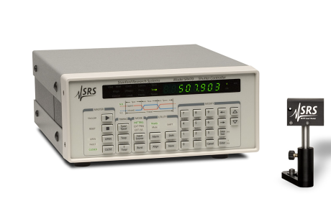
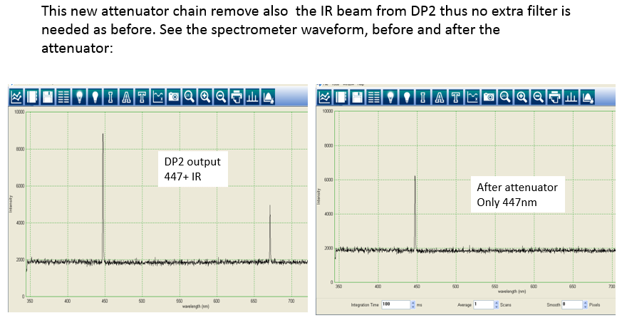
Other Laser parts
Shutter + controller: SRS, Standford Research Systems, $4500
Optical switch: DiCon, GP700-4-1/1X100-8-365-FC-B-Z10553,$62000
http://www.diconfiberoptics.com/products/GP700/scd0081/8r.pdf
Ancillaries optics: linear attenuation with polarizer and ¼ waveplate.

Slide 14
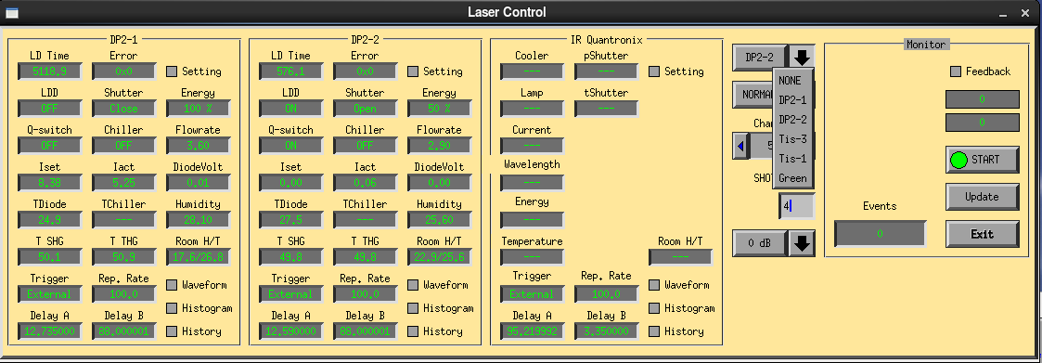
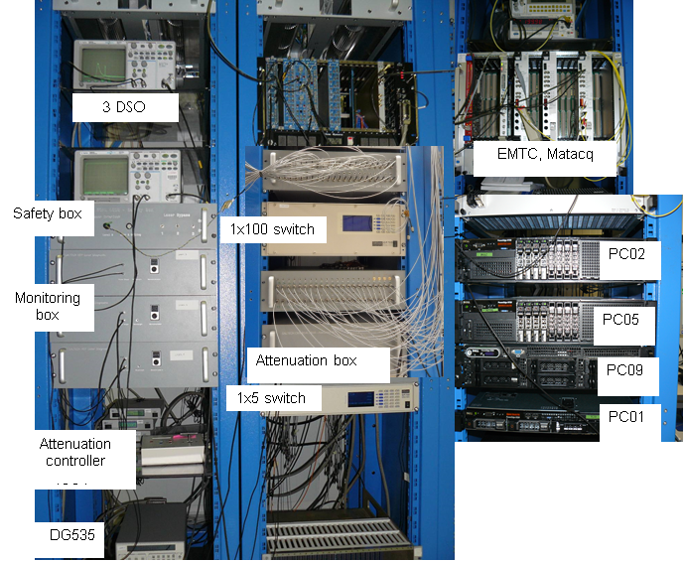
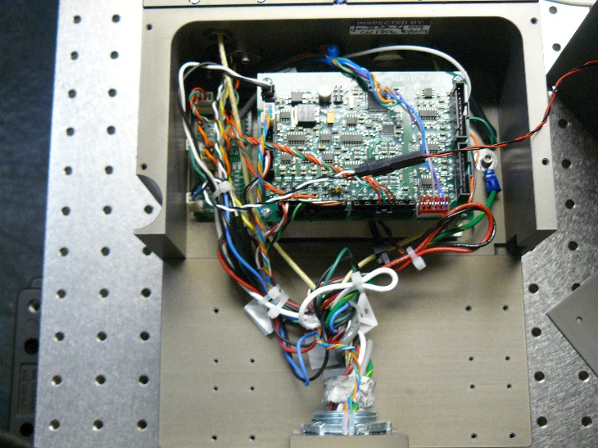
Laser software control
Laser rack control
Laser head electronics
ECAL LASER system web side:
http://laser-caltech.web.cern.ch/laser-caltech/

Slide 15
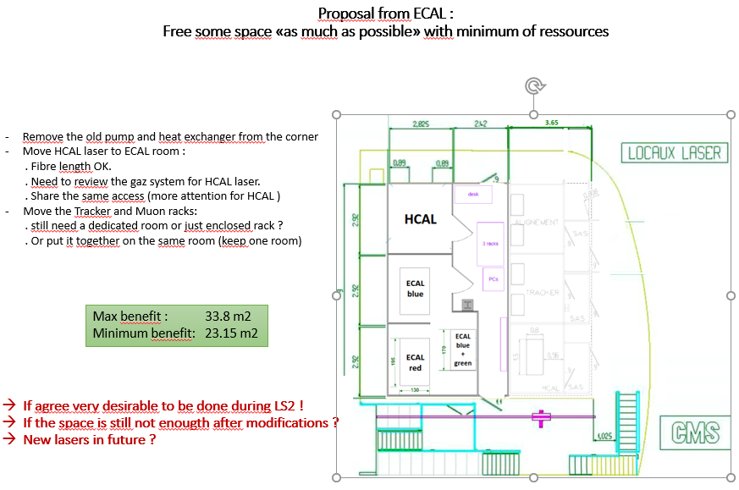
Integration forum 15 Jan. 2018
https://indico.cern.ch/event/687346/
37 m2 for ECAL

