Slide 1
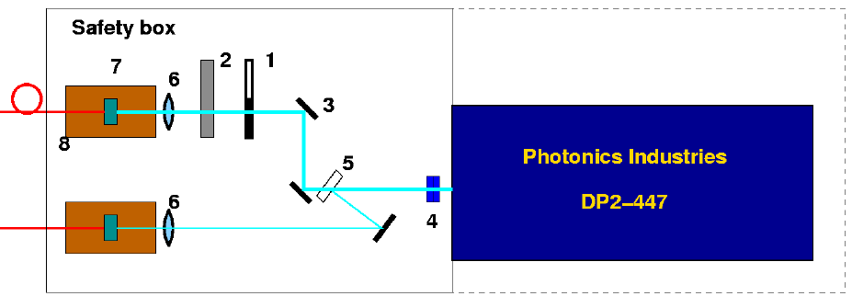
Power measurement 2 August
28 June (TS Liyuan)
P1) DP2-447 output: 93 mW
P2) Before fold mirror 3: 83 mW -0.49dB
P3) After attenuator: 77 mW -0.82 dB
P4) After 1m fibre: 65 mW -1.44dB
P4
P3
main
11 July (moving mirror + cleaning)
P1) DP2-447 output: 89.3 mW
P2) Before fold mirror 3: 80 mW -0.47dB
P3) After attenuator: 70.5mW -1 dB
P4) After 1m fibre: 62.5mW -1.55dB
P2
P0
P1
slow
2 August before intervention
P0) Before filter: 102 mW
P1) DP2-447 output: 80 mW
P2) Before fold mirror 3: 69.3 mW -0.6dB
P3) After attenuator: 60.5mW -1.2 dB
P4) After 1m fibre: - (don’t want to touch main fibre )
2 August after moving 4
P1) DP2-447 output: 93 mW
P2) Before fold mirror 3: 84 mW -0.45dB
P3) After attenuator: 68 mW - 1.36 dB
P4) After 1m fibre: - (don’t want to touch main fibre )

Slide 2
Power measurement 2 August
Intervention :
Increasing – decreasing diode current in order to perform power measurement;
Moving and cleaning a bit the filter 4 in order to move the beam out of the spot: spot clearly visible because of blue reflection on its surface;
Main fibre untouched do not create a second effect. This could explain why the overall loss is slightly higher than the 28 June (with same power P1). Overall alignment could be checked later on;
Spot on mirror: occurred after 28 June (because of same power at this date), immediately after Liyuan’s visit when B field was put ON, id. when data restarted.
Wait and see if filter will be damaged again soon. If yes, dust could be excluded.

