Slide 1
Lasers Incident Easter 2012
Summary of events:
1) GPIB error Sunday 29, 21h28. Restart all 00:57 am.
Comment: linearity scan for the ENCAP finished at ~21h10.
2) Laser1 OFF- restart: 01 MAY, 19h10.
Restart of laser1 OK and sequence restarted ~20h20. Laser1 is ‘fault state’. I don’t know what was the error display on the laser...
Comment: - linearity scan start at 17h08 , stop at 18h52
- power glitch at 6am, following by CMS wide water cooling disturbance
3) Laser1 OFF → Laser2: 02 MAY, 2h54
Laser2 ON at 5h20.
4) Laser2 → Laser1 : 02 MAY, 16h30.

Slide 2
Lasers Incident Easter 2012
Laser1 investigation and problem:
No problem at all regarding the operation: device rebooting for 1) and spare laser2 online OK thus all OK regarding ecal laser operation at it is defined. Good !
The others things are details and transparent regarding ECAL.
Laser1 investigation:
- Put back 20 degrees on room temperature at is was to avoid light disparity (was put to 18°)
- Laser1 error : “water flow error”. While Emanuele got “water Di error” . The error remain ON all the time despite resetting the laser power supply (and error before the pump start)
- Swap the 2 chips relay on logic unit: no effect
- Replace the flow sensor with spare one: no effect
- Replace one relay chip on logic unit: OK , error disappeared !
- Start laser: lamp can’t start ignition , no current à dismount it. Found lamp broken. Succeed to remove piece of glass inside the flow tube without dismount all.
- Restart laser with no tuning at ALL to avoid big monitoring step. Power of TiS laser same as 13 April (new lamp)

Slide 3
Lasers Incident Easter 2012
Conclusion :
i) I m not sure why laser1 went OFF in 2). which error ? If it was “water temperature error” that’s mean no input cooling, due to CMS water trouble -> Most probably the case because the 1 May laser1 was not used so no visible defect before the afternoon when ECAL start to use it.
Anyway laser restart after that thus nothing to suspect on laser side.
BUT this is for sure very bad for the lamp in general when the laser stop suddenly. This for me can explain why the lamp brake later on, also because laser1 not only stopped once but twice like this .
ii) For the case 3), failure of a chip happened already in the past 2 or 3 times (thus I have spare). Maybe there was disturbance on the power line from the laser which make this electronic chip in bad shape after a while and then failed later on ! this is not excluded but this is not important: nothing to be done regarding power line and laser electronic for a such rare default.
iv) The following 3 things which was mentioned have nothing to do with laser default:
- Level of water
- Temperature of water
- Room temperature

Slide 4
Lasers Technical stop 25 April
Laser power measurement campaign to understand low Photonics power level:
(Power not so high with no attenuation)
First step: calibration curve of the Photonics itself:
Working point: 55 A

Slide 5
Lasers Technical stop 25 April
Before cleaning but without the 1x100 switch:
IL(TiS) = 13 dB → a bit too high because of no 1x100 switch included
IL(DP2-447) = 16.4 dB → too high, should be consistent with TiS laser.
After cleaning and polishing:
QUANTRONIX
Test fibre
1X5
Att. box
1x
100
2 mW
13dB
IL(dB) for TiS 1 : OK
TIS 1
40 mW
PHOTONICS
Test fibre
DP2
Coupling+ att.
1X5
Att. box
1x
100
4.9 mW
12.5dB
IL(dB) for DP2 OK
87.5 mW
Ch.1
Main fibre of the Photonics was not clean, most probably during its installation:
no time to check at this time and above all no idea regarding Matacq reference.

Slide 6
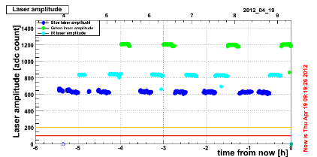
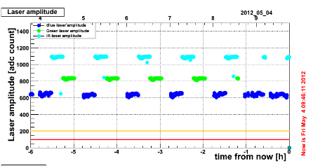
Lasers Technical stop 25 April
Before cleaning campain: Photonics @55A, 100% attenuation
800 ADCs
After cleaning campain: Photonics @55A, 40% attenuation (remote attenuation changed too)
1100 ADCs

