Slide 1

Laser Monitoring System
since installation at pt5
Introduction
B field effects
2009 laser operation
Laser improvement
Manpower
Documentation
- Monitoring and calibration review 2009 -
David BAILLEUX
On behalf of the Caltech group

Slide 2
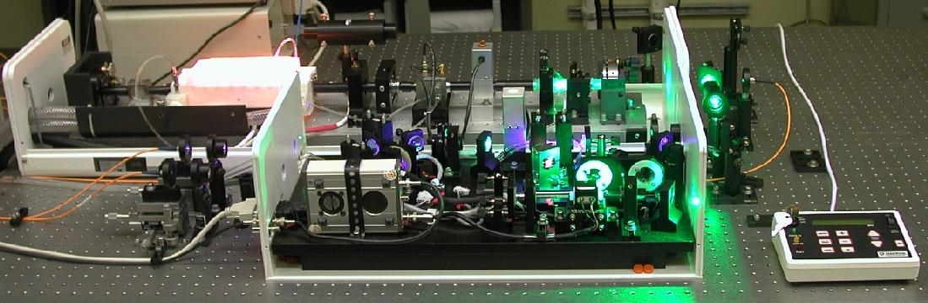
Introduction
ECAL specifications :
2 wavelengths: - one close to the emission peak → best monitoring linearity (440 nm)
- one to monitor readout electronics chain from the APD to the ADC (796 nm)
Pulse jitters: < 4ns/2ns for long (24 h) / short (0.5 h) term
Pulse width: < 40ns
Pulse energy: 1 mJ/pulse (>1TeV equivalent energy deposition in each crystal).
Pulse rate: <100 Hz
Intensity instability: < 10%
Main step of installation:
March 2007: Laser2 and RED laser moved to Pt5
June 2007: EMTC installation
March 2008: Laser1 moved to Pt5
21 April 2009: New cooling system based on pump and heat exchanger.
DCS alarm working fine in case of cooling failure.

Slide 3
Residual B field effect
On pump laser:
● 21 Oct 08:
● 6 Nov 08:
● 8 Nov 08:
● 6 March 09:
● 29 April 09:
● 18 August 09:
LASER 1 lamp broken B ramp down
LASER 2 lamp broken (380 hrs) B ramp down
LASER 1 lamp broken (<48 hrs) B ramp down
LASER 2 lamp broken (250 hrs) Laser power failure (fuses) and wrong laser selection
LASER 1 lamp broken (160 hrs) No B field. Wrong laser selection (+ delay)
LASER 2 lamp broken (1933 hrs) B ramp down
Others problems and performed actions:
USB camera infrared viewer: OK
- USB power meter (April09): OK
Digital scope with LCD display: GPIB crashed with ECAL RUN
- AC control unit for Laser2: Unsolved
Shielding around pump laser: OK Still unknown effect
- Interlock for the lamp with B field: OK

Slide 4
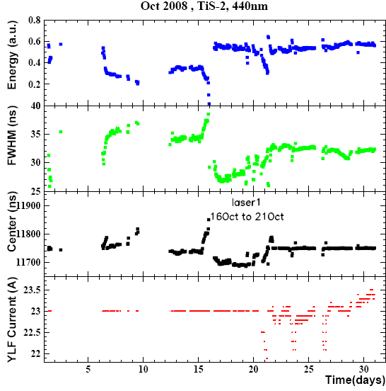
Residual B field effect
Lasers were switch 6 times in 2 months !
Laser1
Laser2
Laser1
Laser2
L.1
Laser2
Laser1

Slide 5
2009 laser operation
Period | laser | Reason to change laser | Other problems*
2-6 March | Laser2 | Lamp out
25 March-23 April | Laser2 | New cooling faulty
23-29 April | Laser1 | Lamp out
5-25 May | Laser2 | Compare pulse with laser1 | 5May: GPIB crashed. All Delays = 0 us ! Laser3 selected… 14-18 May: Low power. Check attenuation, polished fiber connector
2- 9 June | Laser1 | Bad Laser1 tuning; not stable. Move to laser2 with Green filter. | All Delays = 0 us ! Laser3 selected…
9-17 June | Laser2 | Move to laser1 to test shielding box
17 June | Laser1 | Laser 1 not stable after shielding box installed.
18 June - 18August | Laser2 | Lamp out | 15 July: check power (lower on EE) 31 July: GPIB crashed, air-unit failed, feedback on.
From 18 August | Laser1
*Not included external problems which prevent laser run (DAQ, trigger, laser supervisor)

Slide 6
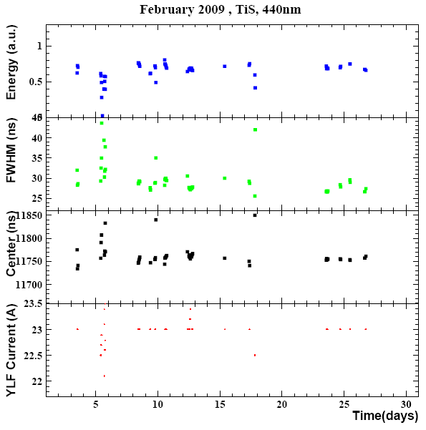
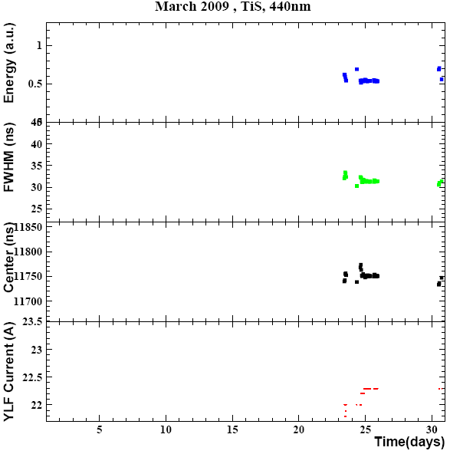
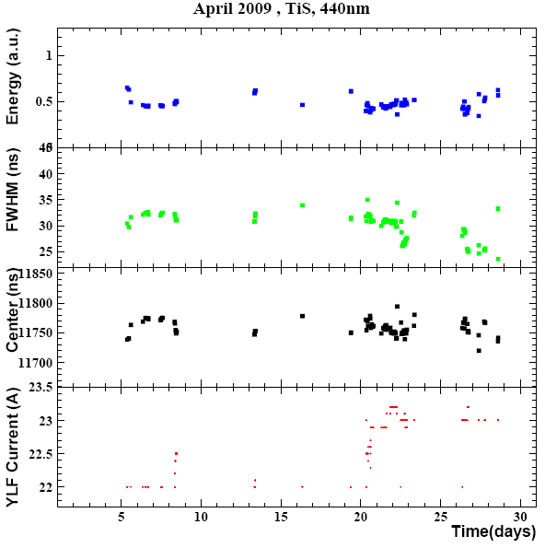
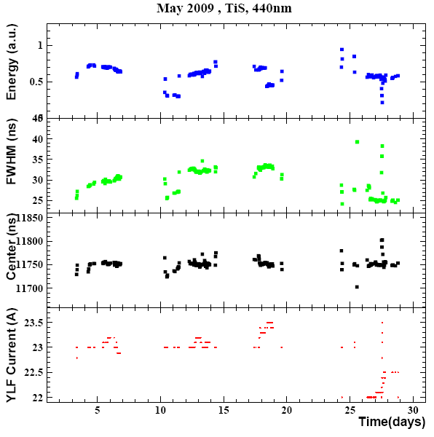
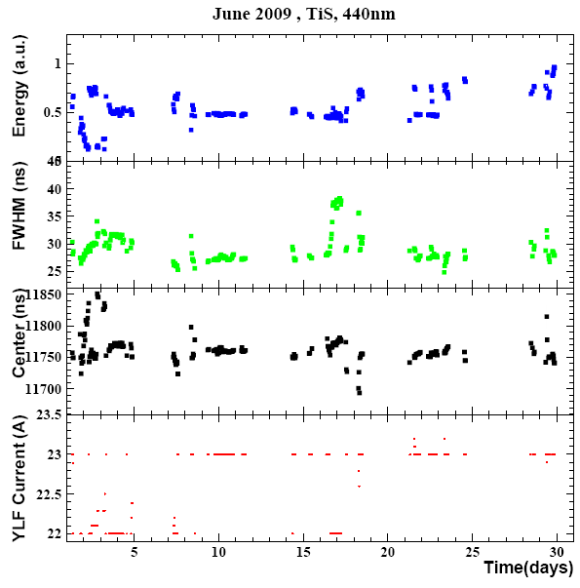
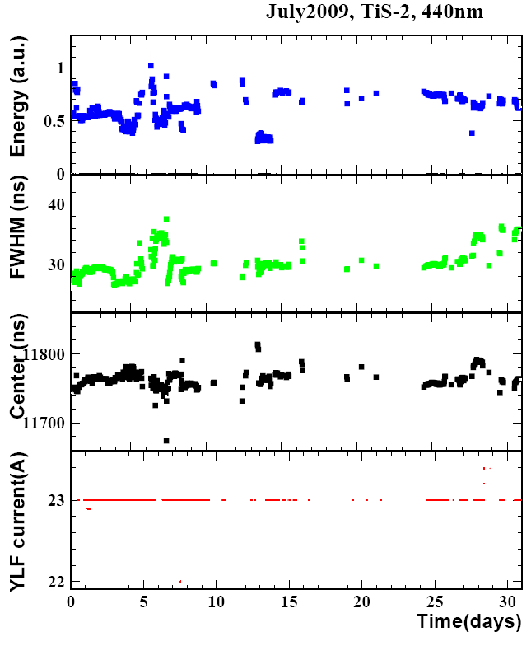
No laser night& weekend
up to ~May.
Plot included internal test
Laser2
Laser1
New cooling
Laser2
Laser1
Laser2
Laser2

Slide 7
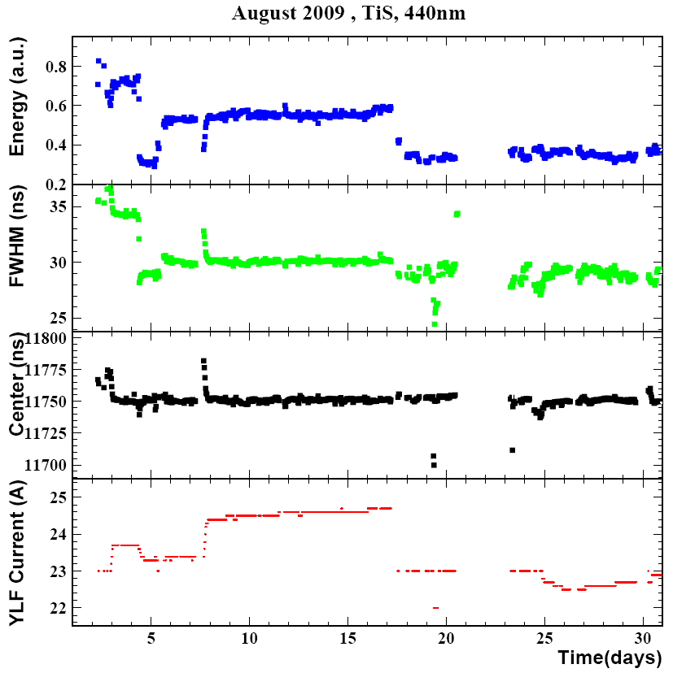
2009 laser operation
Laser switching (lamp):
NRJ: -35%, because of very high current of laser2 (2A more)
Pulse width: 2ns negligible ?
Up to know: be sure the 2 lasers have the same timing, 11750ns.
Jitter < 3.5ns over 1 month
cooling
ALL value are under specification
for long term operation.
Jump of laser pulse energy and width due to laser switching could be eliminated by following a proper laser operation procedure (See page 12 for the details)
Laser2
Laser1

Slide 8
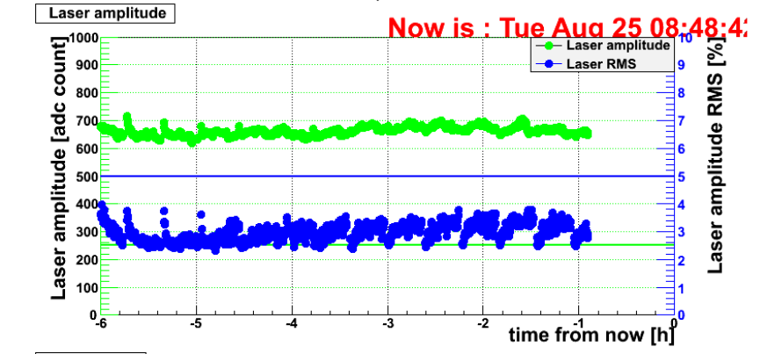
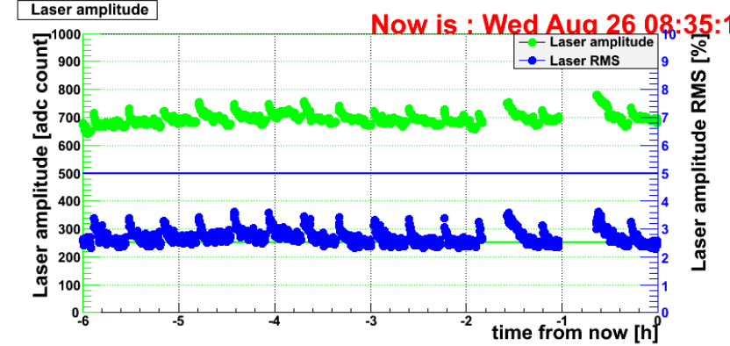
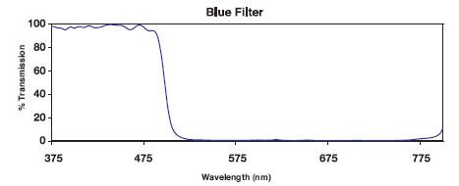
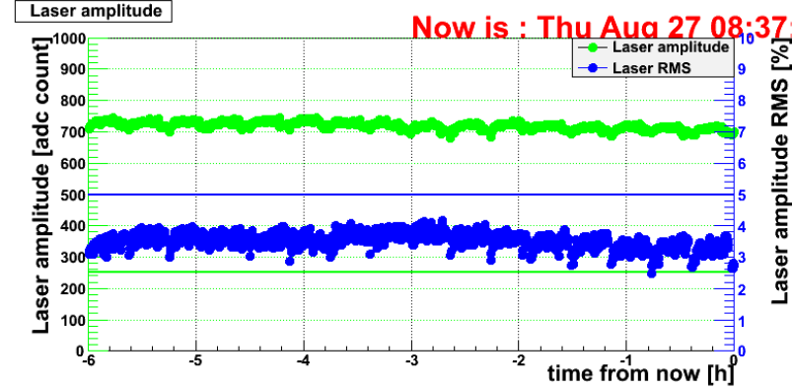
2009 laser operation
Strange effect with LASER1
(First time:18 June)
Unknown reason.
Wait run after laser service.
On LASER2:
Installed a blue filter to remove “pre-pulse”. T>85%. Pre-pulse is now reduced.
Wait to see effect of filter with LASER1 (just installed)

Slide 9
2009 laser operation
Up to July 09: too many effect on laser which make Matacq plot not so good.
Problems which disappeared or could be easily under control:
GPIB, cooling, B field effect (lamp and Temperature), fibers degradation (polishing), pulse jumps due to laser switching.
- By changing laser so many time it’s not possible to fine tune laser in between:
after services, laser need to run few hours to defined working parameters and to be stabilized.
Feedback software can’t work in a such situation: Feedback is applied on pulse center which should be 11750ns. If laser is not yet stabilized or pulse center not at 11750ns (no time to fine tune, ect.) then current will change to compensate bad tuning → effect on amplitude, FWHM stability !
ECAL run itself: hard compromise between laser operation and ECAL in the past:
useless to keep laser ON for long run interruption (night and weekend, for safety reason, ect.) and then it’s take time to get pulse stabilized.
From July 09: long run operation day and night and problem under control (GPIB, cooling, B field effect)
Laser already closed to the best stability.

Slide 10
Laser power evolution
Power measurement done after services. Low or high value depend of services and tuning optimization (FWHM rather than power,etc.)
New crystal
Laser1:
Min = 33 mW
Max = 109 mW
At Pt5
Laser2:
Min = 37.5 mW
Max = 70 mW (not yet used)
New crystal
At Pt5

Slide 11
Further Improvement of Laser Performance (I)
Reducing switching time:
Aim:
Reduce the time needed for the monitoring region scan. Currently, it’s average is 3 sec/region with tail.
Idea:
Remove two protective Ti:S shutter operations for each step (close and open), so that the average switching time needed will be reduced to 1 sec/region, well below the 4 sec allocation.
Separate laser control from DSO data taking by using two GPIB cards, so that the tail will be eliminated. (See below for the details)
EMTC will guarantee no trigger sent to lasers before confirming switch position, otherwise the switch may be damaged.
2) Modify GPIB control:
Aim:
- Avoid DSO causing GPIB crashing.
Idea: Separate GPIB tasks to avoid crash:
3 scopes on 1st PCI-GPIB, ecal-laser-room-02.
All other lasers devices on 2nd PCI_GPIB, ecal-laser-room-02 or another P.C

Slide 12
Further Improvement of Laser Performance (II)
3) Laser settings:
Laser settings can be done many ways. Given the difference between two lasers as well as before and after regular fine tunings (tuning, hardware, working time, aging) the following procedure will avoid any jump in laser pulse parameters.
Normal operation: laser lamp is OK up to ~ 2 months. Regular maintenance is carried out weekly for fine tuning and eliminating any potential problems.
New laser pulse setting procedure:
Width: Laser pulse width can only be controlled by the laser power, which cab be adjusted by setting the pumping current. After fine tuning or laser change a fixed laser pulse FWHM, say 30 ns, can be achieved by adjust initial pumping current . Note, we will keep FWHM fixed for both laser 1 and 2.
Energy: Laser pulse intensity can be adjusted by using internal attenuator, which is kept at 80% level at the beginning, so that it is consistent . Note, this adjustment will not affect FWHM. For ECAL the laser pulse intensity can also be adjusted remotely by the laser supervisor through setting external log and linear attenuators.
- Timing: Laser pulse timing can be adjusted by setting a delay after the width and intensity are fixed, so that it is at 11750 ns.
Note, the software feedback will stabilize pulse center as well as intensity and width (See next page for the details).
Change laser with the spare one:
Up to now, laser power was always in a good range (ADC count) and fine tuning of power for each region has been done.
Following this new procedure , there will be no difference in laser pulses between two lasers and after fine tunings.
Up to now: internal attenuator is set at 100% for full power, it was not used in fine tuning.
Following the above new procedure with initial internal attenuator at 80% → freedom to compensate power
→ redefined remote attenuator + 20%.

Slide 13
Further Improvement of Laser Performance (III)
4) Software feedback:
The software feedback is applied on Ti:S pulse center by trimming the pumping current to compensate pulse timing variation, which is our feedback parameter of choice.
→ The pumping current will increase regularly to compensate the lamp aging. Pulse energy and width will also be stabilized. Result published in IEEE Trans Nucl Sci Vol 55 No 1 (2008) 637-643.
5) For shifters:
Switching blue lasers during normal operation:
Can be done remotely (no hardware intervention) in ~2min if all lasers concerned are ready.
ECAL shifters need to stop ECAL run and start again after laser change.
In case of laser hardware failure:
Call laser expert to change laser if possible to avoid intervention at pt5.
RED laser ?
No spare. In case of services or troubles, remove it from calibration sequence.

Slide 14
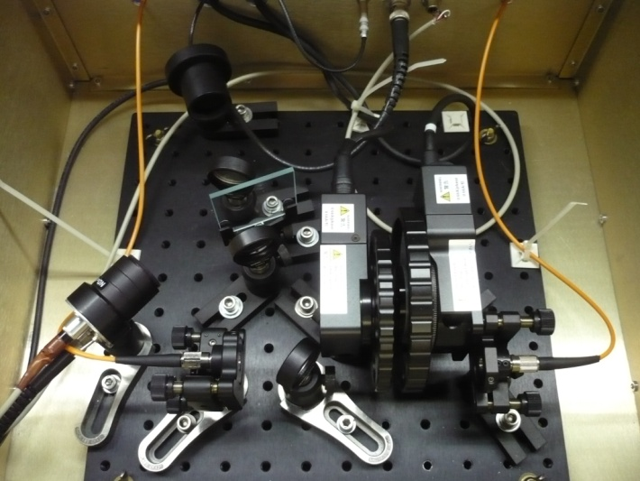
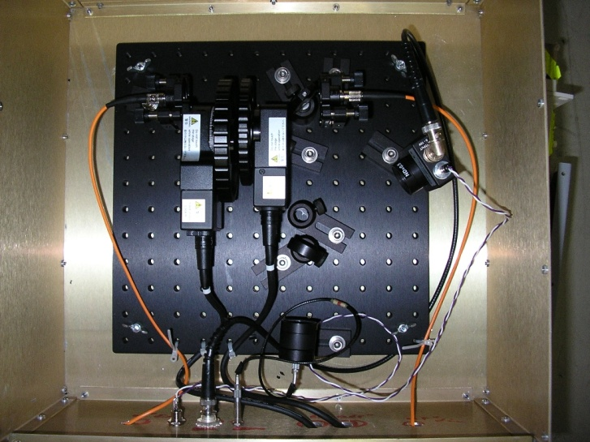
Further Improvement of Laser Performance (IV)
5) Pin diode for Matacq/ fast Acqiris
First box installed at pt5
Trigger Acqiris:
Home made with Hamamatsu diode, 0.13mm2 active area:
negative pulse, LEMO cable.
Pulse Matacq and Acqiris
DET210: positive pulse, BNC cable, 12 V bias
Rise time = 1ns.
Changed box with old one from H4, 15 July
Pulse Matacq and Acqiris
Thorlabs DET10A, positive pulse, BNC cable, polarized 12V
Rise time = 1ns.
Hamamatsu diode, same.

Slide 15
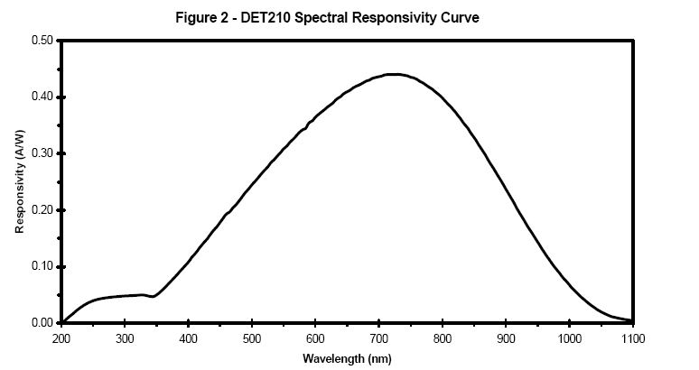
Further Improvement of Laser Performance (IV)
Pulse Matacq and Acqiris
Thorlabs DET10A, positive pulse, BNC cable, polarized 12V
Rise time = 1ns.
RED amplitude on Matacq = ~ 3x BLUE amplitude

Slide 16
Manpower
Laser system Maintenance and Operation
Daily maintenance and operation: D. Bailleux
Laser system engineer: L.Y. Zhang
Laser system software engineer: K.J. Zhu
Shifters on call for night and weekend to cover 7/24h operation
Already started with the following people this year: J.Veverka, C.Rogan, V.Timciuc, Y.Ma
Additional students depending of availability : K.Shin
Experts on call received training on basic laser operation in order to keep a blue laser online.
Most of the case, problems could be fixed remotely.
Maintenance will be done regularly every day so the work load for shifters would be not heavy.

Slide 17

Documentation
http://laser-caltech.web.cern.ch/laser-caltech/
        Logbook;
        Calibration plots;
        Maintenance;
        Histograms;
        Reports, manuals, technical specifications;
        Spare parts
Sharepoint of the CMS ECAL electronics systems
Manuals, technical specifications, spare parts.
Spare parts and ideas for upgrade
• No spare for 1 x 5 and 1 x 100 switches, DSO, Ti:S crystal, Ti:S LBO assembly, laser power meter, power detector, IR camera…
Pump laser upgrade: The YLF:Nd pump laser may be replaced by diode pumped model with high stability, reliability and much less maintenance requirement.
A spare red laser and a orange laser for endcap monitoring.

