Slide 1
DP20-427
Problem of alignment after the move of the laser
19 January 2024
From laser head output directly :
3A=160mW
4A=420mW
5A= 718mW.
In April 2023 we’ve got higher power after the shutter :
3A=239
4A=513
5A=800mW
I have checked internal trigger (changed the mode on laser software, EXT to INT) and got the same power. It was to be sure there was no issue with DG535.
2. Power after the shutter and main attenuator : no difference, OK (after small laser head adjustment , unscrew and screw it again on the base plate)
3A= 150mW after shutter and 115mW after polarizer. The lost is OK.
3. After 1m fibre : here is the issue
Power is only 3A=50mW after the epoxy 1m fibre. 4A=90mW : power was higher then immediately decreased to 90mW.
What is problematic is that the connector become damage all the time from 3A !
All attempts with current higher than 3A and the connector burned each time !
The internal attenuator of the laser is 100% (full power)

Slide 2
DP20-427
Problem of alignment after the move of the laser
22 January 2024
With 3A:
Sortie laser: 160mW
After shutter: 150mW
Before fibre: 115mW
After coupling: it should be 80% of the power so around 90mW and we have only 50mW.
Problem was the focusing: need to move the 3-stage axis on left side , to optimize the power. Check few times the fibre end to see if no burning around 3A.
23 January 2024
Pump current (A) | P 2023 after shutter | P 2024 laser output | P after shutter | P after polarizer | P after 1m coupling
2.5 | 108 |  | 50 |  | 35
3 | 239 | 162 | 145 | 115 | 97
3.5 |  | 278 | 255 | 200 | 167
4 | 513 | 410 | 380 | 300 | 250
4.5 |  | 550 | 514 | 404 | 340
5 | 800 | 690 | 646 | 480 | 423
6 | 1090 | 969 | 919 | 697 | Increase 580 then 500
6.5 |  | 1110 | 1050 | 800
7 | 1380 | 1240 | 1200 | 904
75% of the power after the polarizer
Problem again of burning but at 6A. Before it was 3A

Slide 3
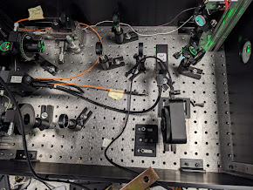
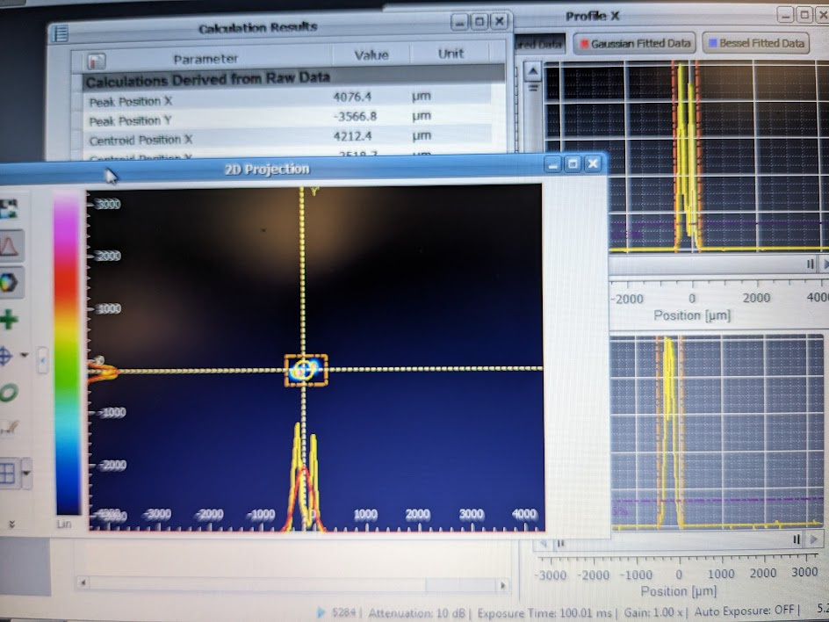
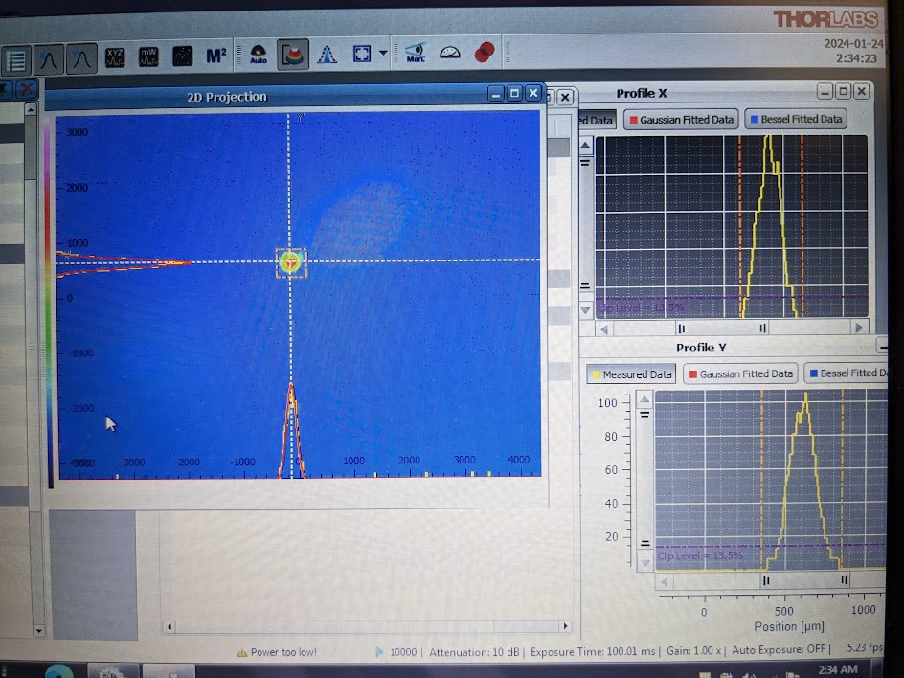
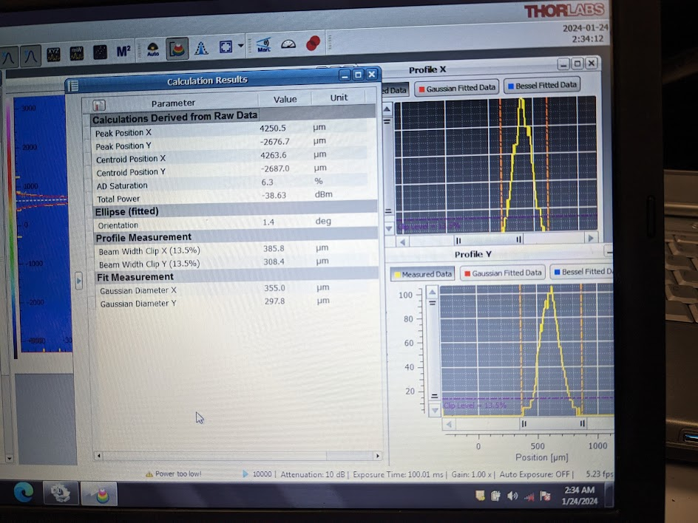
DP20-427
Problem of alignment after the move of the laser
24 January 2024
Thorlabs beam profiler : need trigger from DG535.
Measure the distance from support plate to the CCD camera of beam profiler and same with the 3-stage axis to the fibre.
- use 5% shot102 attenuation, 10-13% internal DP attenuation . Power currant at 2.3A
Get 2 peaks for X axis !
Moving the beam profiler from few cm towards the focus lens didn’t help.
On Y axis it seems OK, around 300um.
2) There is well 2 visible beam spots from the direct DP2 output.
=> move the shutter to block one beam spot
=> Better on beam profiler, only one peak
=> check the power : power lower !
3A = 87 (was 97)
3.5A=135 (was 167)
4A=200 (was 250)
Still not OK and power too low

Slide 4
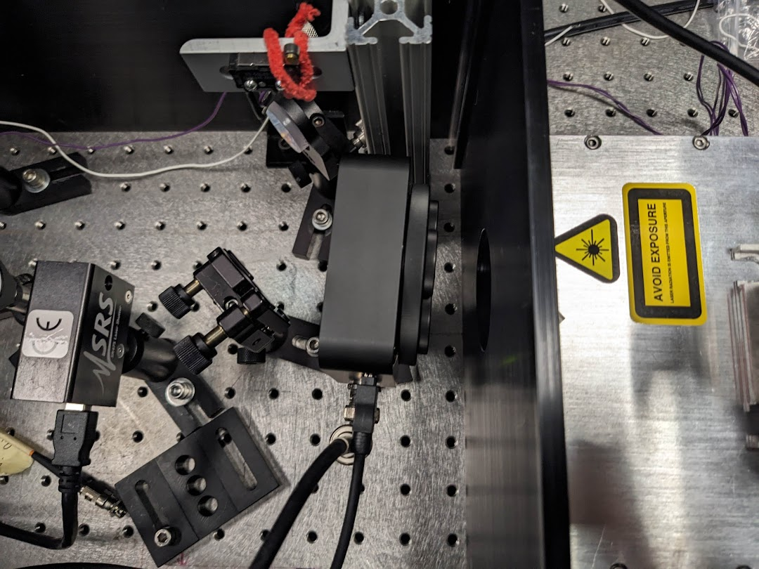
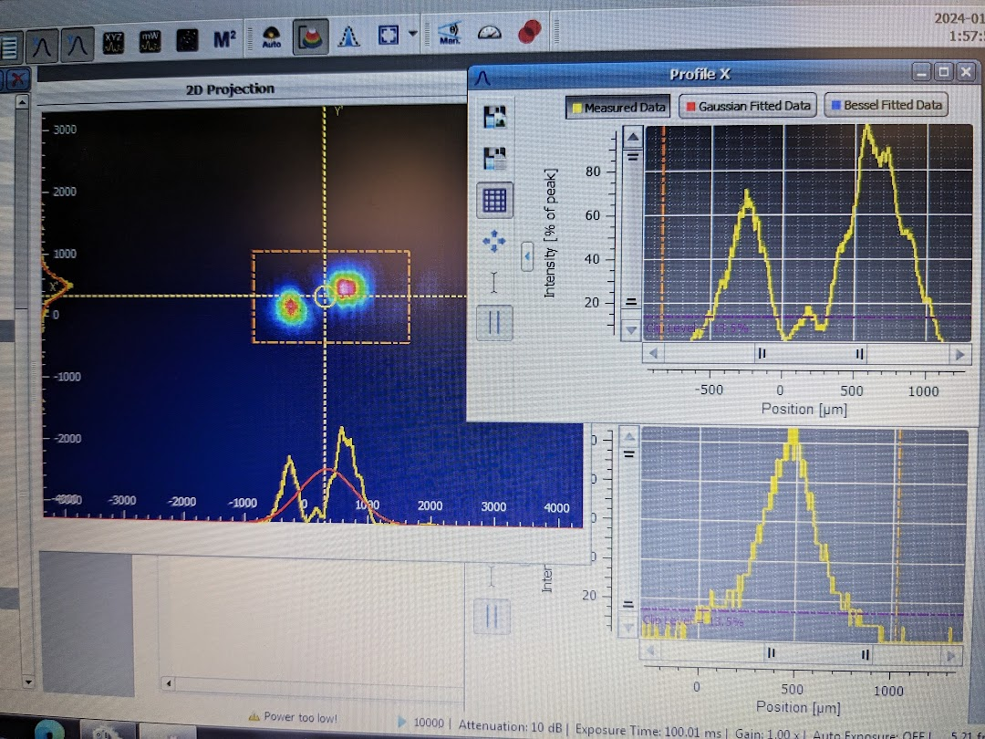
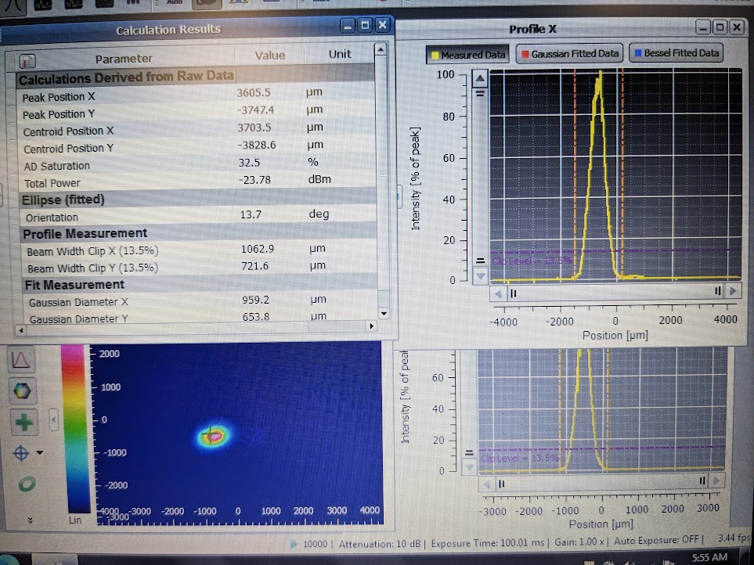
DP20-427
Problem of alignment after the move of the laser
25-30 January 2024
1) Use the beam profiler on the DP20 output directly.
Around 10% internal attenuator.
Result: same, 2 peaks.
2) Check laser configuration:
Gate source should be “INT” according to last good setting from Photonics.
=> no difference on the pulse.
3) Suggested tests by Photonics:
- check laser setting INT EXT gate control : OK.
- change the temperature of the crystal (SHG): no improvement
- change the internal attenuator to see if it is not damaged: OK
- moving 2 motors axis to test if the problem is from mechanical shift or from damage: issue solved ! Get only one peak on X
From Photonics it is due to the move of the laser : stress on the base is responsible of this offset. (thin Teflon spacer could be inserted)
4) Re-aligned main coupling of the 3 axis stage: one more burned fibre. No more high epoxy fibre.
5) Redo 2 fibres with high epoxy ! Could run the laser with standard fibre because only low power is needed.

