Slide 1
Status of the laser monitoring
CMS week, 6th February 2024
David Bailleux,
On behalf of ECAL laser team

Slide 2
Laser room story
New green laser
Modification of the trigger
Reflections issue
Summary

Slide 3
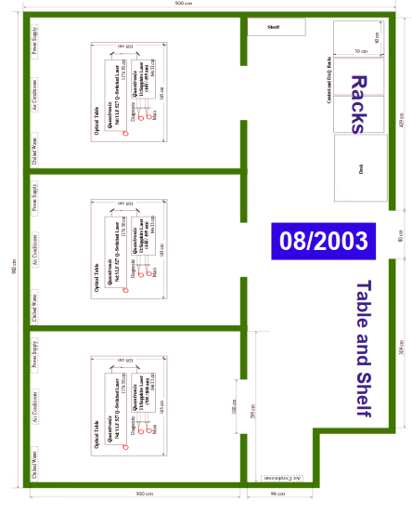
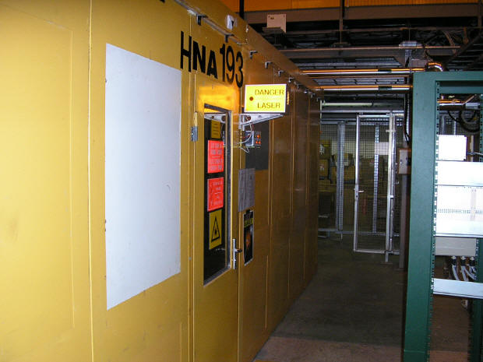
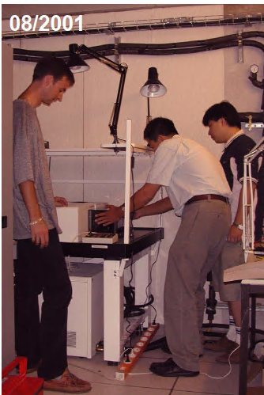
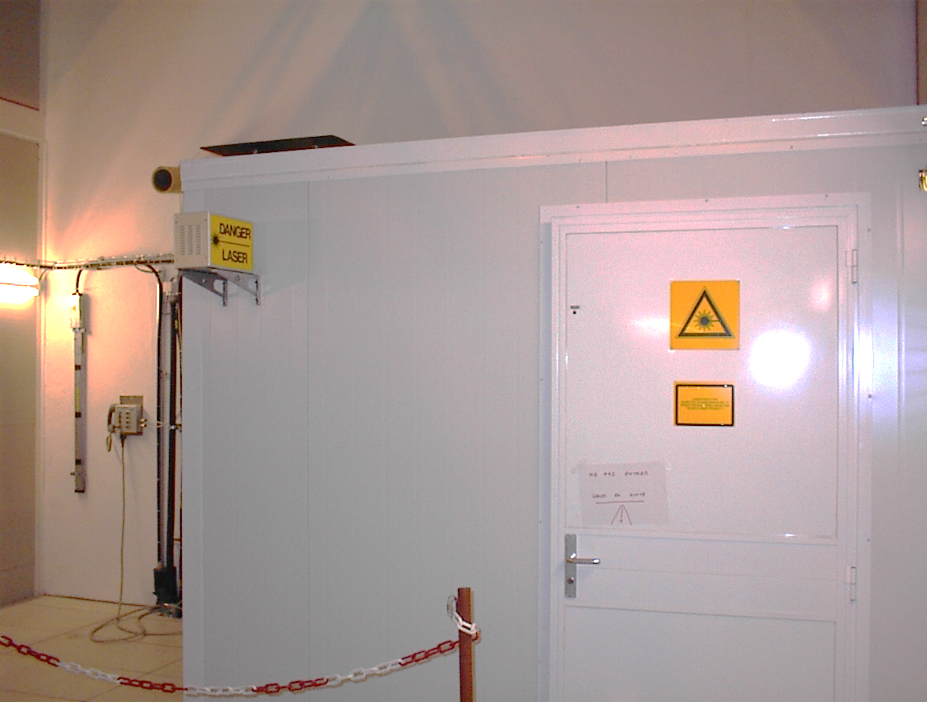
1) Laser room story
Beginning of 2001, with the CMS group of the LAPP (in Annecy), an experimental test bench using a Xenon lamp showed the possibility to characterize the crystal under radiation (GIF experiment). It was the green light to go ahead for a laser system solution.
2001, the 1st room was installed inside the H4 radiation beam area (close to the detector)
2002, first test beam period with the ECAL prototype module M0’
2003, 3 lasers were installed inside a new room in H4 : spare blue + 800nm
2004, add remote linear attenuator + Matacq (online pulse monitoring)
2005, add portable softwall clean room facilities for each laser table : issue with dust
2003
1st room, 2001-2003
2nd room, 2003-2007

Slide 4
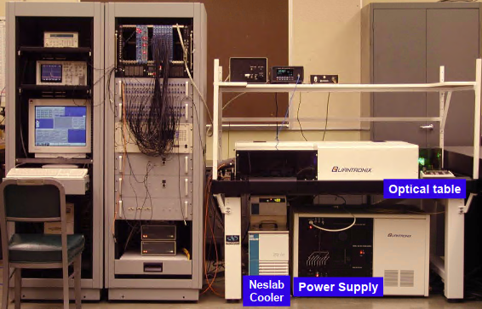
1) Laser room story
Available wavelength with one tuneable laser: 440 and 532nm.
Pulse energy : 1mJ
Pulse width: 25ns
Pulse power: 25kW

Slide 5
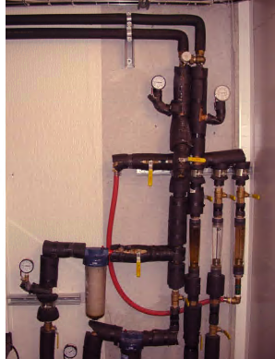
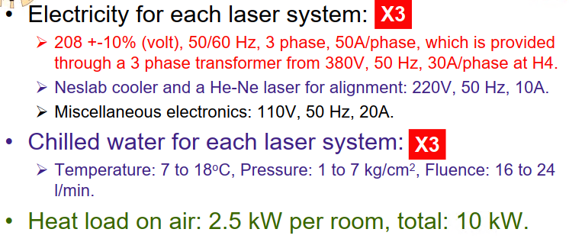
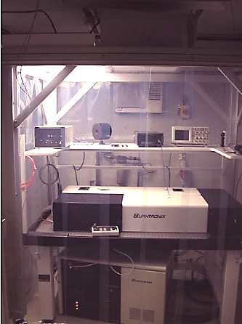
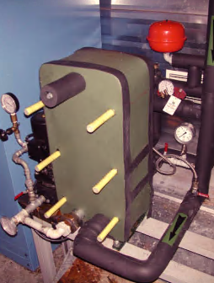
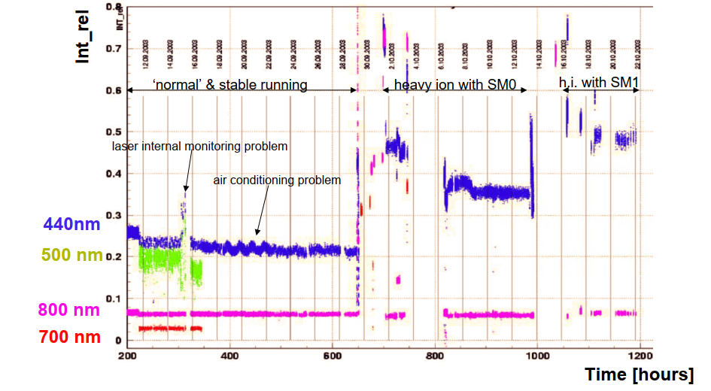
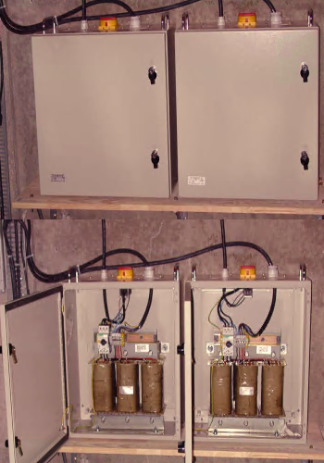
1) Laser room story
Cooling distribution inside laser room
Installation in the H4 test beam zone: 3 lasers from 2003
The lasers was used from 2001 to 2007 in the North area.
Example of 2006 : 1600 laser runs under beam periods, processed quasi online by a CMSSW job + H2 and cosmic runs.
Heat exchanger
One laser
Laser operation 2003 test beam periods

Slide 6
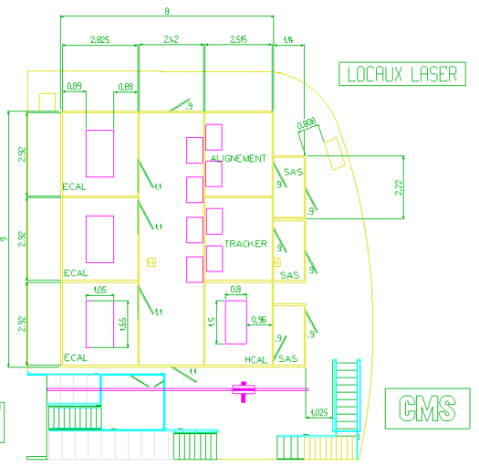
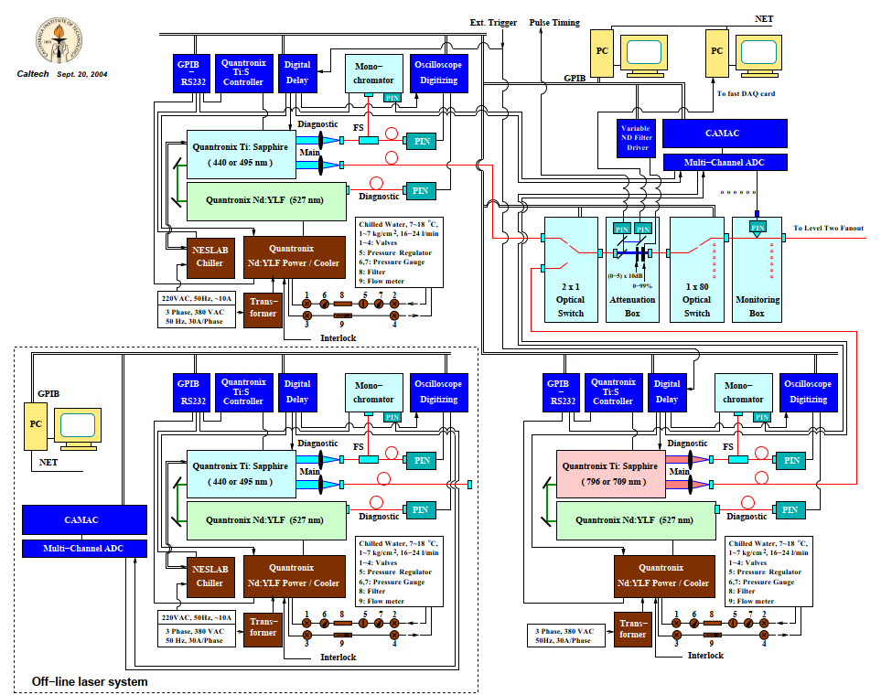
1) Laser room story
2008: installation in P5 USC55: 3rd ECAL laser room.
Laser monitoring system in USC55 , 2008

Slide 7
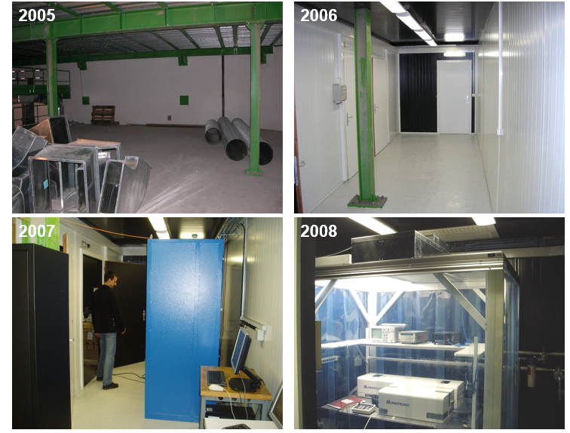
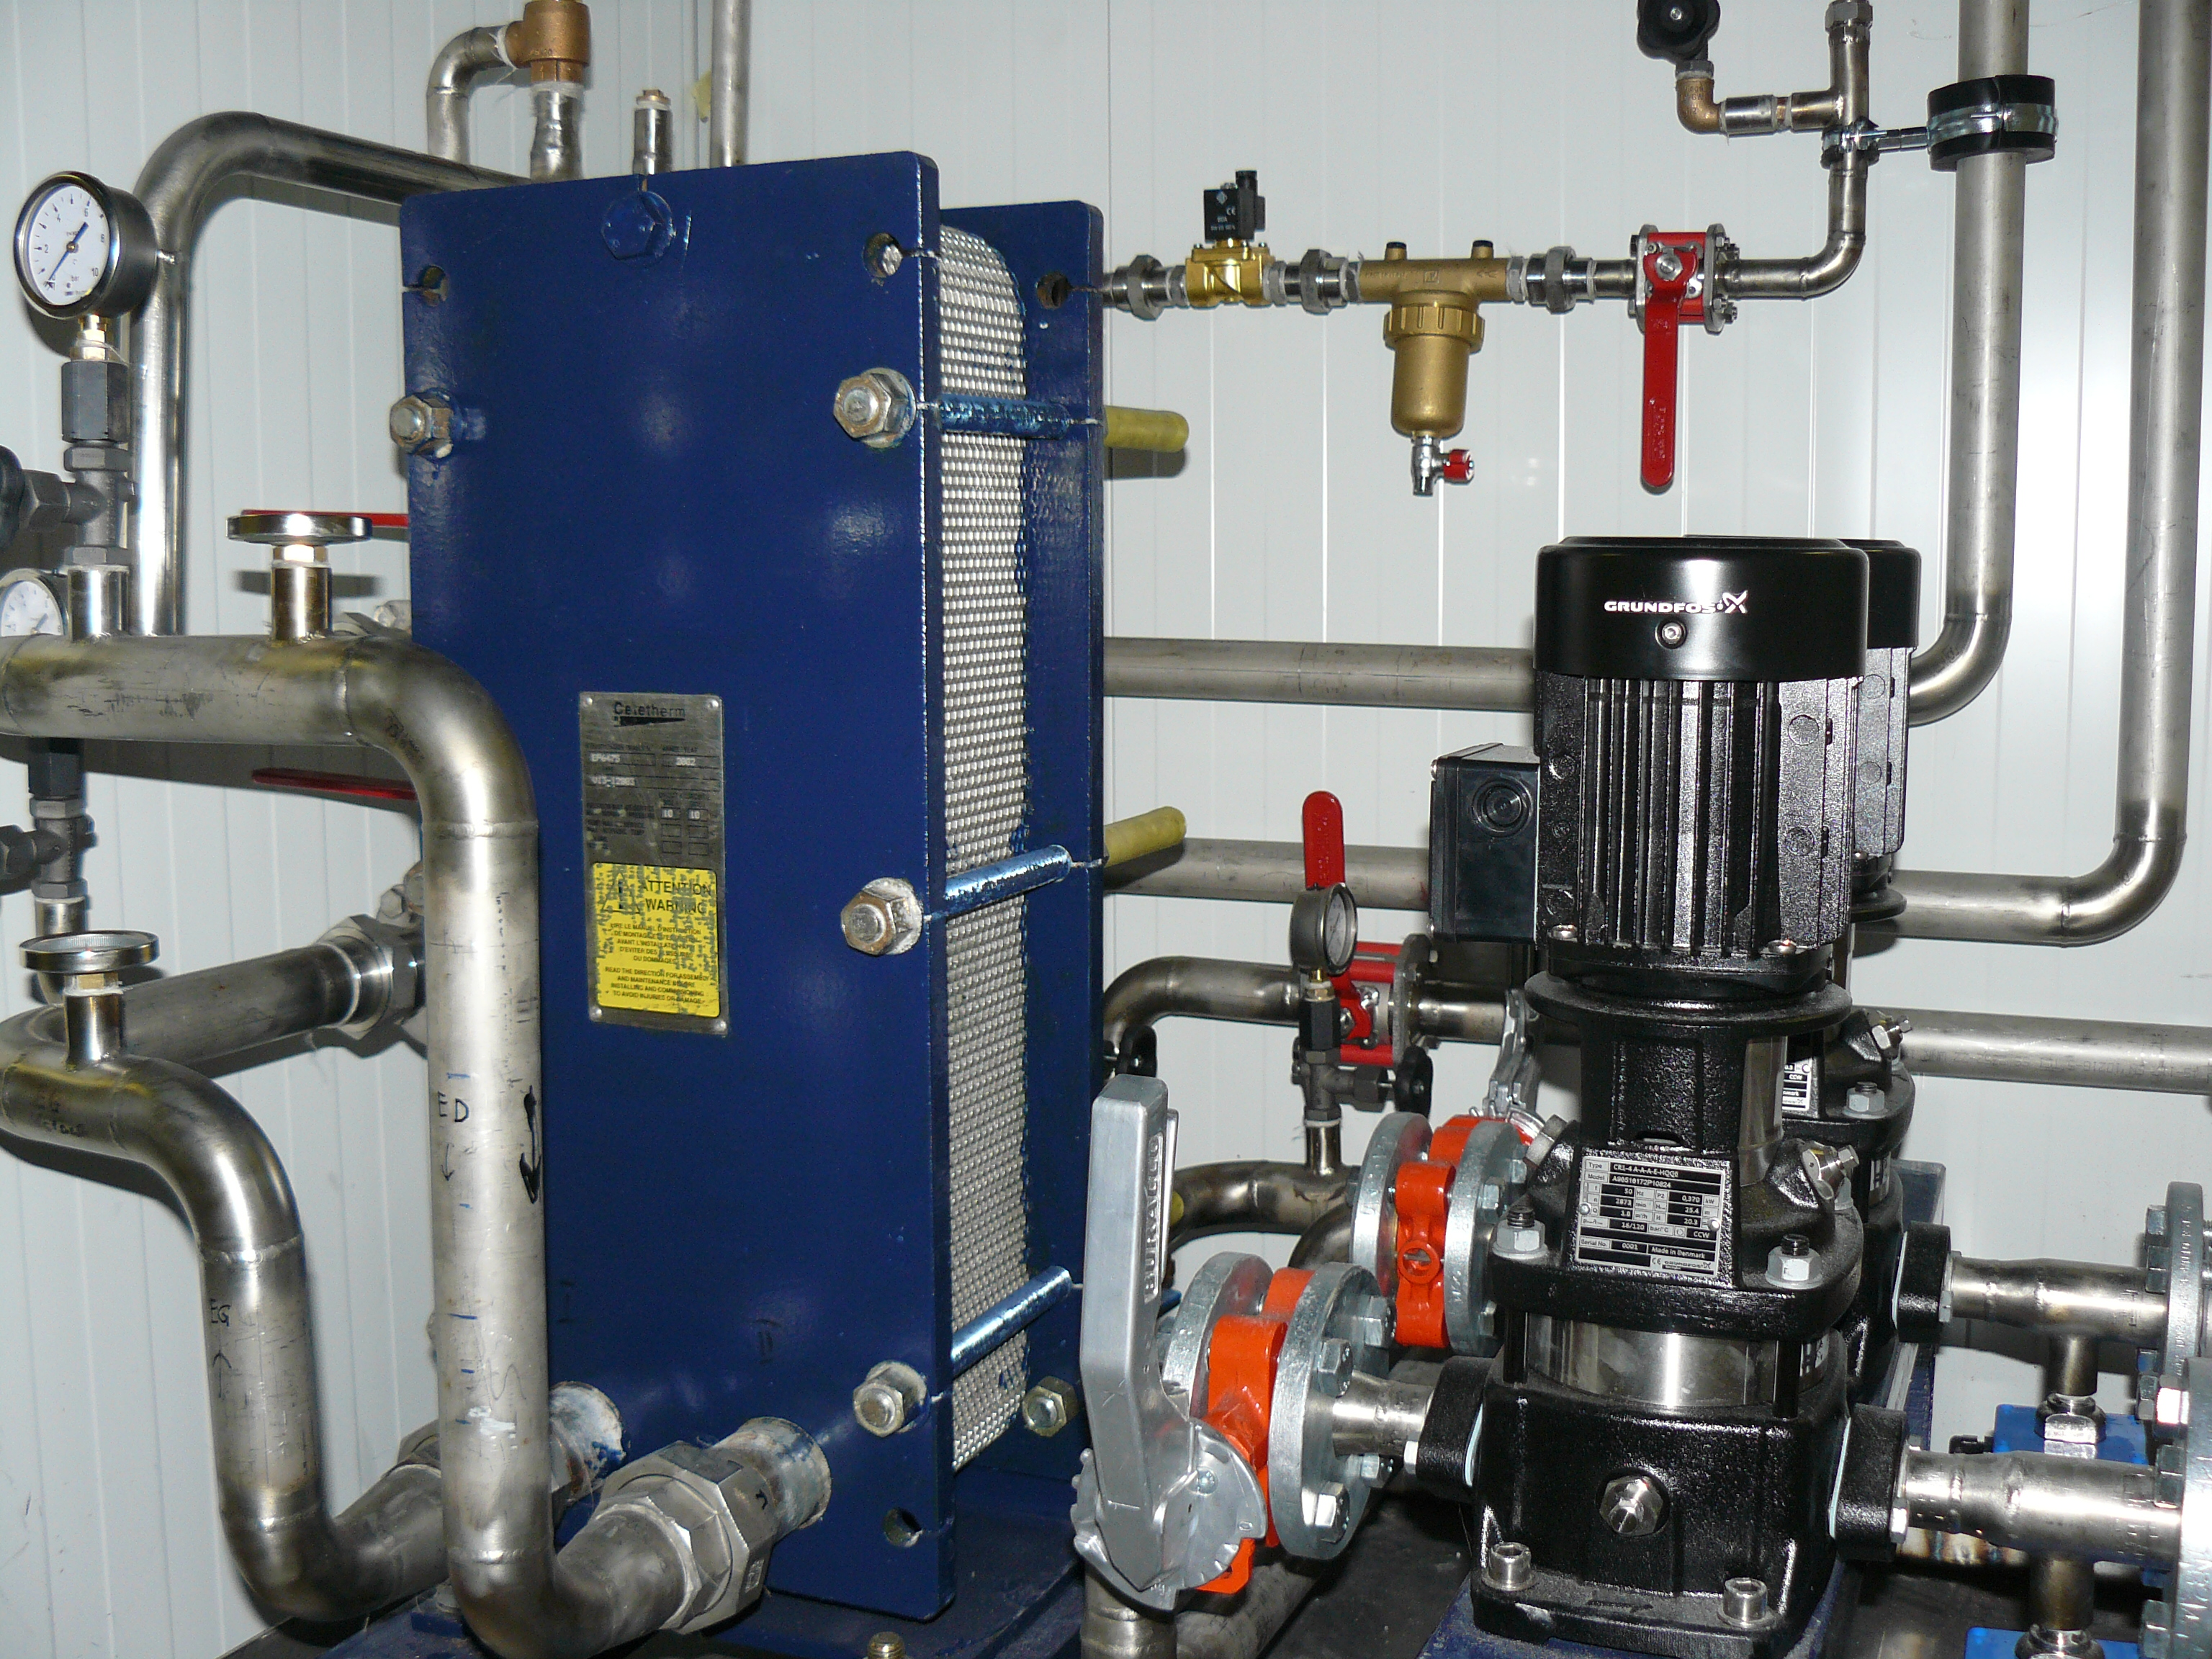
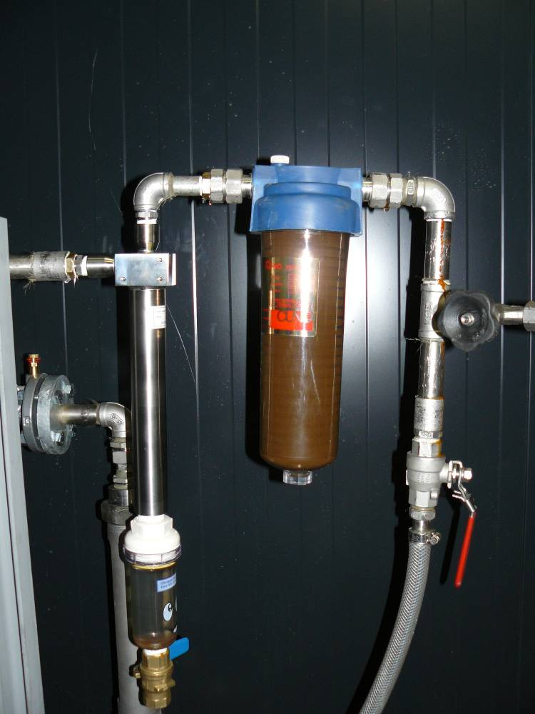
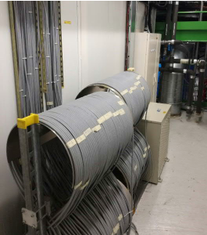
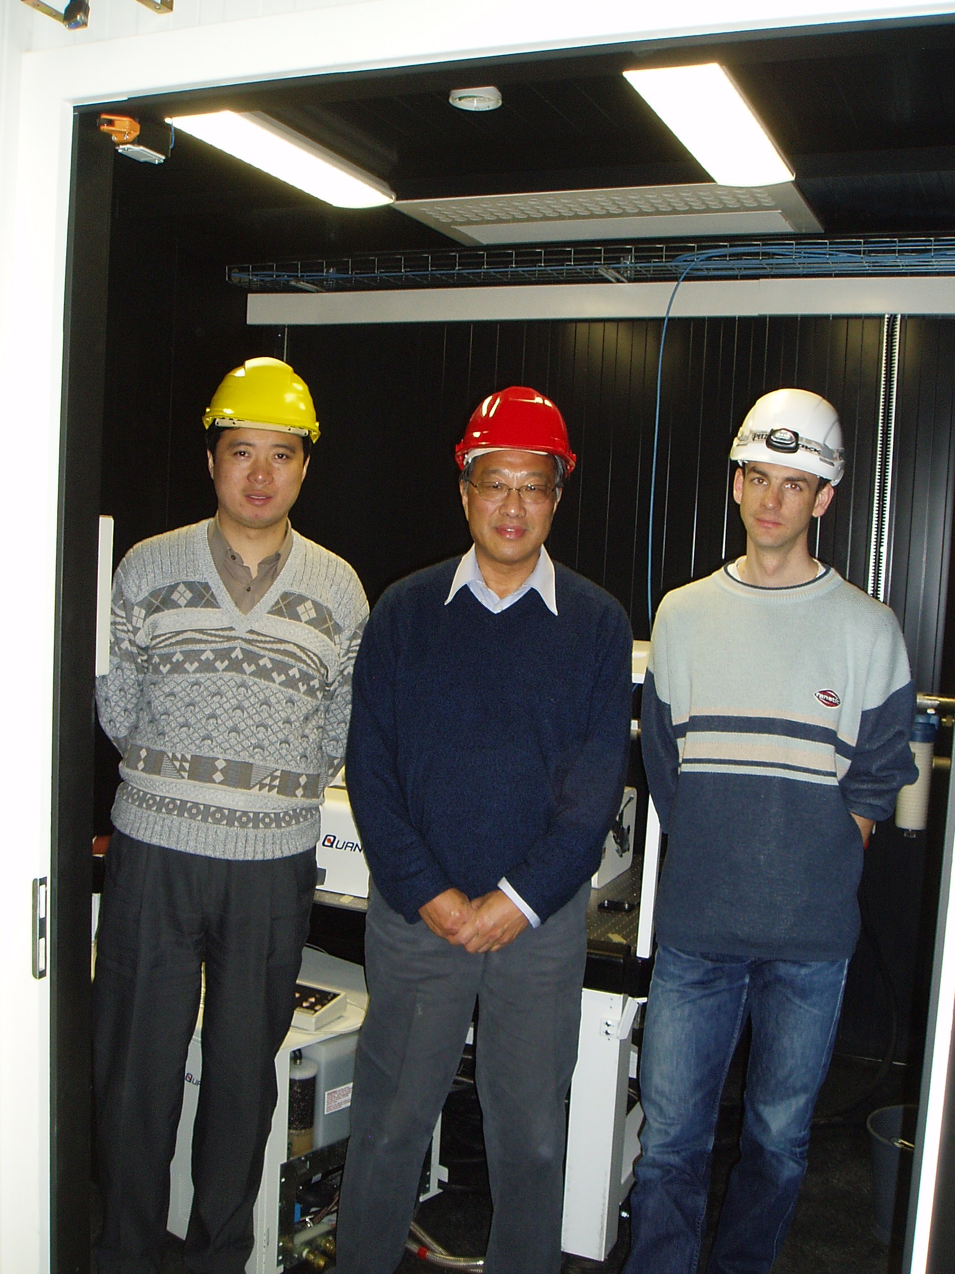
1) Laser room story
Pump and heat exchanger with
chilled water 6°C
Laser requirement: dust particules ≤ 70 µm
Optical bundle towards UXC55
+ 3 phases transformer

Slide 8
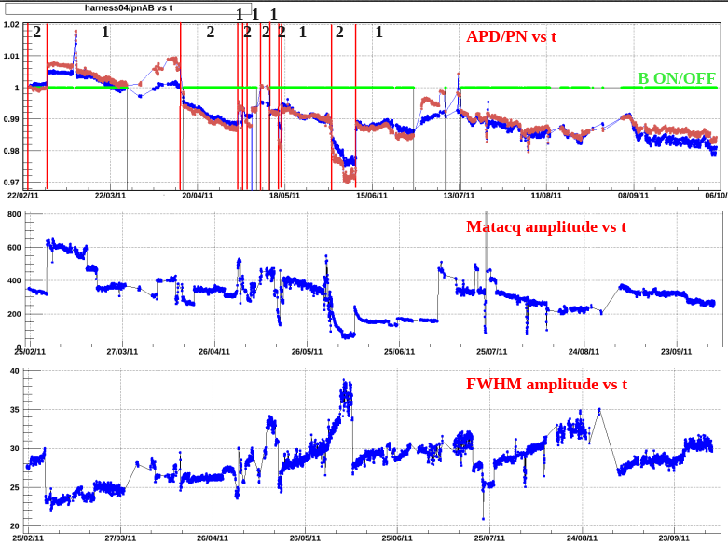
1) Laser room story
APD/PN dependency with pulse shape variation
Laser operation from 2008 to 2012:
- run laser with shifters on call : 2 experts + up to 4 operators /year
- B field effect: shielding was needed (solved in 2010)
- add a small green laser in 2011 for a cross correlation with the blue.
Get more and more experience to face all kind of possible issues but :
- still interruptions of monitoring due to regular issues,
- laser beam properties dependent on the alignment,
- hard to maintain good stability,
- lasers are aging, power degradation over time (thus need correction)
- end of production for some components !
Example of laser response, Feb to Sept 2011
2011: a task force has been put in place to review upgrades of the laser system: benefits, risks, integration, time schedule, costs.
Usual damage lamp and flow tube

Slide 9
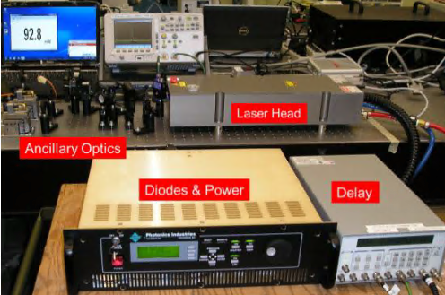
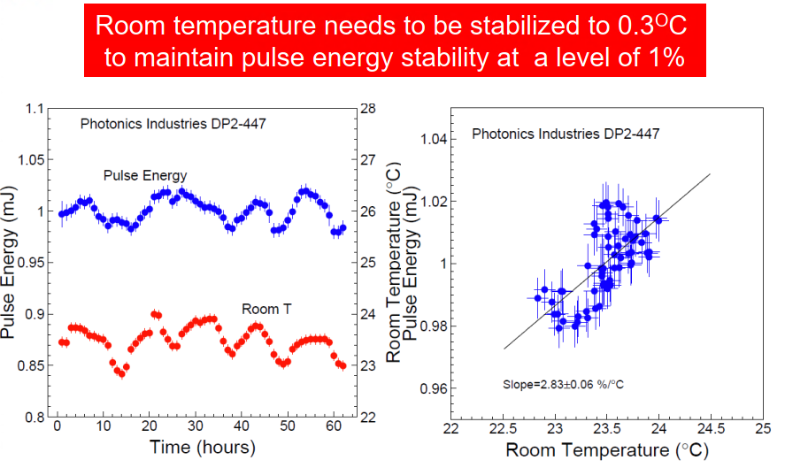
1) Laser room story
Laser DP20-447 commissioning at Caltech:
Conclusion of the laser task force committee :
the entire blue laser system must be replaced.
Need rearrangement of the lab in USC : need more place !
February 2012, the first DP2 laser (diode pump) was received at Caltech.
In operation in April 2012 in USC55.
6 months from order to operation !
Mid 2012: user training at the company, USA

Slide 10
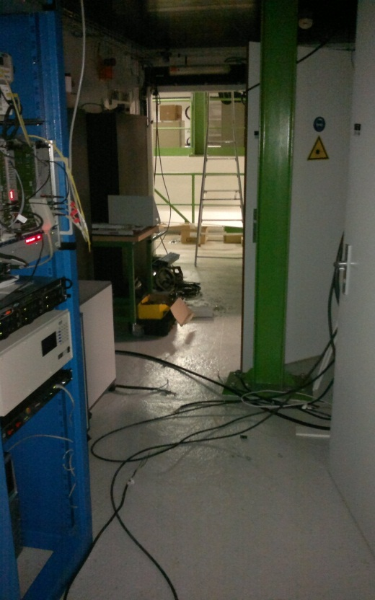
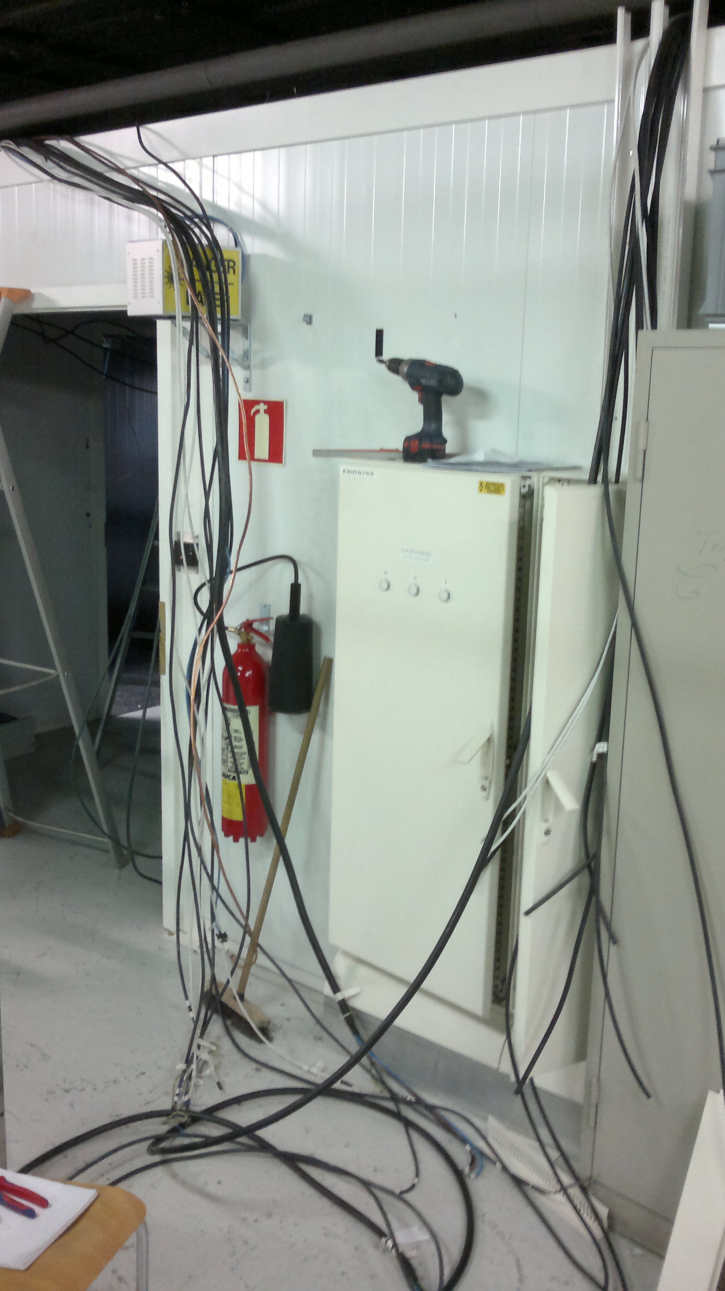
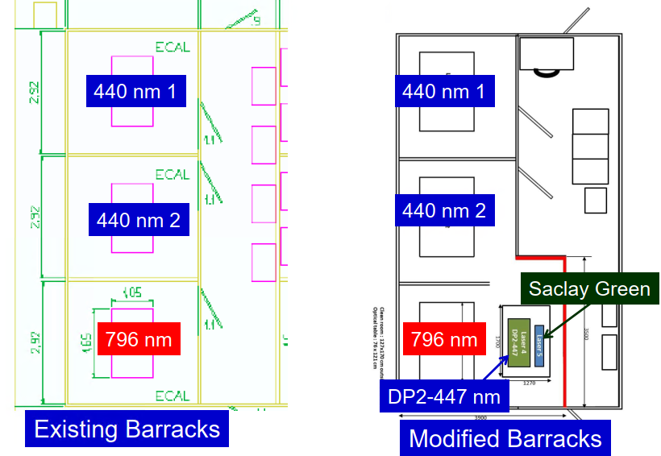
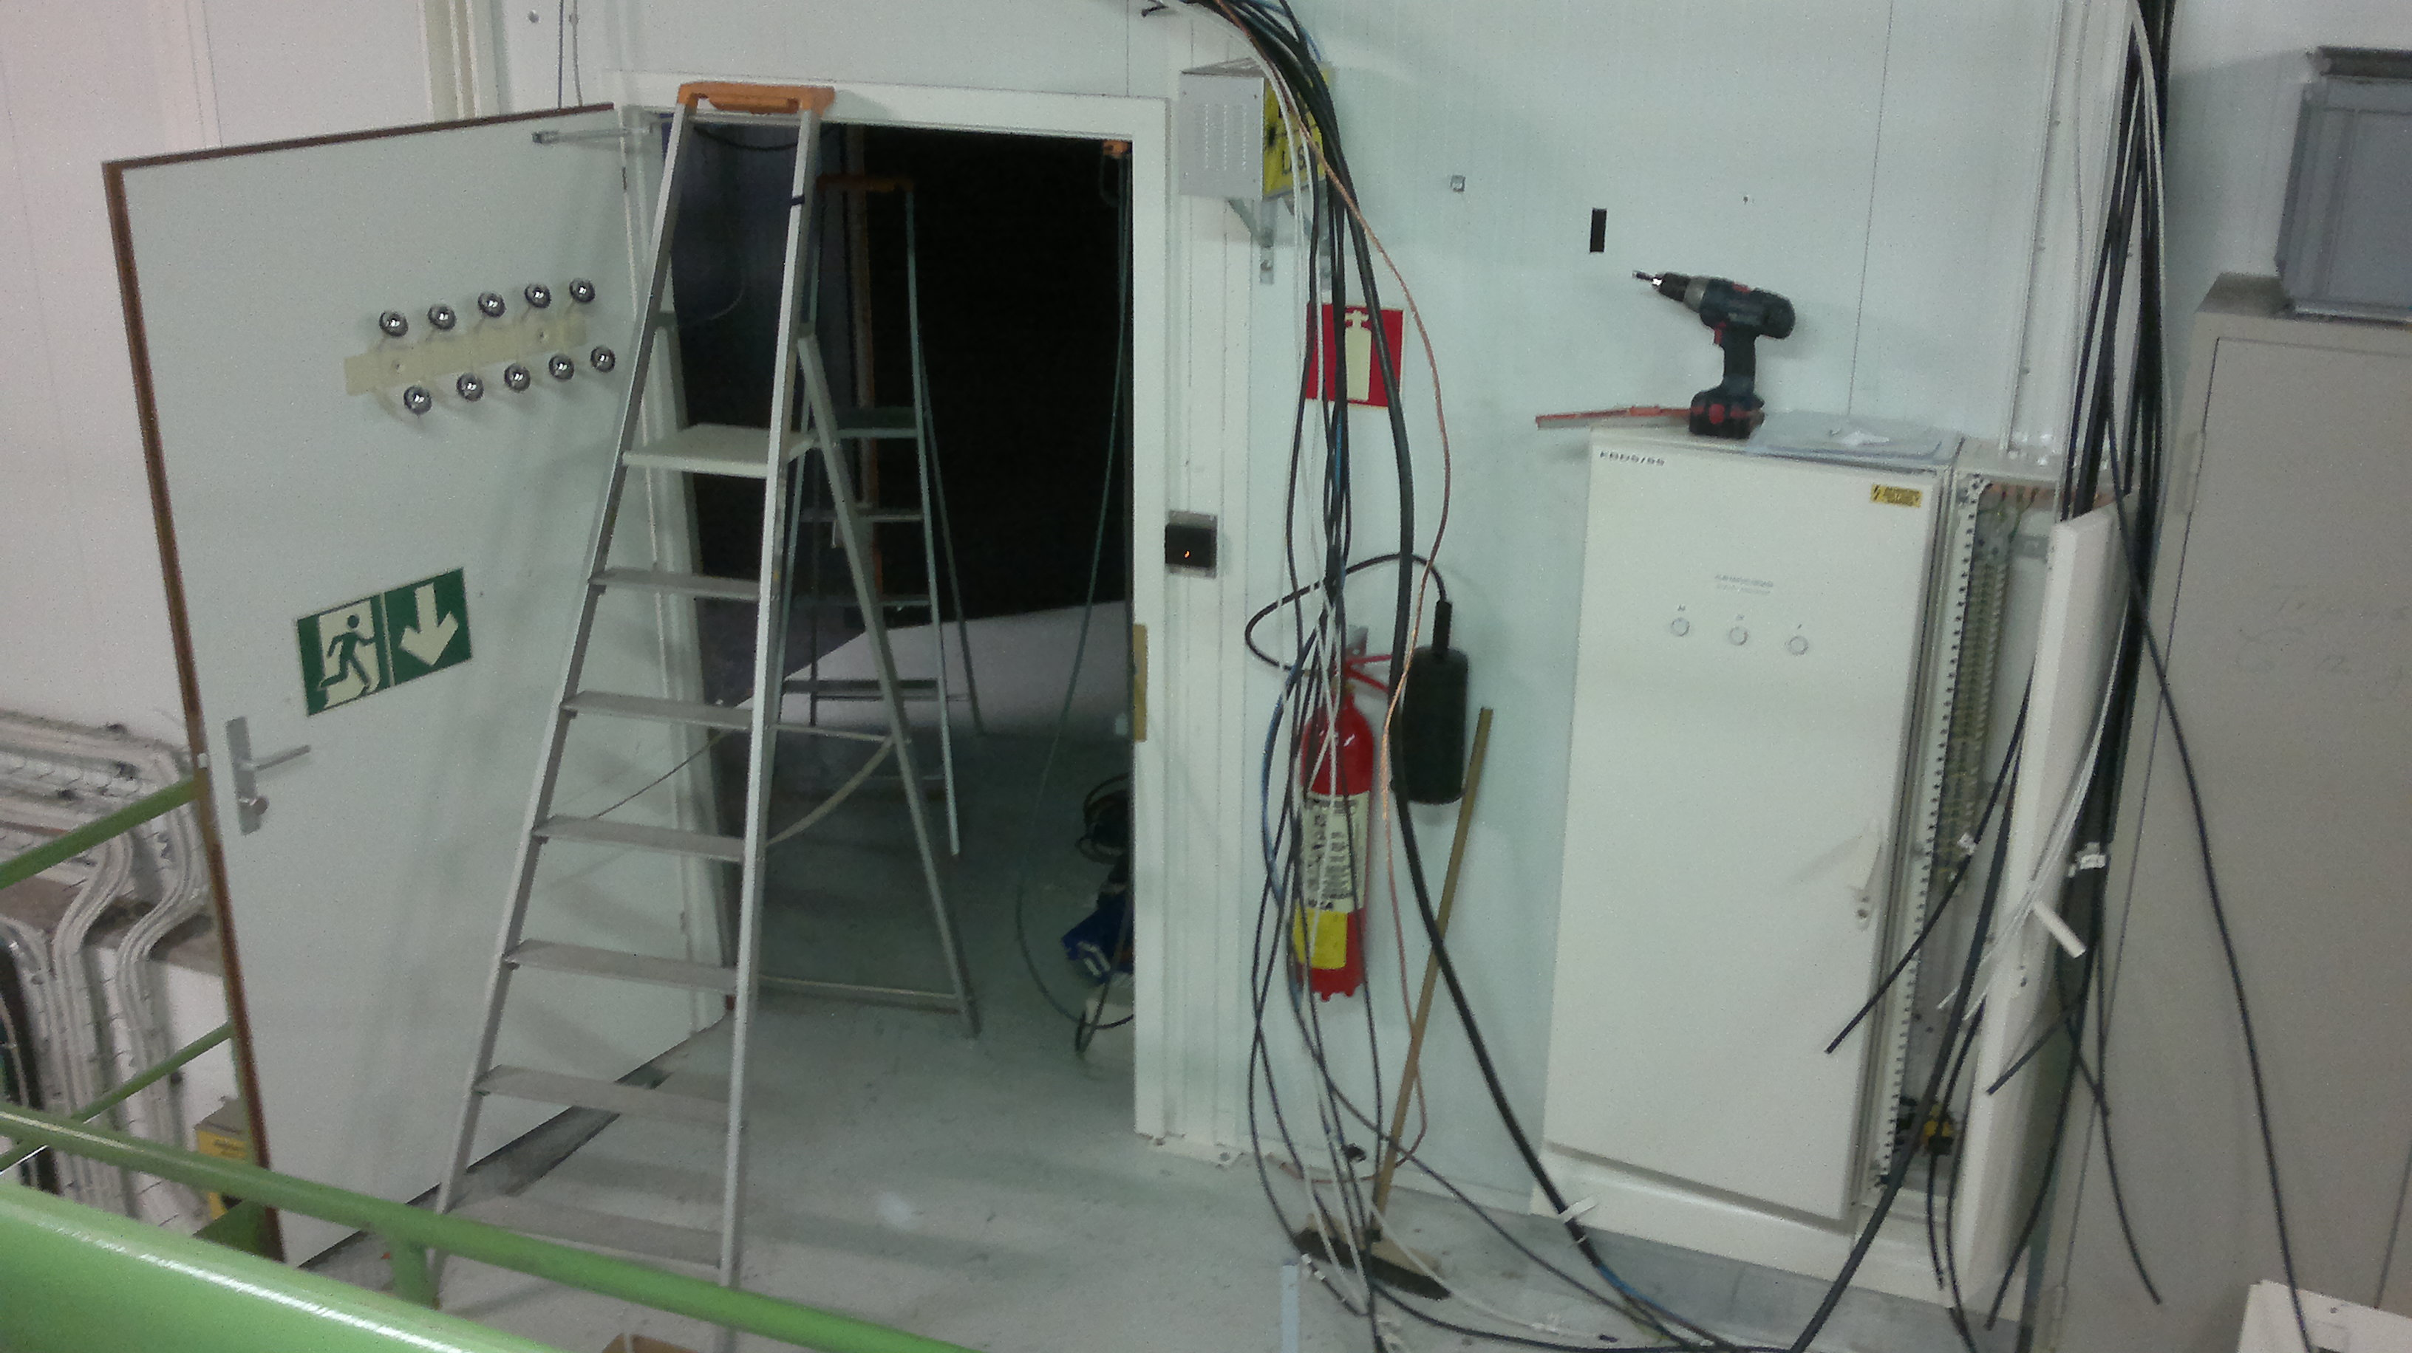
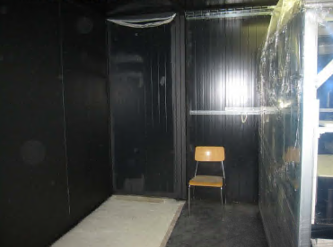
1) Laser room story
2012: 1st modification of the room, for having a new optical table.

Slide 11
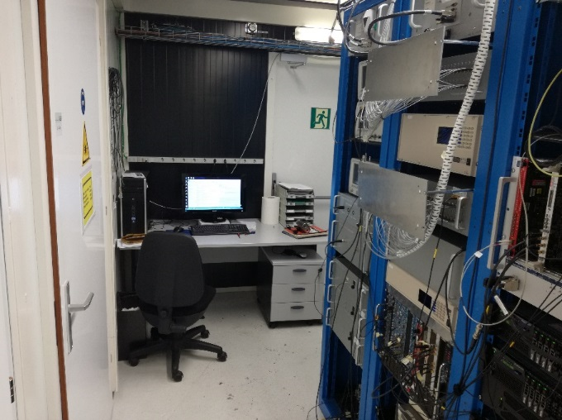
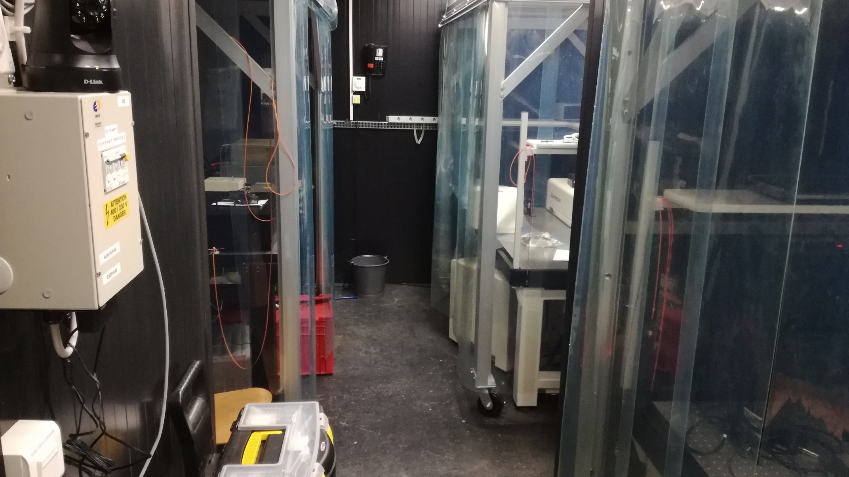
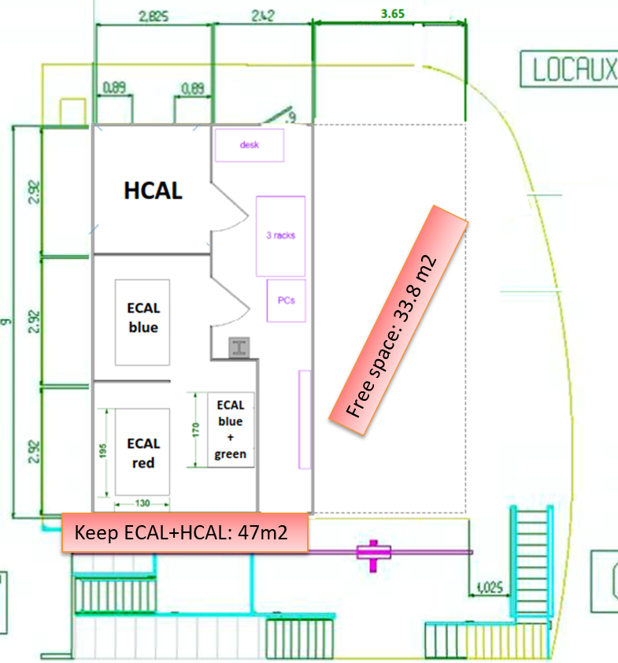
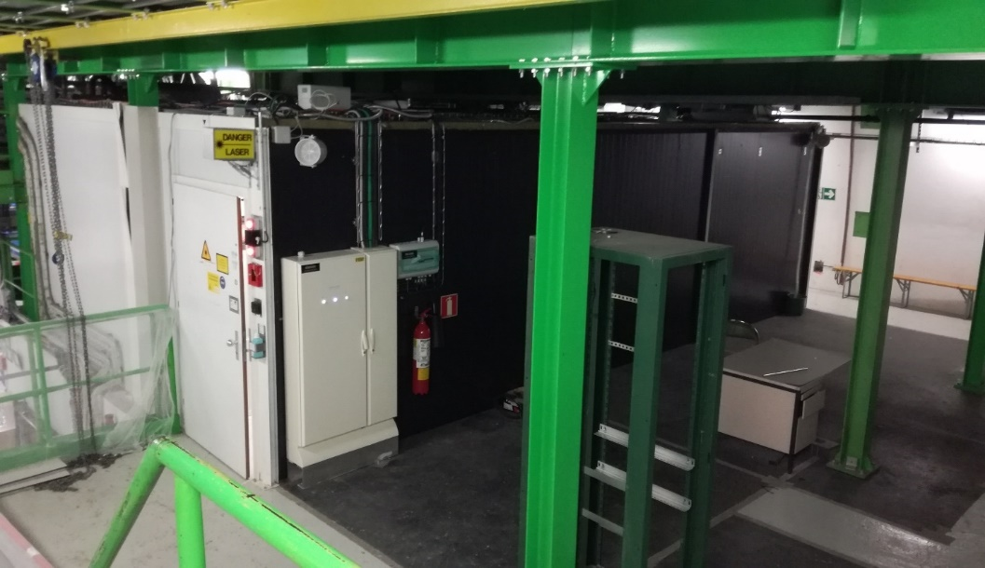
1) Laser room story
2012 : DAI for a second laser as a spare.
Improvement of optic, based on 1st laser experience
Add humidity sensor
2014: 2nd blue laser installed in USC55
Need 1st service under warranty after 6 month
Feb/March 2019: 2nd room modification :
removal of the Tracker and Alignment laser lab and move the HCAL inside ECAL lab. Electrical cabinet moved.
new green pillars for reinforcement

Slide 12
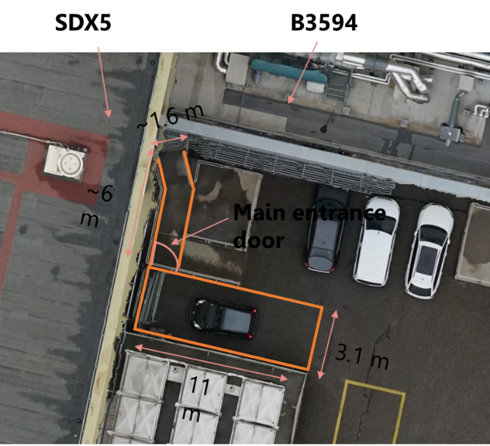
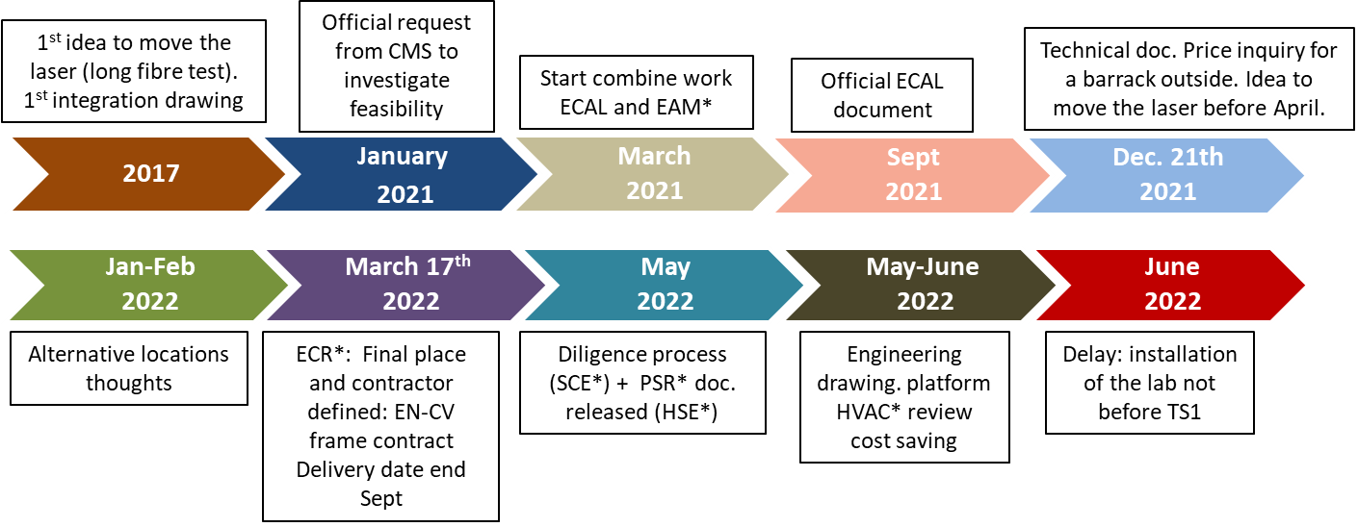
1) Laser room story
2018 to 2023: Task force to study the feasibility to move the lab on surface:
need to free the place for the C0₂ cooling system
2017 to 2021: 3 tests with long laser and trigger fibres.
2021 to 2023: overall project on the new lab on surface
The project using a container outside failed after 1 year: no company found.
=> Final location in SDX5
In parallel, optical fibre procurement process:
Delay due to a wrong quotation from the 1st company.
The second company on the list was selected.
Initial location, Nov. 2021
Schedule in 2022
2023, Oct. 30th to Nov. 25th : move + cabling + acceptance test

Slide 13
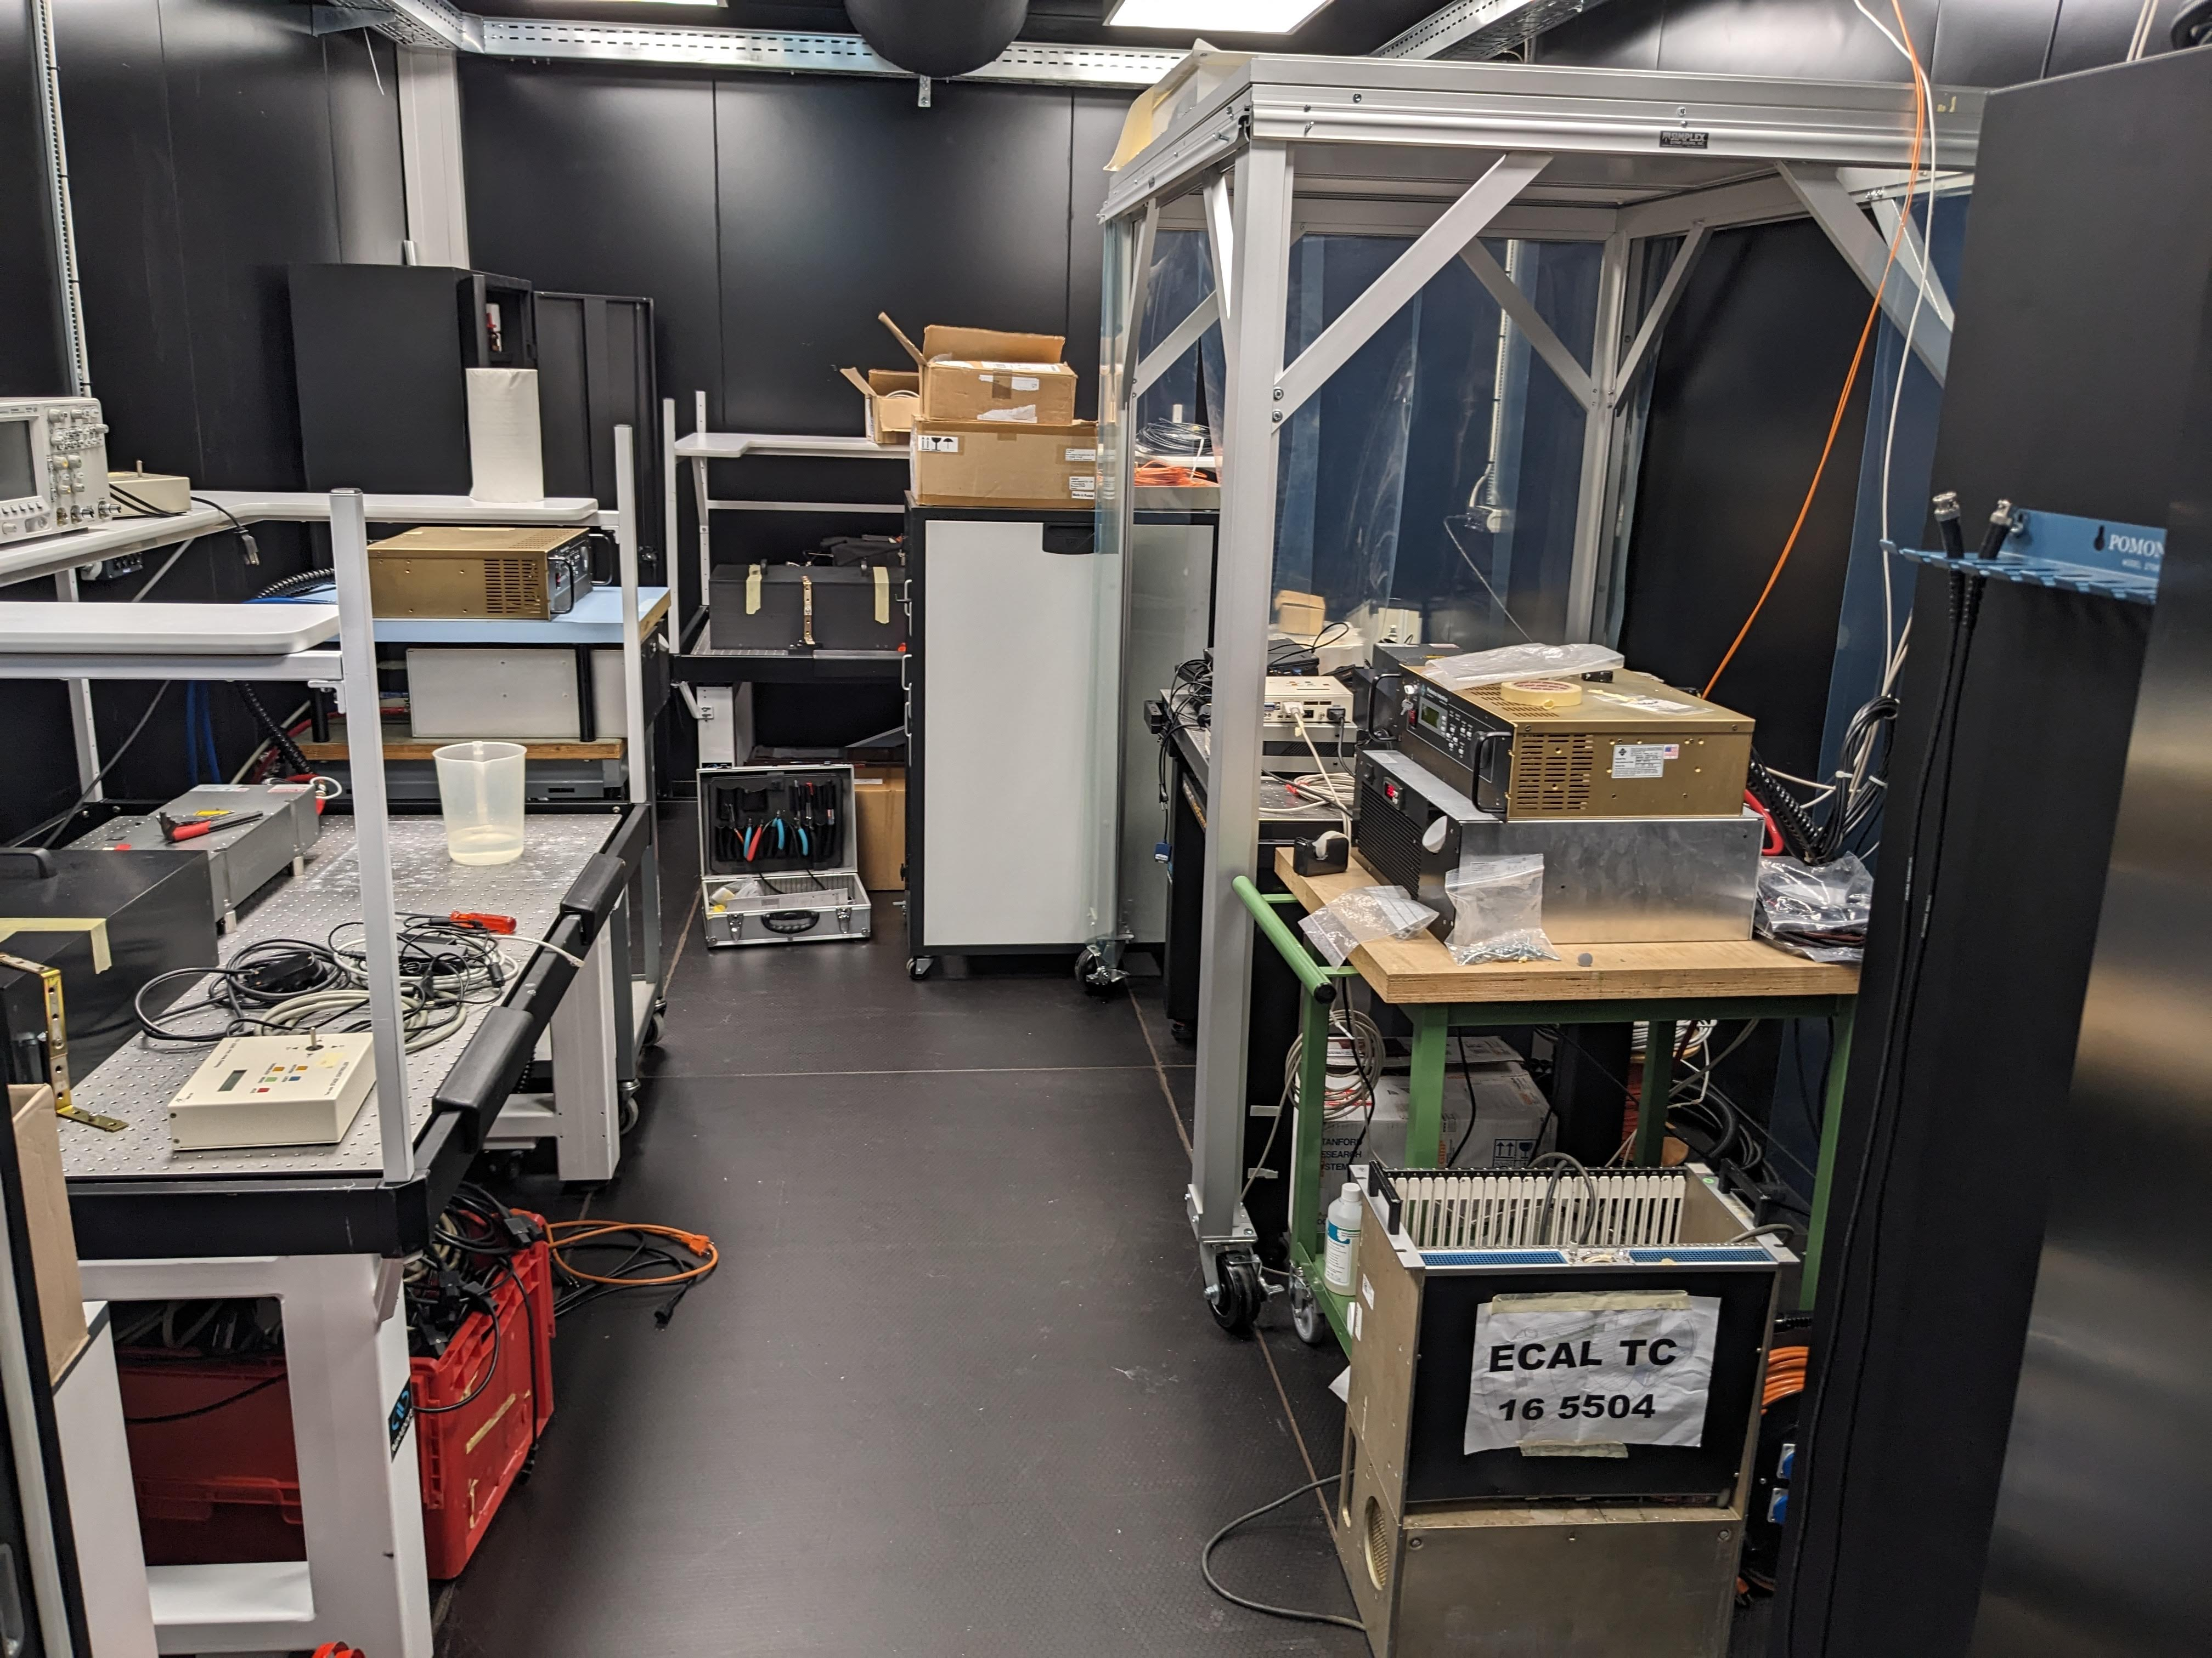
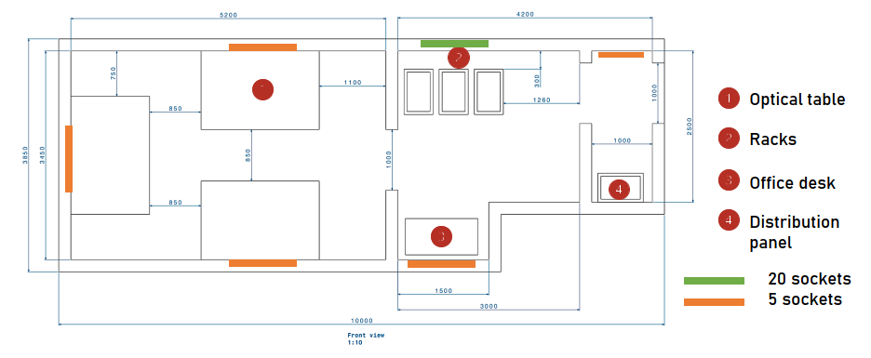
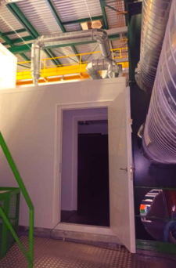
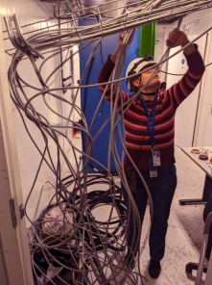
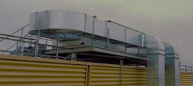
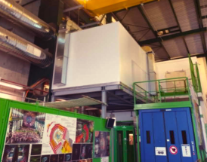
1) Laser room story
2022 to 2023: new lab construction and installation
https://laser-caltech.web.cern.ch/

Slide 14
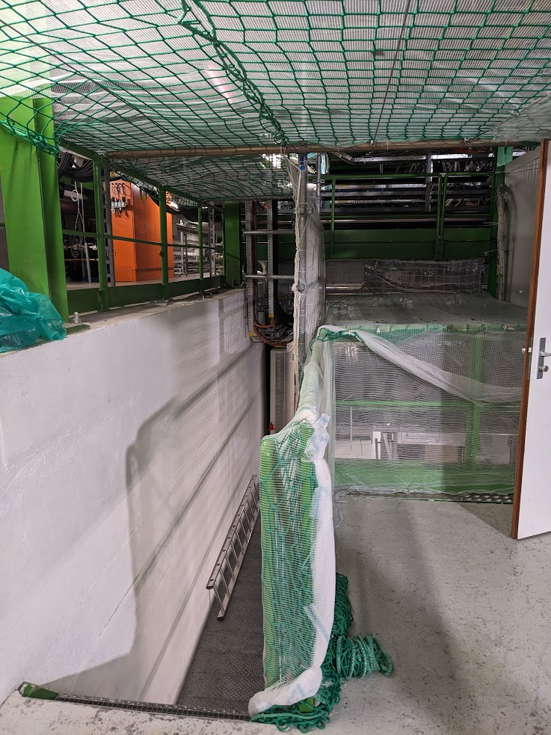
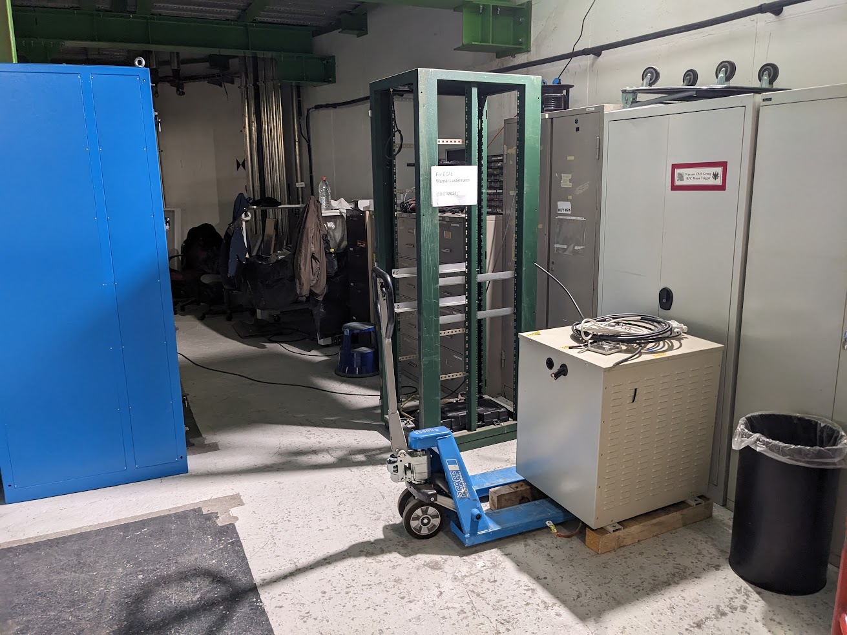
1) Laser room story
… A page turns in USC. Old laser room fully removed, HCAL stays in S2 level (new room of 9m² under construction)
Laser lab was used by ECAL, HCAL, Tracker, and Link alignment system
HCAL: monitoring the HCAL channel-by-channel gain and timing as well as the effect of radiation on HB and HE megatiles.
Tracker: to detect movement and deformation of the Tracker support structure with precision better than 100µm
Link Alignment : to monitor the relative position of the Muon Spectrometer with the Central Tracker
Today

Slide 15
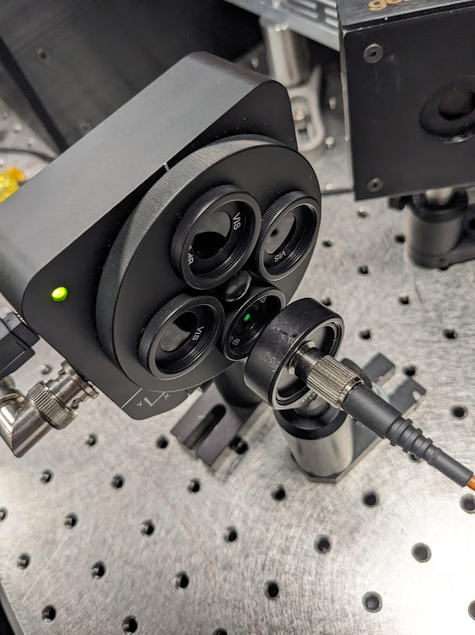
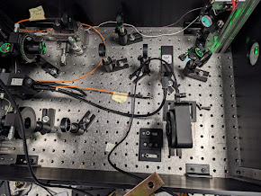
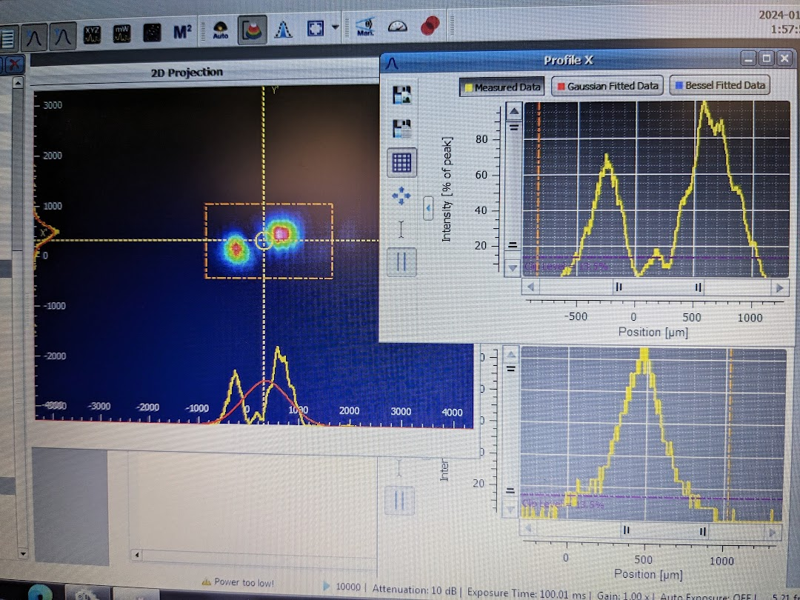
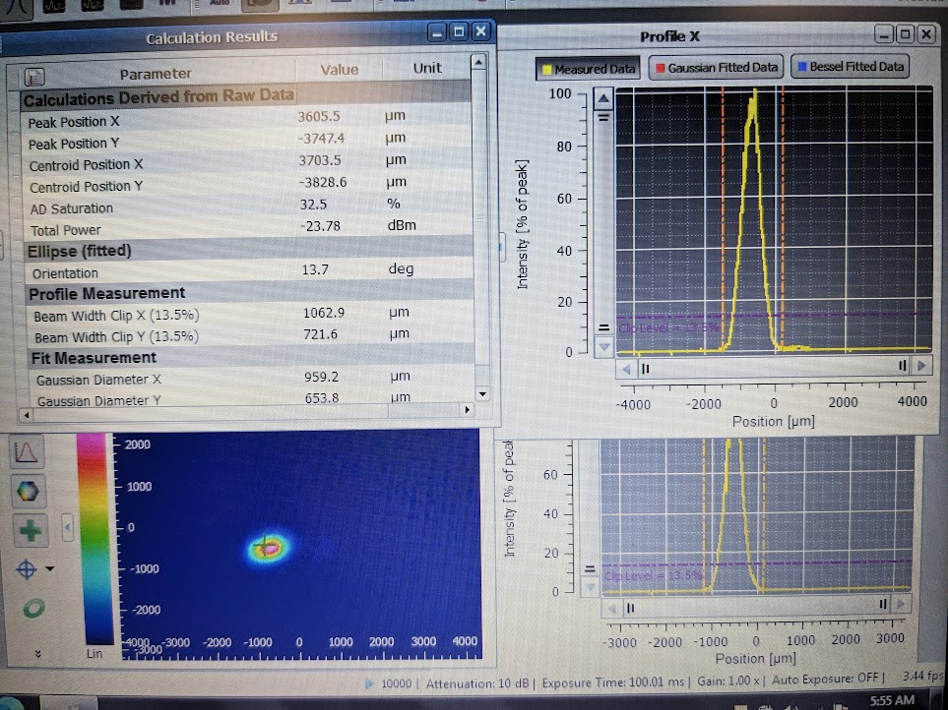
2) New green laser DP20-527
October 2023: commissioning . No problem on laser side, run at 5A
January 2024: re-align the laser on surface after the move :
Issue with the coupling : the main fibre burned at low currant (3A)
Investigation :
Adjust the focusing of the fibre with the 3 stages axis. Power was optimized. Damage of the fibre connector happened at 6A.
Check the beam properties with beam profiler:
➔ Observed 2 peaks on X axis !
Suggested tests from Photonics:
- check laser setting INT EXT gate control : OK.
- change the temperature of the crystal (SHG): no improvement
- change the internal attenuator to see if it is not damaged: OK
- moving 2 motors axis to test if the problem is from mechanical shift or from damage: issue solved ! Get only one peak on X
From Photonics it is due to the move of the laser : stress on the base is responsible of this offset. (thin Teflon spacer could be inserted)
Still need to find good fibre alignment (not ok at high power)

Slide 16
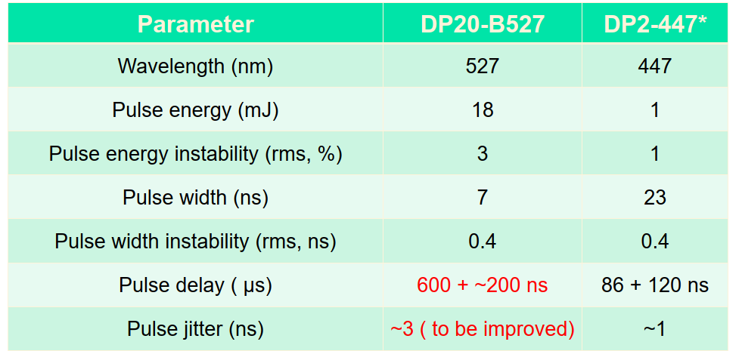
3) Modification of the trigger
Problem and solution in October 2023:
The new green laser need to be triggered 600µs in advance (88µs for the blue)
The “Warning Test Enable” (WTE) calibration trigger is received only 107µs in advance.
=> Send the WTE in advance. No issue on TCDS side but need agreement as WTE is common to all subdetectors. All lasers will be impacted. Need EMTC firmware update (delay the laser of several orbits)
ECAL DPG, Liyuan 2022
Test on 29-31 January:
(with a different SM each day)
Inputs from Marta
January 29th
- Legacy sequence with old EMTC ﬁrmware running smoothly (tested with EB-01)
- New EMTC ﬁrmware installed on EMTC #1
- Laser farm processes restarted
- Tried to start global run to study laser reﬂection, but L1 trigger wasn’t ready
2) January 30th
- New EMTC ﬁrmware tested in miniDAQ with blue laser and EB-02
- New TCDS conﬁguration with WTE sent 7 orbits before the laser trigger tested in global with the collaboration of cDAQ
- Identiﬁed new WTE delay for the Matacq and the legacy blue

Slide 17
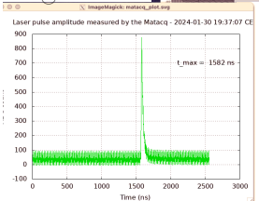
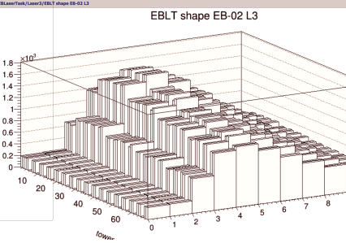
3) Modification of the trigger
3) January 31st
- New EMTC ﬁrmware loaded after bug ﬁx, tested with blue laser in EB-03
- DB adapted to allow larger WTE delay values in conﬁg ﬁles
- New green laser included in the sequence, miniDAQ runs to set the correct WTE delay
- TCDS conﬁguration new change to shoot new green with the correct timing: the WTE is now sent 8 orbit before the calibration L1A
- New ﬁrmware installed also on EMTC #1, tested together with new TCDS conﬁguration in global runs
- Legacy green laser to deﬁne the corresponding new WTE delay
- New WTE delays for LEDs has been computed and added to the conﬁg ﬁles, to be tested
- Scan phase mode tested
- Global runs with trigger in, we see a small rate in L1_SingleJet35, always in diﬀerent BXs. It can be seen also without
the laser, so it shouldn’t be caused by the laser shooting in physics
Inputs from Marta
Bring the EMTC boards for reparation: bad LEMO connection
New green laser + new EMTC ﬁrmware + new TCDS conﬁguration commissioning successful. Final settings:
•WTE orbit: 8th orbit before the orbit with the calibration L1A (set in TCDS)
•WTE_2_Matacq: 24959
•WTE_2_BlueXXX: 24959 (XXX: set for all types of blue lasers in the conﬁg ﬁle)
•WTE_2_Green: 28848
•WTE_2_Green2: 4361
•WTE_2_LED: 40656
•WTE_2_LED_SOAK_DELAY: 40856
•Delay A for all lasers: 11.27 us
Next steps:
- Complete commissioning of the LED with new WTE delays
- Further check shooting in physics also with new green and legacy blue, also using TP plots (not available during the tests)
- Perform reﬂection studies (next slides)

Slide 18
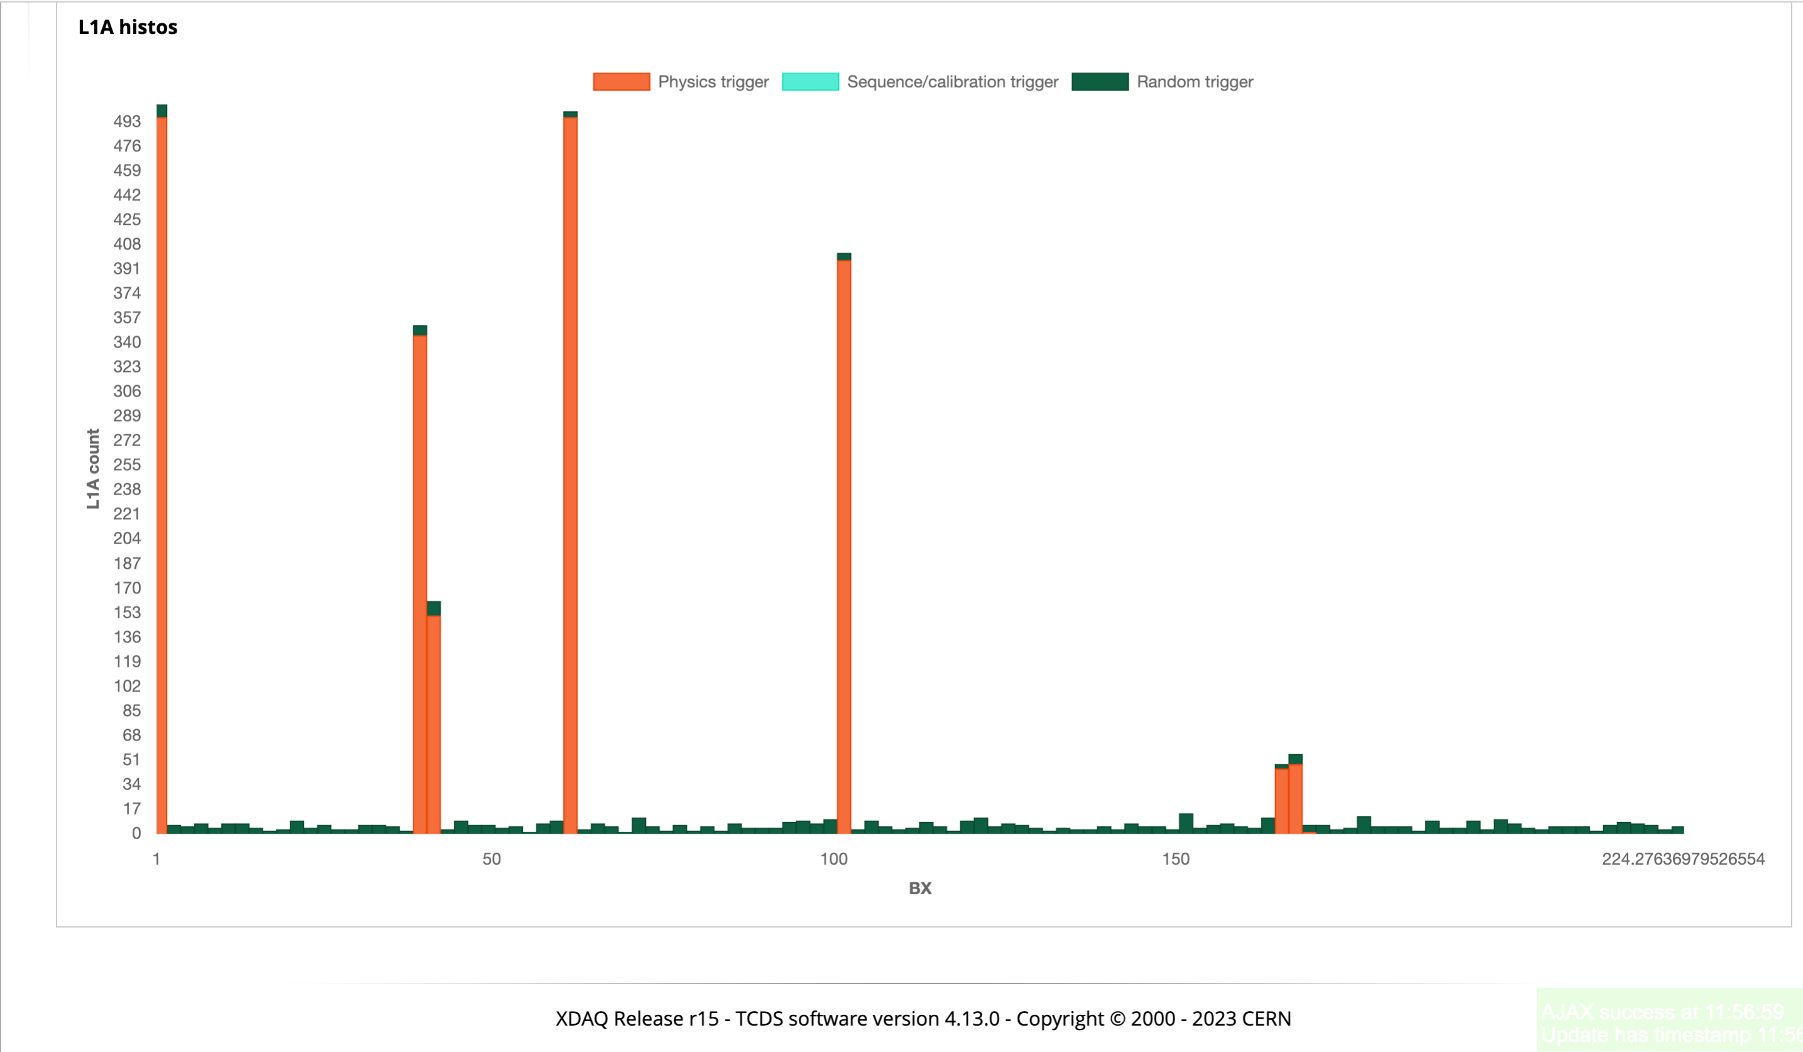
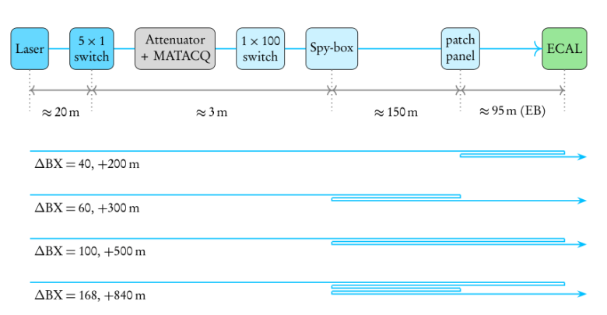
4) Reflections issue
Commissioning phase in November 2023:
observed laser reﬂections while testing the lasers at maximum power with trigger in.
=> both blue and green lasers shooting in physics also in BXs 40-41, 62, 102, 165-169

Slide 19
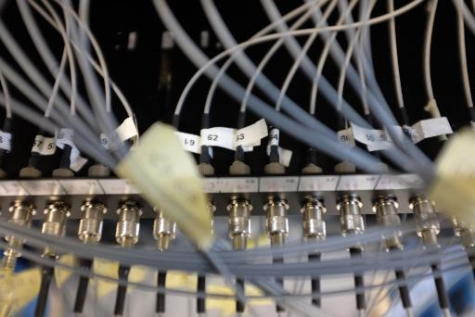
4) Reflections issue
1st test:
Try optical gel on a FC/FC connection => not resistant to the laser power
Other tests to be discussed:
2nd test:
Bypass the spy box : no more in use anyway.
3rd test:
Replace the connection on S2 rack intermediate patch panel by a splice.
But a possible issue here is that the reflection coming from the SM will be higher after round trip.
Splice =
- cut 2 end fibre connectors ,
- cannot use spare ribbon from ECAL side (spare from laser lab side)
- can go back to fibre end connectors (manual operation)
- need to be planned (tool to be borrowed from optical link group)
4th test:
Idea to use FC/APC connector
Problem: this type of ferrule is in ceramic, not in metal => small production complicated ! We need special diameter for our 365µm fibre.
APC is limited to 200µm fibre because above, the angle has no more significative impact on reflection.
Spy box
S2G14 patch panel
Splicer and cladding tool

Slide 20
Summary
ECAL laser lab may have reached its final location, after 16 years underground and 7 years in test beam north area.
5 major modifications: 2 different rooms in H4, 2 modifications in USC before the final location
Lasers in operation: 3 Quantronix lasers, 2 blue diode pumps laser, 2 small diode green and 1 powerful green laser.
2 experts + 4 operators with the Quantronix lasers. Today only one expert !
Green laser: very sensitive to the transport. Damage after the delivery to Caltech, after the delivery to CERN and after the move on surface.
Reflections issue:
- no problem while high power is not needed,
- investigation on hardware side to reduce the peak reflections (useless to change the connectorization)
- to be seen on DAQ side to deal with it,

