Slide 1
Laser monitoring system
CMS week, 19 September 2023
David Bailleux
University of Notre Dame

Slide 2
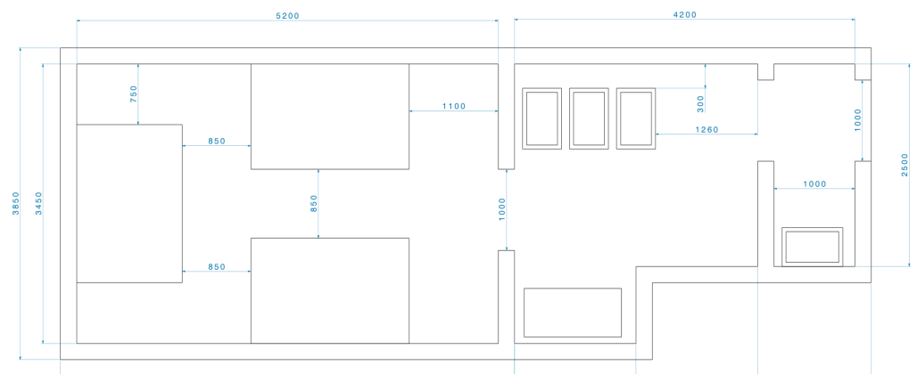
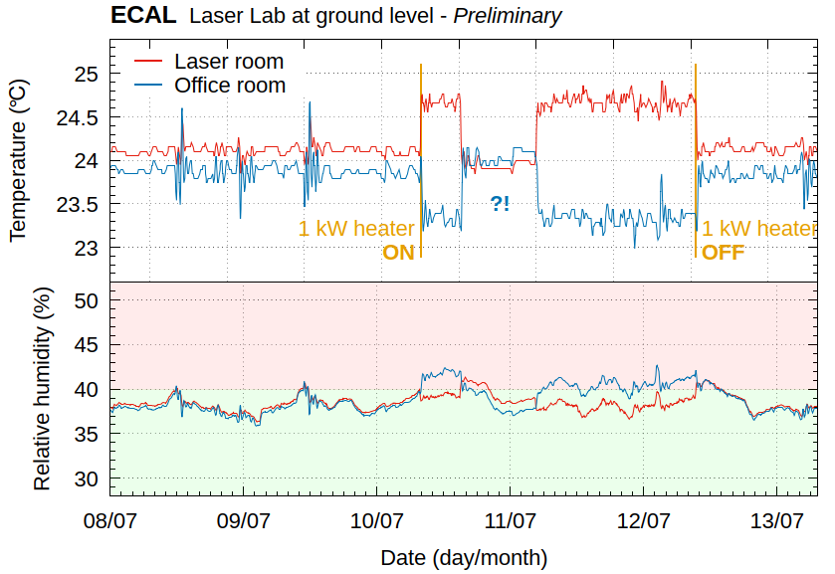
New laser room
Pilot run in June : no showstopper, all was fine as expected after resolving few issues (laser cms week June 2023)
TIG presentation on 13 July ferri_tig_230713.pdf
Office room
Laser lab:
Safety system is working fine after replacement of the main controller box by the company.
Door : access control OK. Still need to find a good door closer
Temperature and humidity control:
1) Humidity within specs but very close to the limit of 40% relative humidity and above time to time.
2) Temperature : not within the specs. Issue discovered after a load test in July (pilot run in June )
Explanation from EN-CV: the system is doing an average between the 2 rooms to set the temperature. Set point is 24°C (lower temperature will increase the humidity): if we heat one room the other one will decrease. To be changed to reduce variation.
For the humidity, more fresh air will be added by changing a valve: ongoing. Test next week !
Laser room

Slide 3
New laser room
Once the valve is replaced , we will test the HVAC system:

Slide 4
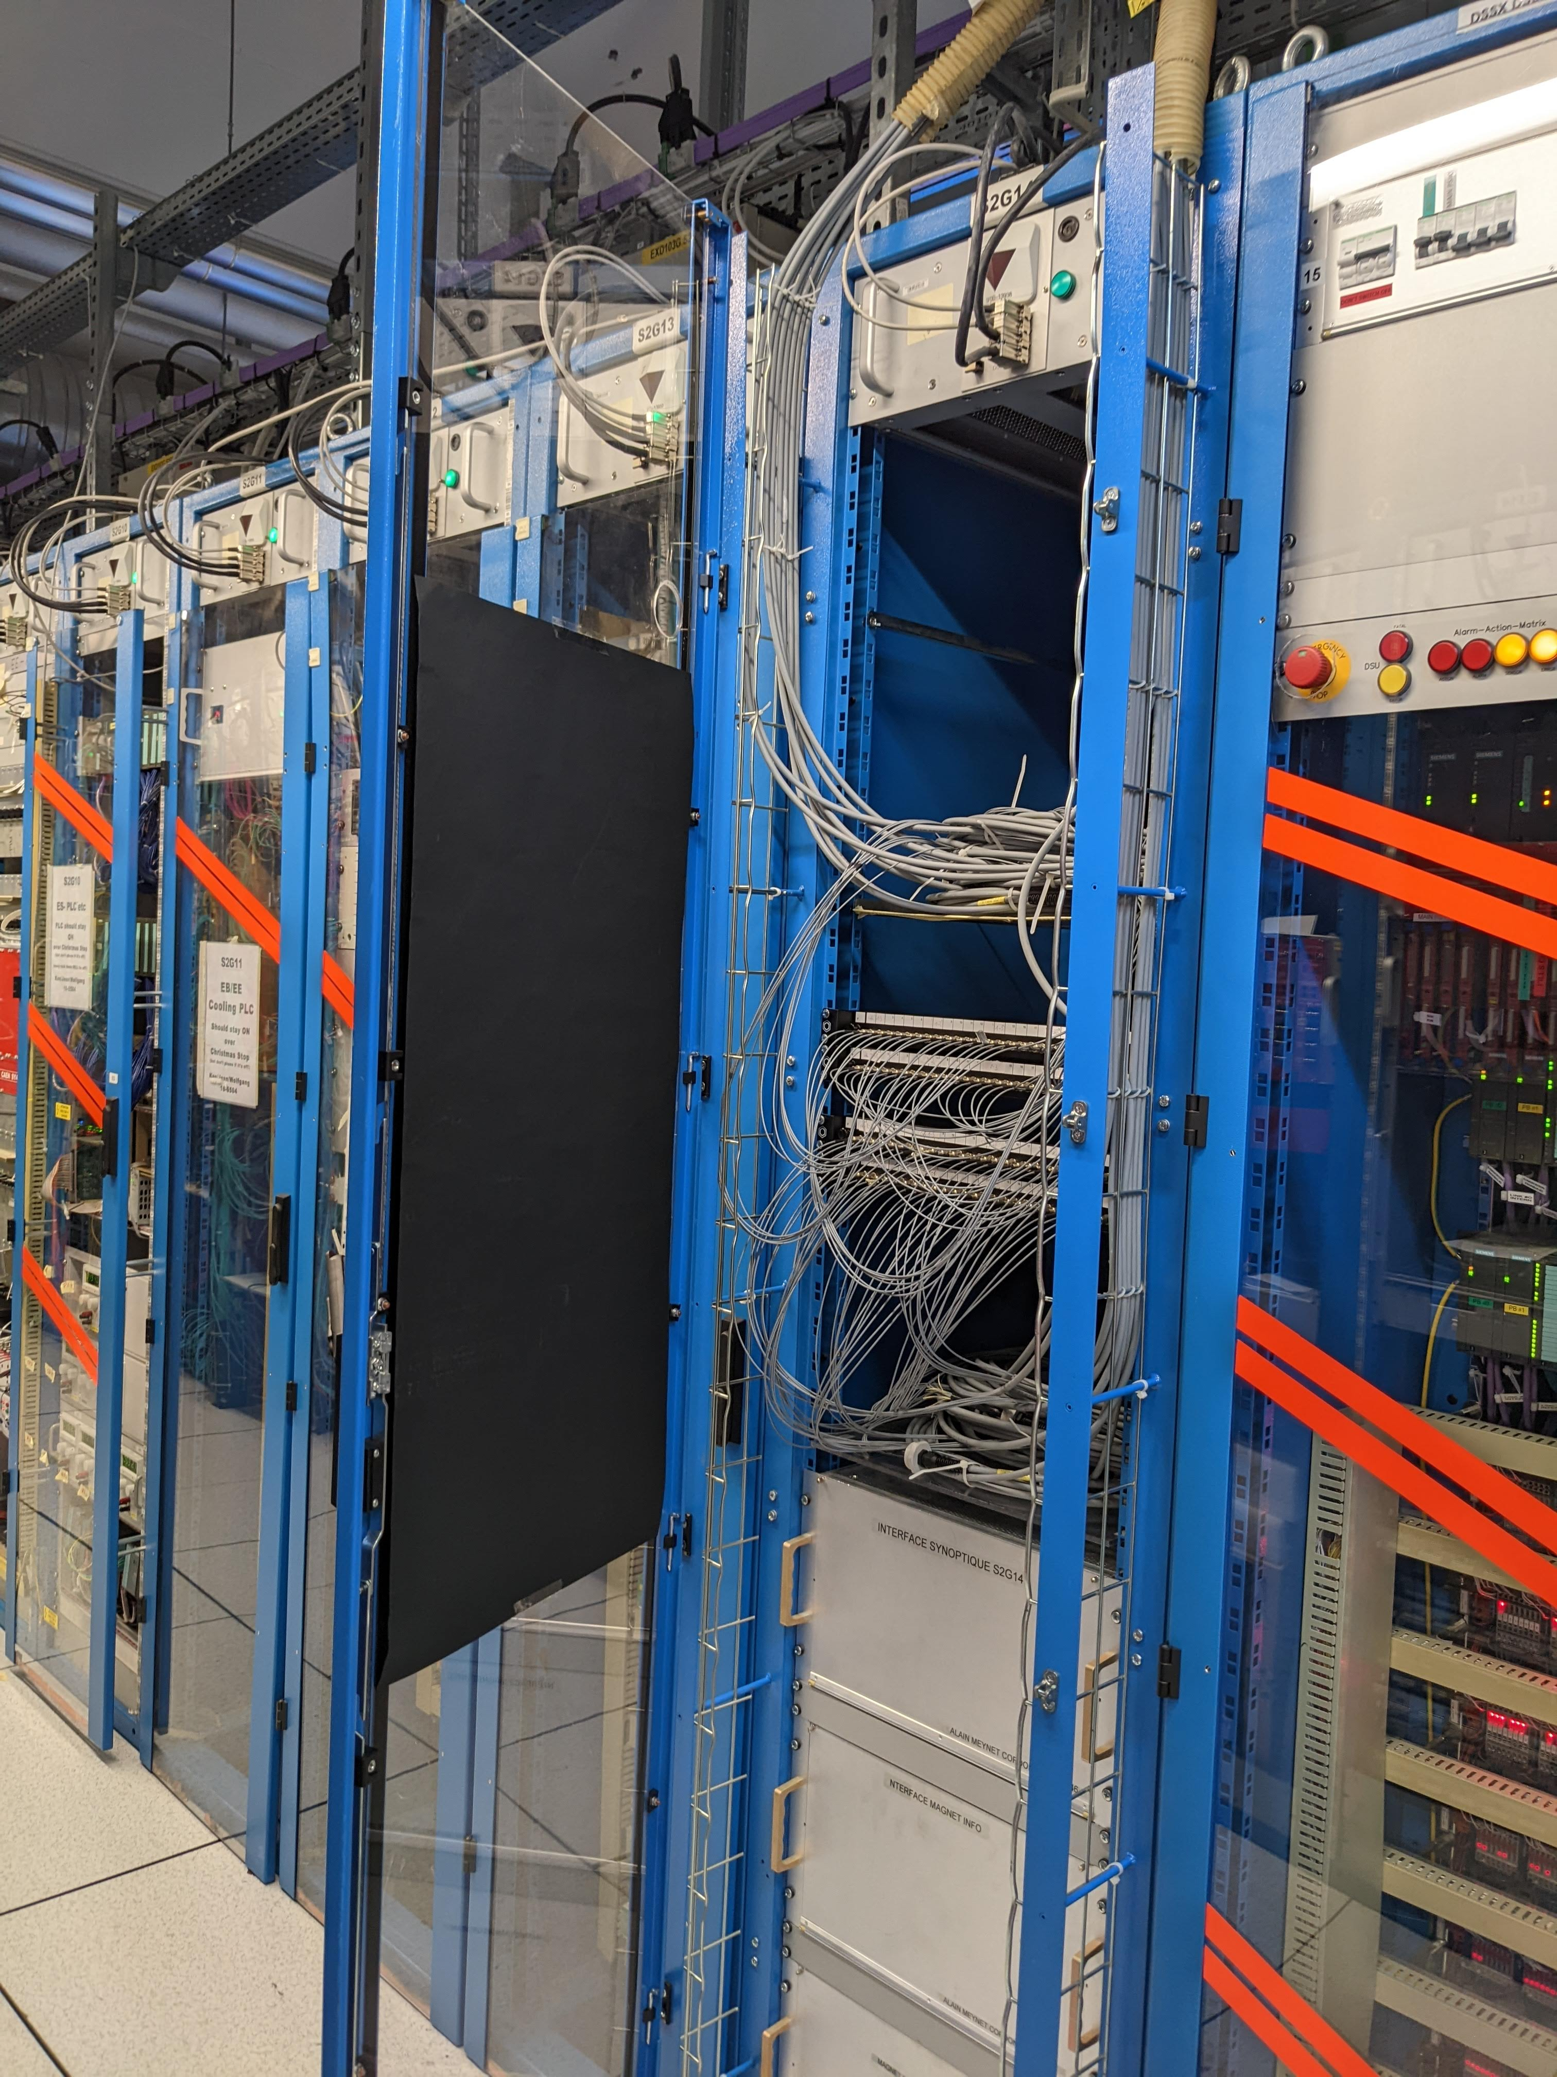
New laser room
 |  | SEPTEMBER |  |  |  | OCTOBER |  |  |  | NOVEMBER
 |  | 04-10 | 11-17 | 18-24 | 25-01 | 02-08 | 09-15 | 16-22 | 23-29 | 30-05 | 06-12 | 13-19 | 20-26 | 27-03
 |  | W36 | W37 | W38 | W39 | W40 | W41 | W42 | W43 | W44 | W45 | W46 | W47 | W48
Door | Handle | Complete
 | Pump
HVAC | New Valve Installation |  |  | 20-22
 | Testing Phase |  |  |  | Start
 | Additional Transfer Time
ECAL | Full Installation to surface |  |  |  |  |  |  |  |  | YETS Start
Move in November:
Help from Jean + Federico&Marta from November 6
Transport team for the heavy part (need EDH form)
What will take more time:
cable for the voltage injection to move to S2G14
all fibres to move, clean and connect to S2G14
all cabling inside laser room (both room)
Schedule:
we should reasonably say 1.5 week for the move: Minimum ! If nothing goes wrong (HCAL need to move as well, no interruption on USC , transport team, etc. )
+ 2 weeks for the commissioning with ECAL
(Endcap minus will be opened mid November. Power on to be seen)
CMS need to have the place free for the 1st December !
S2G14

Slide 5
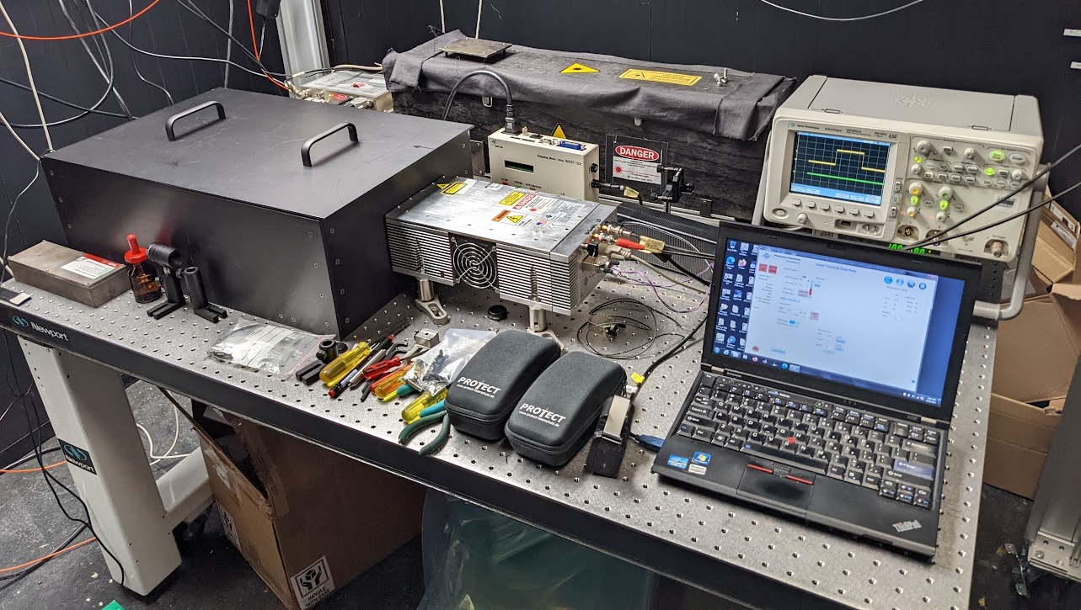
New green laser
Dec. 2021: DAI for the Laser
April 2022: laser delivered to Caltech
June/July 2022: 1st reparation/improvement at Photonics : pulse jitter larger than the specification of 1-2ns => change the trigger system . But loss of ~90% of power !
September 2022: 2nd reparation at Photonics : optical damage
April 24th 2023: CERN installation, 1 week , in USC cavern

Slide 6
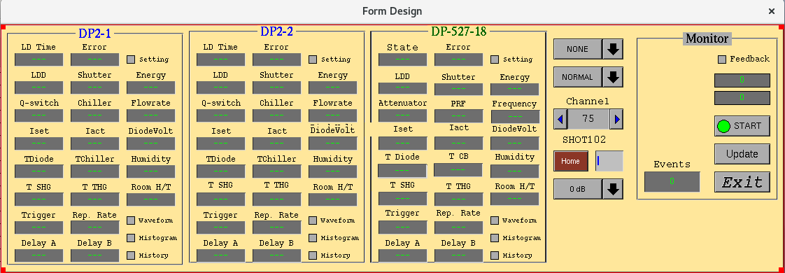
New green laser
Laser program has been modified to integrate this laser on the sequence, using the old infra red (IR) laser color code.
Legacy green :
Get the trigger and delay from dedicated EMTC output
Laser controlled by Xdaq PC mainly for its shutter
New green :
Get the trigger and delay from DG535 generator as the blue
Laser controlled as the blue laser , instead of the old IR
Using IR colour code will allow to keep the legacy laser as a spare because no modification on Xdaq and Caltech program side is needed, BUT this imply modification for the corrections.
In a first step, labels on DQM can be modified as well as the code which done the analysis
Laser code selection, to be reviewed
(Blue quantronix and Photonics2 not in used )

Slide 7
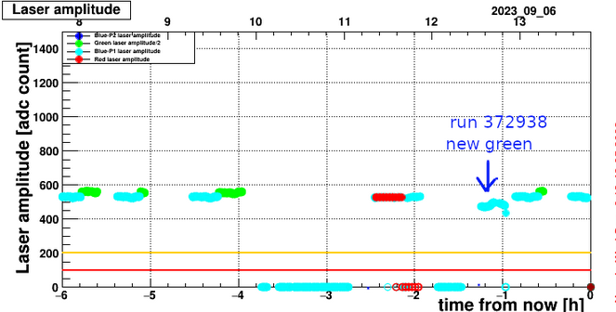
New green laser
Test online 22-24 August, 6 September
problem is the 600µs delay of this laser compared to 88µs for the blue.
WTE: laser events start upon reception of the WTE signal (WTE=21 bx, 525ns)
WTE is sent one orbit in advance (around 100µs) so laser delay more than 6 orbits.
=> The pulse need to be shifted by multiple of calibration cycles wrt to the WTE
For that we use the Delay A on laser side
Summary of delay calculation/test: elog
Few tests in local and global, switching between legacy and new laser program, running with special HLT configuration and performed adjustment of the delay step by step.
Found issue using IR color code , not yet working properly on laser side.
Found a good value, 9457.25us to get pulse on DQM despite that timing was not OK on the Matacq. Power has been adjusted as well from laser side.

Slide 8
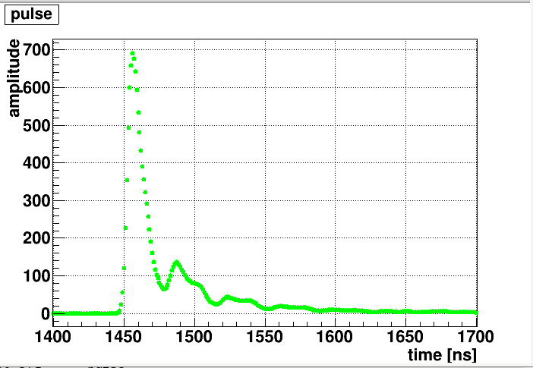
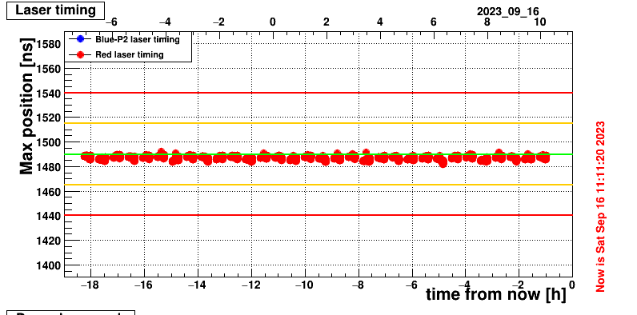
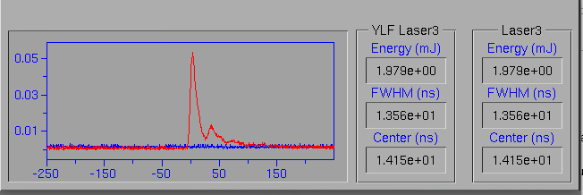
New green laser
Test online 14 September
After few new iterations using the IR color code, good delay has been found . Delay = 9458.03 us
Test online 15-16 September
Running 17hrs with only green laser : OK
Problem pointed:
Post pulse for the green: will could increase the laser current to improve the pulse shape
When using the normal calibration sequence with blue, the green went out of time.
Need investigation (ex: stop the blue while green is fired , put the 2 green online or switch back to legacy laser program keeping blue and green)
Matacq plot, 14 September
One pulse seen on laser side
Average of pulses over 600 evts
Matacq plot, Saturday 16 September

Slide 9
Summary
Laser lab: waiting the final commissioning of the HVAC , after valve replacement this week. Conclusion middle of October.
Move in November: no contingency margin, need to free the place for the 1st December (underground room removed) Cross fingers
Green laser: pulse found on DQM. New laser program can stay running online. 3 lasers can be put together if needed (blue + 2 green lasers). Issue with normal calibration sequence when blue is online. Further test needed before November.
Thanks to Saclay and run coordination teams

