Slide 1
Laser room relocation
CMS week, 5th December 2023
David Bailleux & Marta Tornago,
On behalf of ECAL laser team

Slide 2
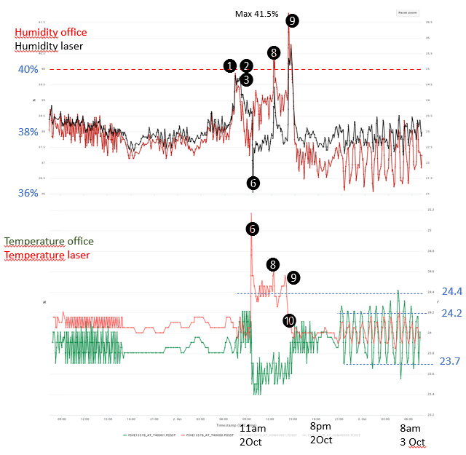
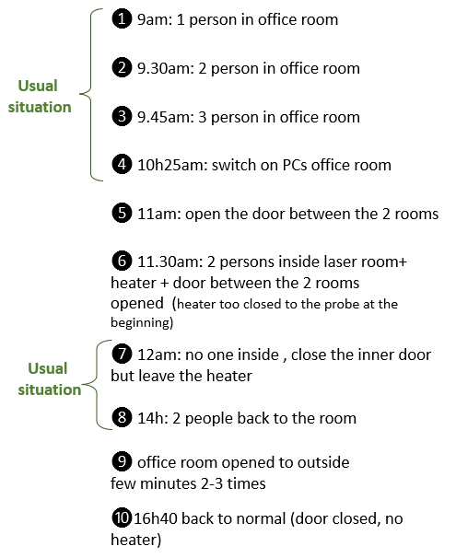
Some history
Pilot run 14 to 23 June: no showstopper. All OK with blue laser.
http://cmsonline.cern.ch/cms-elog/1187058
July: A HVAC issue was discovered by using a heater (huge delta T)
Solution found by EN-CV:
Replace a valve with a more powerful one to allow more fresh air.
=> Done on September 21.
Test: we defined operation to test this modification and see if the issue disappeared.
=> test OK.
The success of the HVAC was and is crucial before giving the greenlight for the final move.

Slide 3
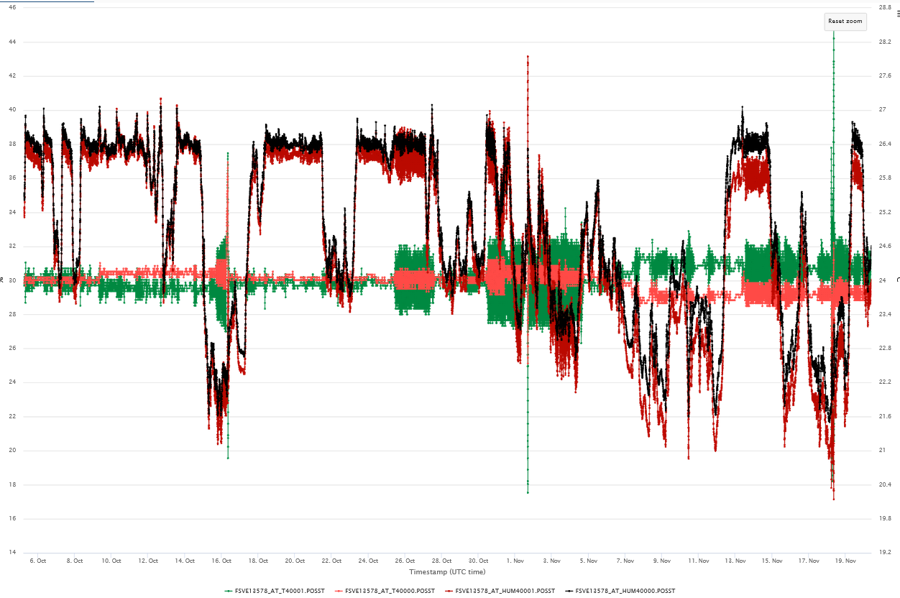
HVAC situation
Temperature and humidity plot from September
Rh(%)
Temp(°C)
RH(Office room)
RH(Laser room)
No more temperature fluctuation as observed in July (∆1°C or more with heat load)
24.6
24
T(Office room)
T(Laser room)
23.4
Since October 2 small problems observed due to sensors
-> solved
Laser relocation work

Slide 4
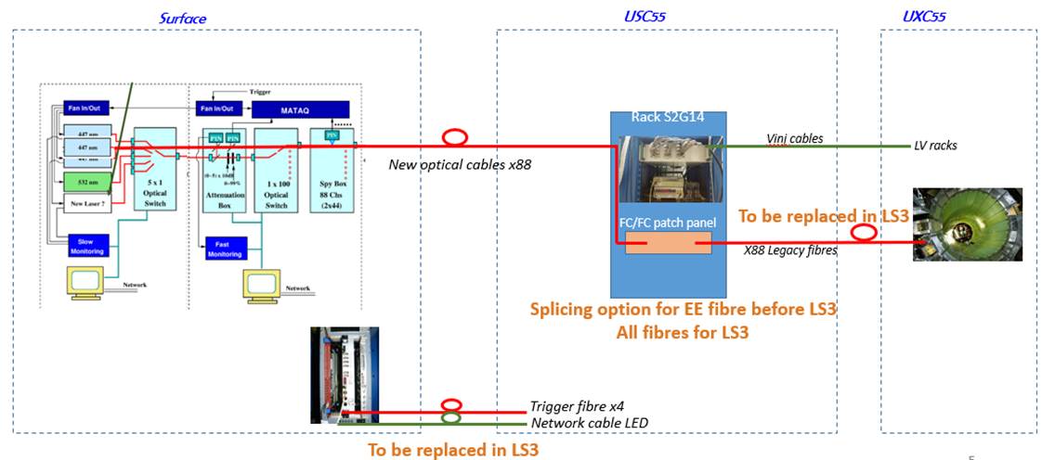
Laser relocation activities
The move of the parts started with the pilot run and preparation of the new lab continue in shadow during data taking.
EYETS plan: very tight schedule due to cooling project. ~2 weeks for the move and 3 weeks for the test.
Need to give ECAL green light on 24th November !
- 30 Oct to 3 Nov: preparation work 2 people + transport team
- 6 to 8 November: move and connection of cables, 4 people
- 8 to 25 November: switch on ECAL, data taking.
Final setup of the monitoring system
Preparation work with CMS TC:
Oct. 10, activity review: Define the plan of the work package (safety aspect) EDMS
Oct. 31, VIC: Visit Inspection Commune, visit on site to start the work package. (Need to create an Impact) => OK with us for the co-activity with CO_{2 .}
But tight time because it is needed to install pillars again just after

Slide 5
Laser relocation activities
•Monday 30th to Friday 2nd November
- disconnection of the lasers and all devices inside the 3 racks
- move the lasers and the equipment by hand
- move the optical tables by the transport team
•Monday 6th and Tuesday 7th November (elog: http://cmsonline.cern.ch/cms-elog/1201374)
- routing of ﬁbers and MEM LV cables-connection via the patch panel in USC55 of the ﬁbers coming from surface to the those going to ECAL
- connection of the new laser trigger ﬁbers to the EMTC
- ﬁnalisation of connections and lasers powerup in the lab on surface
•Wednesday 8th November (elog: http://cmsonline.cern.ch/cms-elog/1201431)
- EB+ and EE+ switched on-Deﬁnition of parameters to correctly see spare blue and legacy green both on MATACQ and DQM-Rearranged swapped ﬁbres
- started data taking in global with spare blue and legacy green
•Thursday 9th November (elog: http://cmsonline.cern.ch/cms-elog/1201471 )
- deﬁnition of parameters to correctly run LED in the sequence
•Friday 10th November (elog: http://cmsonline.cern.ch/cms-elog/1201510 )
- EB- and EE- switched on, all ECAL in the runs-Rearranged swapped ﬁbres
- adjustment of lasers power
- tests with maximum power of the lasers, observed reﬂection on the laser path

Slide 6
Laser relocation activities
•Monday 13th November (elog: http://cmsonline.cern.ch/cms-elog/1201575)
-Improvement of the jitter of the system with cable replacement
-One run with all ECAL in with legacy blue, green and LEDs, then back to spare blue + legacy green
•Tuesday 14th November
-EB- and EE- switched oﬀ, EB- back on in the afternoon
•Monday 20th November
-EE- switched back on, running with all ECAL in
-Issue with safety door due to bad contact solved
•Wednesday 22nd November (elog: http://cmsonline.cern.ch/cms-elog/1201920 )
-Tests with blue laser at maximum power and main pulse shooting in BX=1 to observe the reﬂection
•Thursday 23rd November (elog: http://cmsonline.cern.ch/cms-elog/1202012 )
-Repeating tests of Wednesday 22nd adding a 21m-long ﬁbre on diﬀerent points of the laser path
•Saturday 25th November
- ECAL switched oﬀ, end of new laser room commissioning

Slide 7
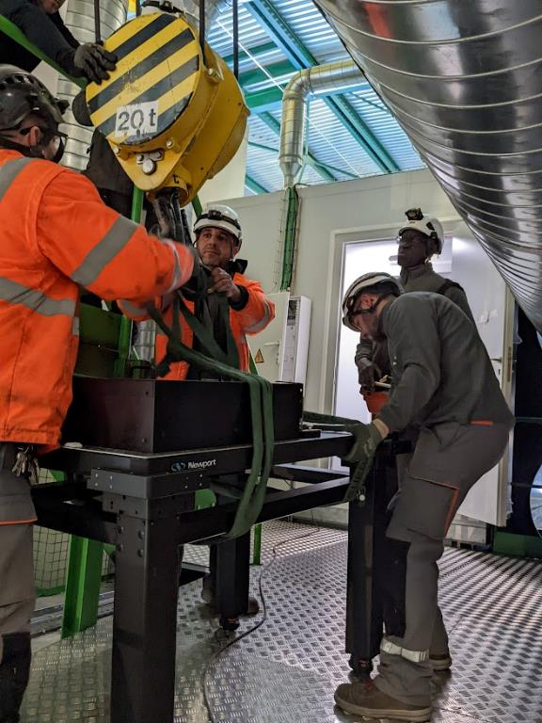
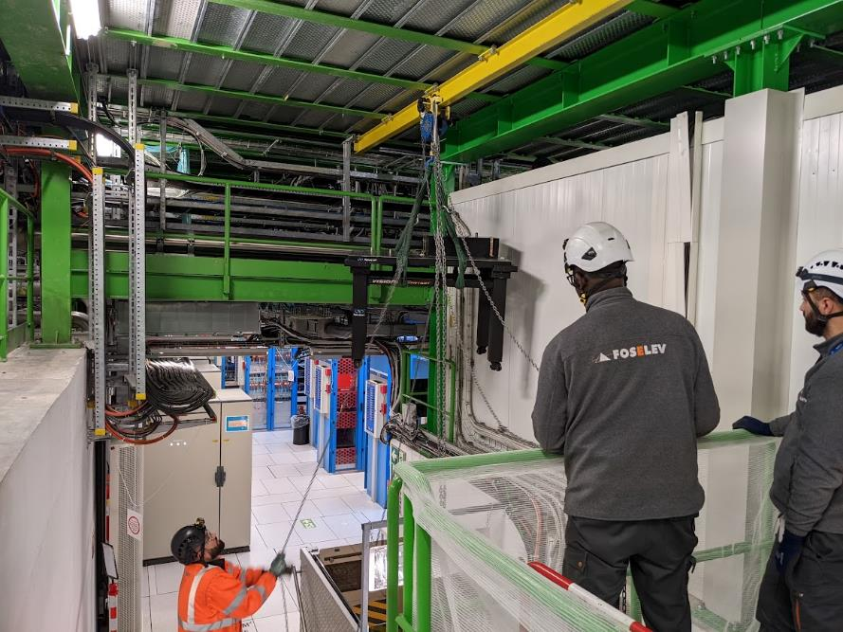
Laser relocation activities
Transport team for heavy parts

Slide 8
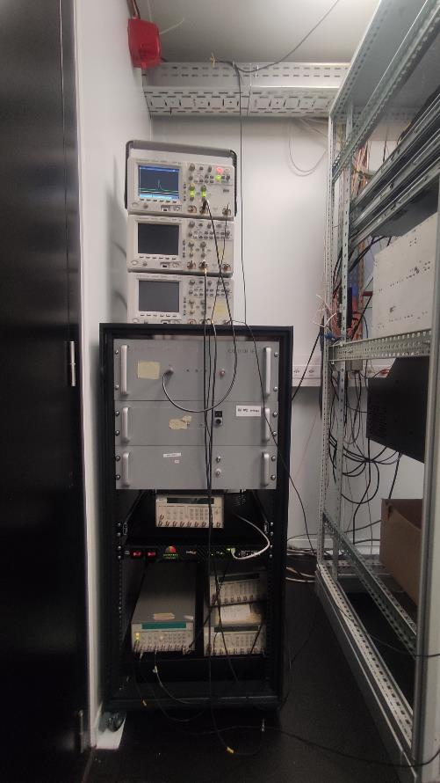
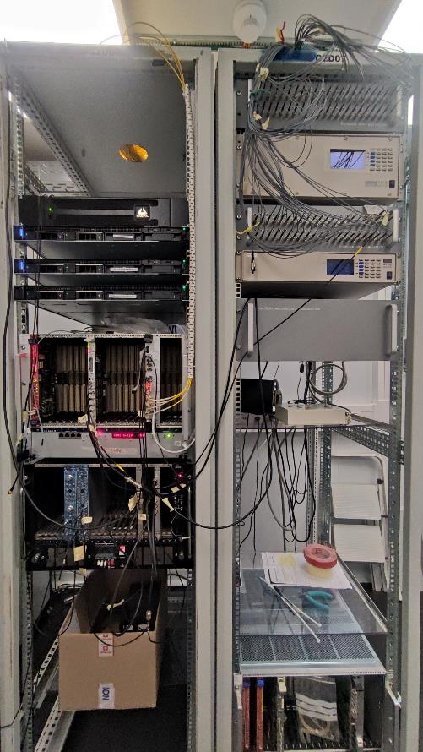
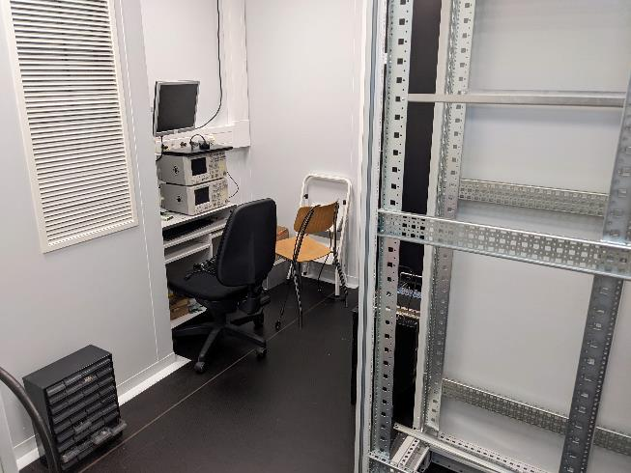
Laser relocation activities
New lab
Office room

Slide 9
Laser relocation activities
New lab
Laser room

Slide 10
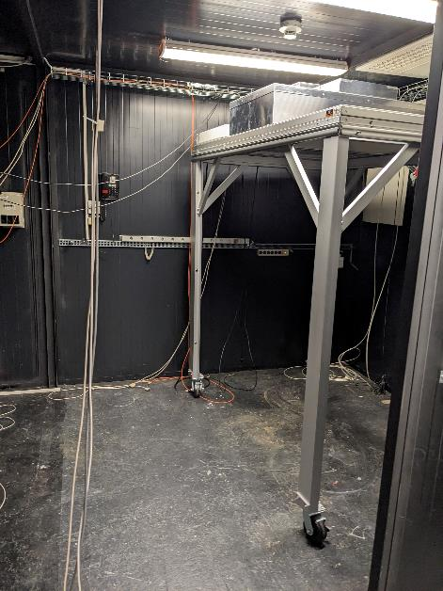
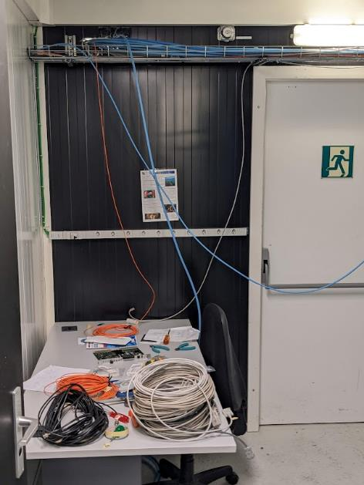
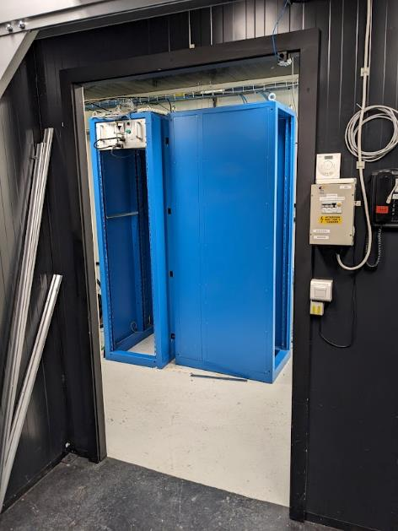
Laser relocation activities
Old lab

Slide 11
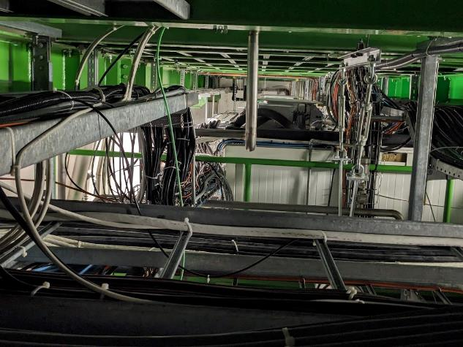
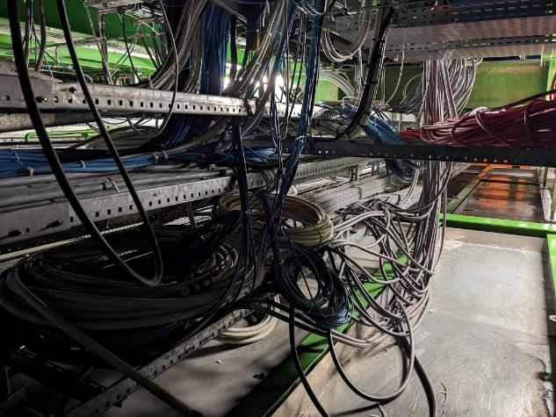
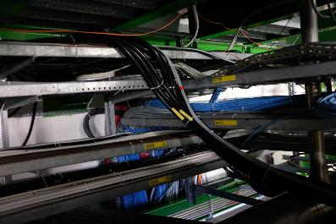
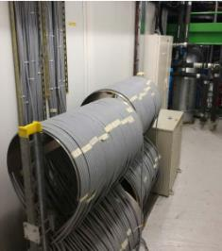
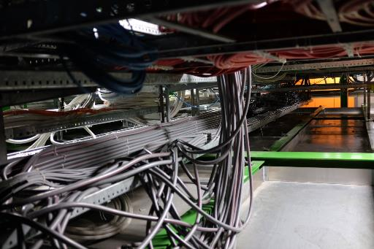
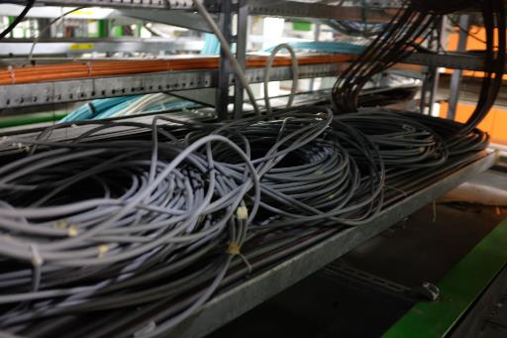
Laser relocation activities
Working area USC
S2G14
Laser room

Slide 12
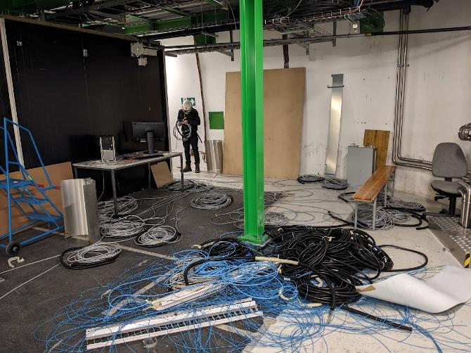
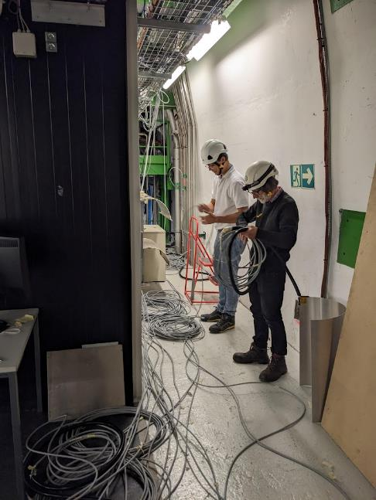
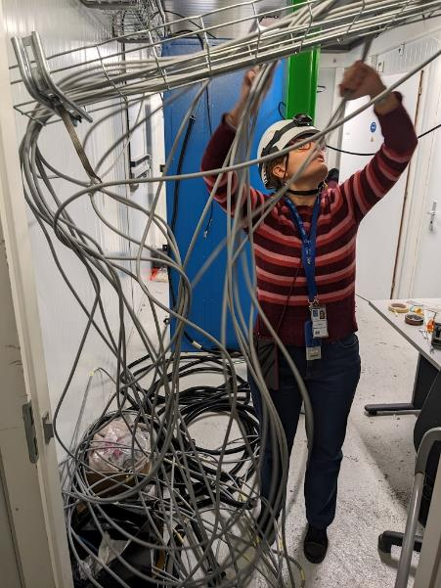
Laser relocation activities
Working area USC

Slide 13
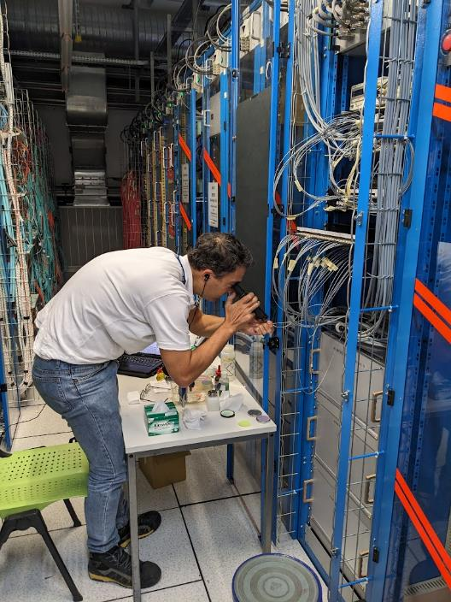
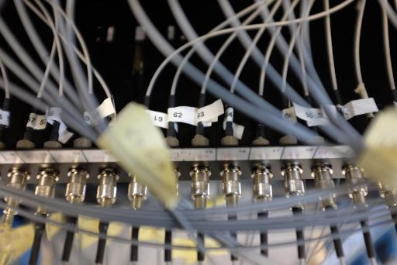
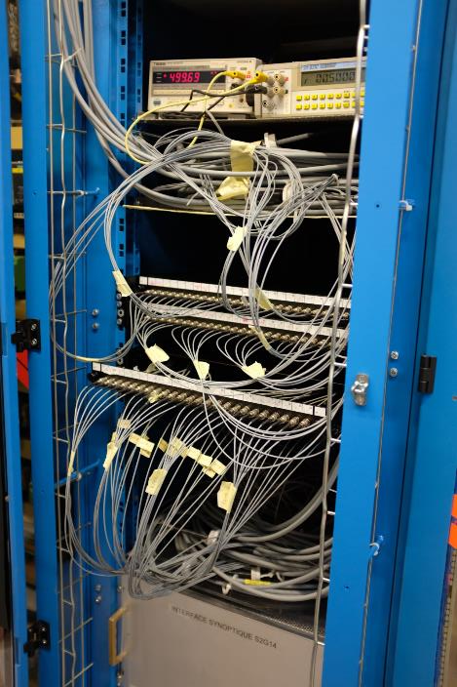
Laser relocation activities
S2G14

Slide 14
Laser relocation: runs
Setting up of the lasers
8 to 10th November
Start with the spare blue laser which was used for the pilot run. Then adding the legacy green laser and finally test the second blue laser which was underground for 1 day.
Adjustment parameters:
MiniDAQ-SR and Cosmic-SR config file modified
wte_2_led_soak_delay moved from -2 to 16076
wte_2_led_delay moved from -2 to 15708
posttrig parameters for the Matacq adjustment = 4947
Green laser:
wte_2_green_laser= 11
green laser power moved from 9 to 20
nimDelay value=7781 ( ~ecalpro/.lasercfg)
Laser power moved from 240 to 255
Performed tuning for: timing , jitter and power
Blue laser:
wte_2_blue_phot1_laser moved from 21 to 11
Delay A = 11.32 us for the spare(DP2-1), A=11,27 for the one online during physics (DP2-2 )
Laser current = 35A (as underground)
Laser attenuation moved from 35 to 50%
Reference:
http://cmsonline.cern.ch/cms-elog/1201618
http://cmsonline.cern.ch/cms-elog/1202151

Slide 15
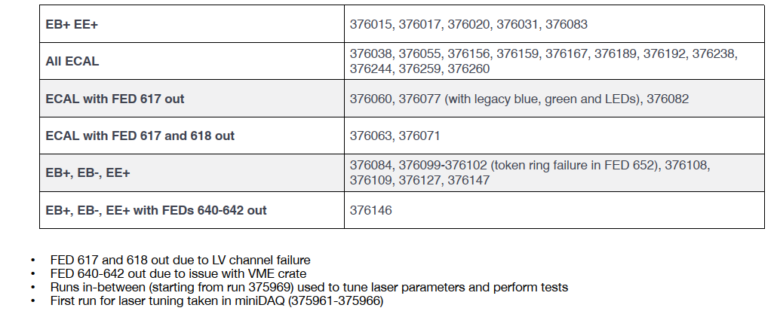
Laser relocation: runs
Global runs summary

Slide 16
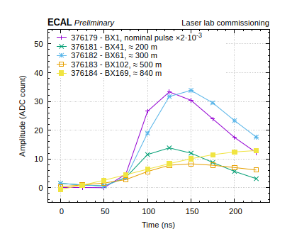
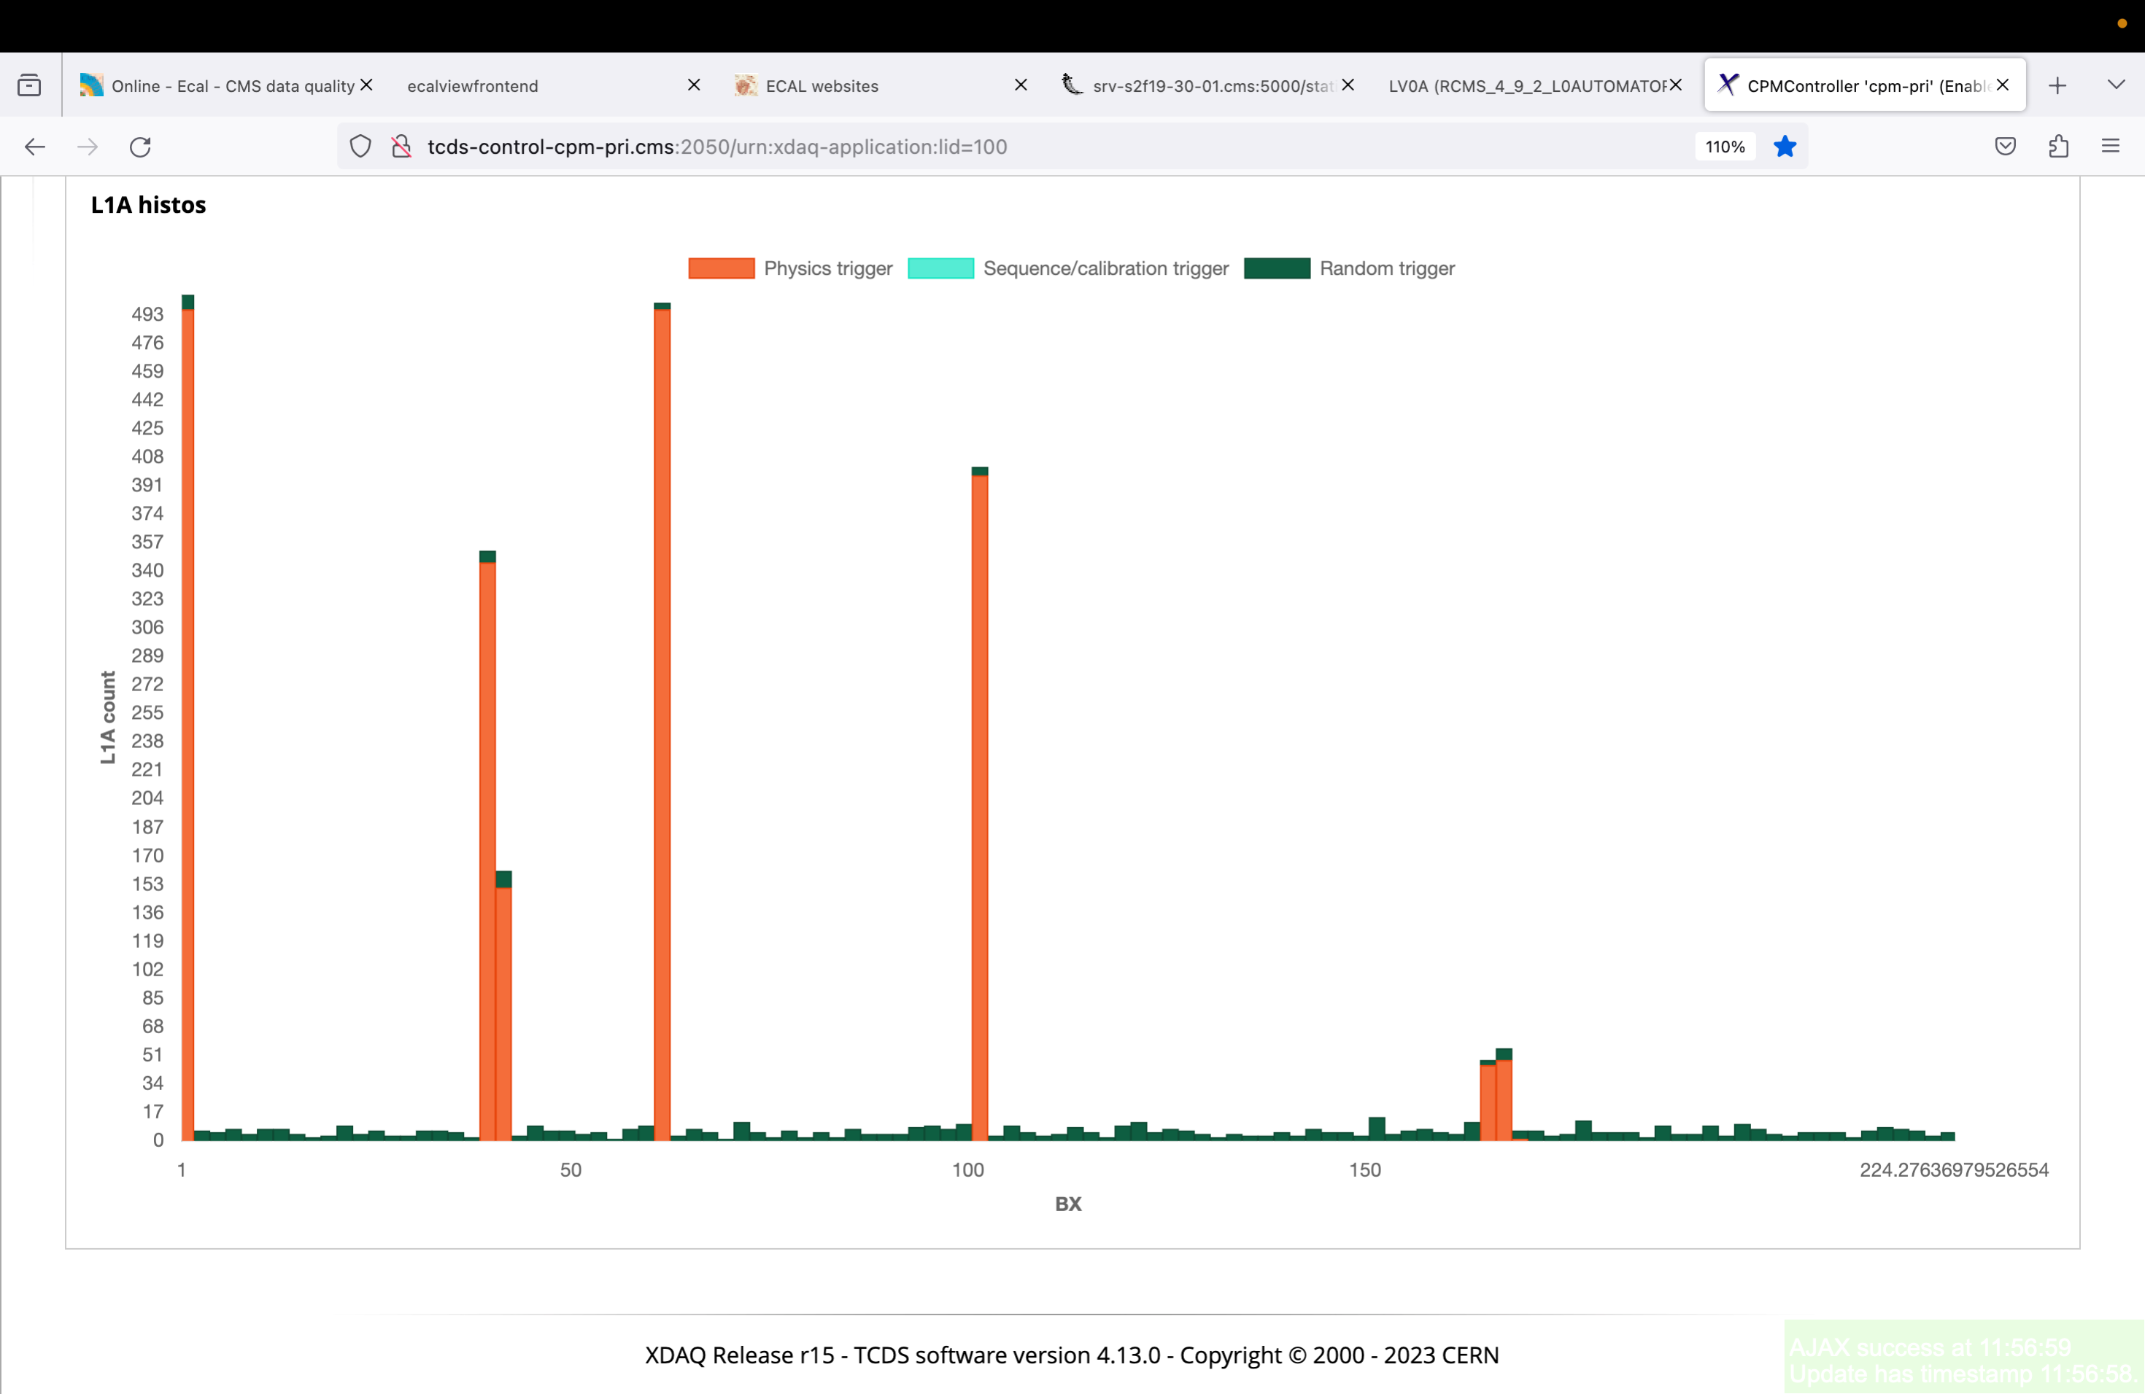
Laser relocation: pulse reflection
Observed laser reﬂection while testing the lasers at maximum power with trigger in !
Dedicated tests performed to further investigate the issue:
• Set laser delay to see the main pulse on BX=1
• Observing both blue and green lasers shooting in physics also in BXs 40-41, 62, 102, 165-169
• Checked the amplitude of each component with DQM
From Federico Ferri

Slide 17
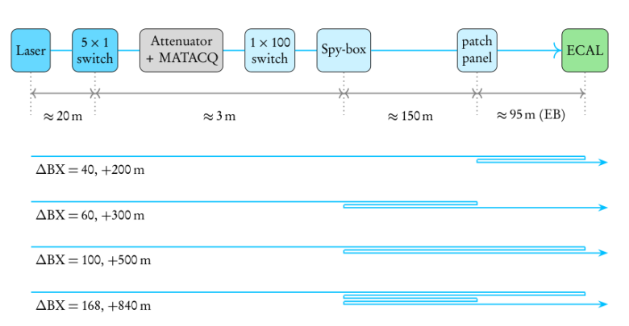
Laser relocation: pulse reflection
Further tests performed adding 21m-long ﬁbre in diﬀerent points of the laser path for EB-01
• When the additional ﬁbre is added after the 1x100 switch to only 1 LM of EB-01 we can see the laser shooting in BXs: 1, 37, 41, 58,
62, 100, 165-169 (double peak around BX 40 and 60 due to diﬀerent path for the LM regions of the same SM)
• When ﬁbres are added to both LMs of EB-01 the laser shoots in BXs: 1, 41, 62, 165-159.
• Adding the two ﬁbres after the patch panel the laser shoots in BXs: 1, 41, 50, 62, 165-159
• Adding the ﬁbre before the 1x100 switch doesn't cause diﬀerences wrt previous test

Slide 18
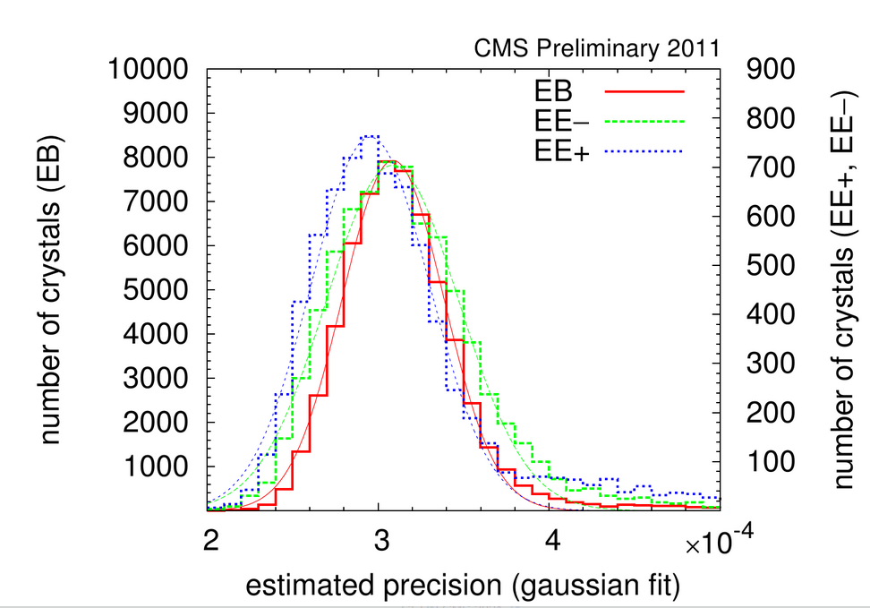
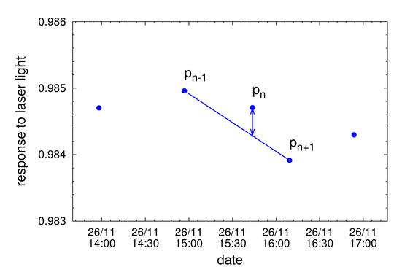
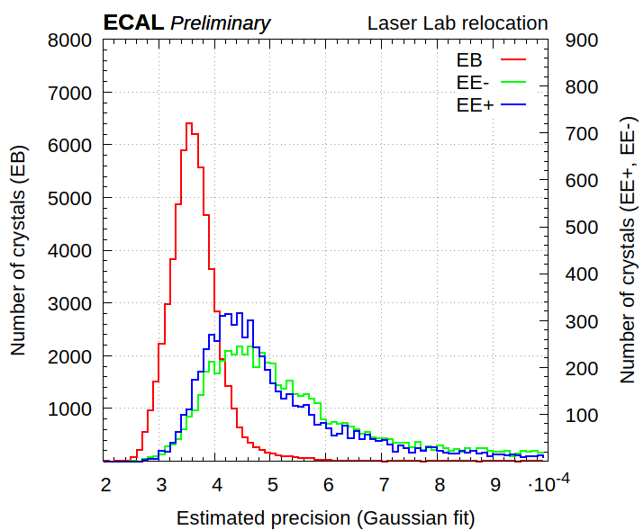
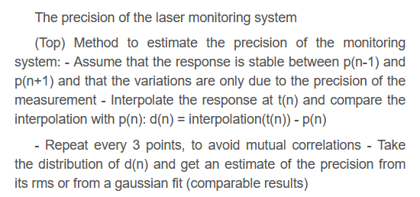
Laser relocation: measurement precision
From Federico Ferri

Slide 19
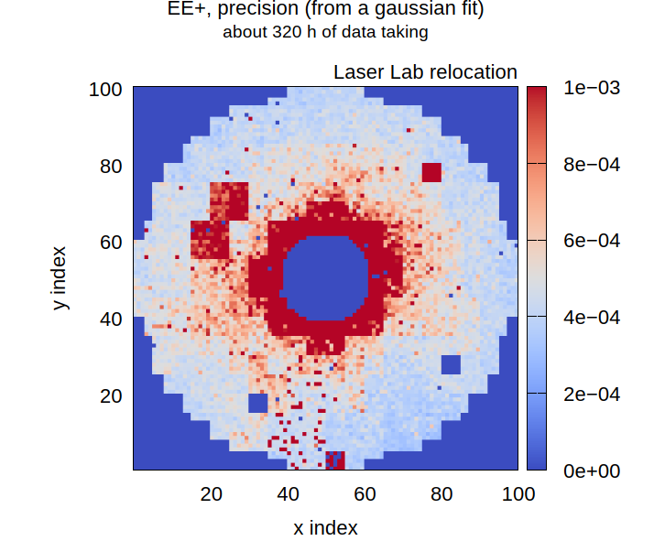
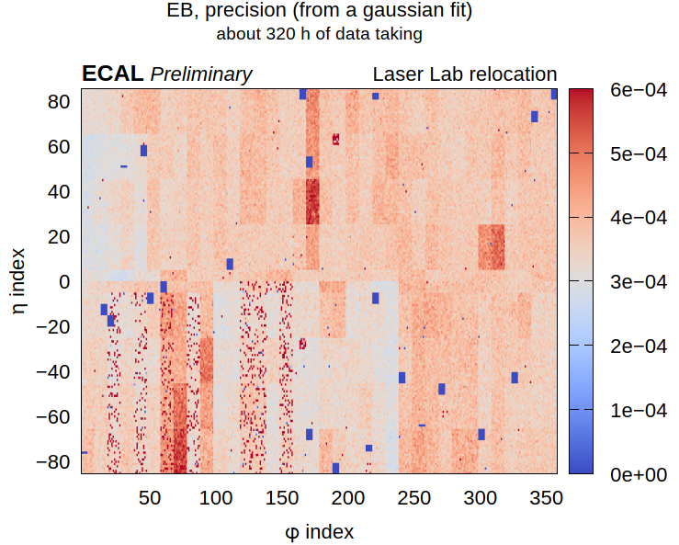
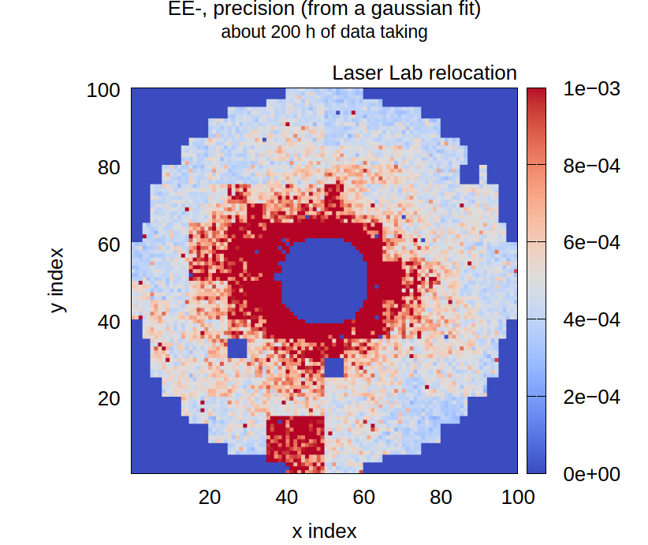
Laser relocation: measurement precision
From Federico Ferri

Slide 20
New green laser
Started test from end August after the LHC restart:
- Test the modified laser program including the green laser (the legacy one is not control in the same way)
- Test several configuration to face the 600µs delay of this laser:
We receive the signal WTE from TCD only 107µs in advance !
=> Solution : advance the trigger by one calibration trigger cycle minus 600µs
- Issue with laser frequency: due to the huge delay on generator box we had only 50Hz of events. Solve by using a chain of 2 digital generators.
Problem issue :
even with the good delay found, some post pulses are always on physics, at around 1Hz (no continuous calibration trigger)
Blue and new green on 15 October

Slide 21
New green laser
Raison and solution:
As the laser flashes one cycle late, we have one more pulse that generate a L1A Physics (the cycle can be paused, while L1A is still enabled)
=> Send the Warning Test Enable ( B-G0 command) in advance. There is no issue on TCDS side but need agreement as WTE is common to all subdetectors. Test could be done in February.
All lasers will be impacted. EMTC firmware to be adapted.

Slide 22
Conclusion
The laser relocation was a success . The place is free for the cooling project.
no delay according to the proposal schedule, no issue during the move
Thanks to Jean, Marta ,Federico, Giacomo and Stefano!
Next steps:
For the HVAC we request to decouple the temperature of the 2 rooms. Otherwise, one variation in one room generates variation in the second room.
Green laser work: need to get the trigger modification and test with TCDS team and with ECAL (29 January to 7 February)
Need to study the reflection effect we observed using high power. Reflection that appears on physic events and thus could be an issue in a close future.

Slide 23
Back up

Slide 24
Test to be done with Nye gel on FC/FC coupling, already on hand.

Slide 25
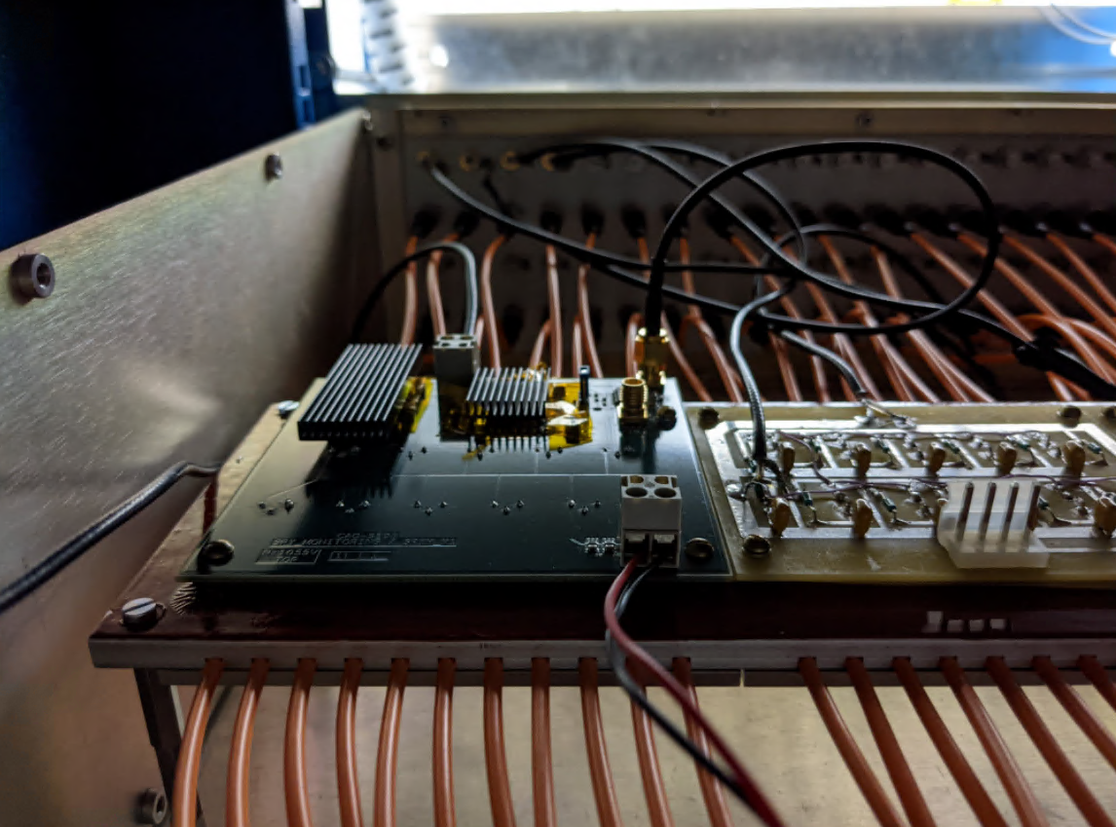
«Spybox», 2014

