Slide 1
Laser status July 2021
Green Laser:
Power amplitude in April: around 750 ADC counts.
Power amplitude in June: < 200 ADC counts.

Slide 2
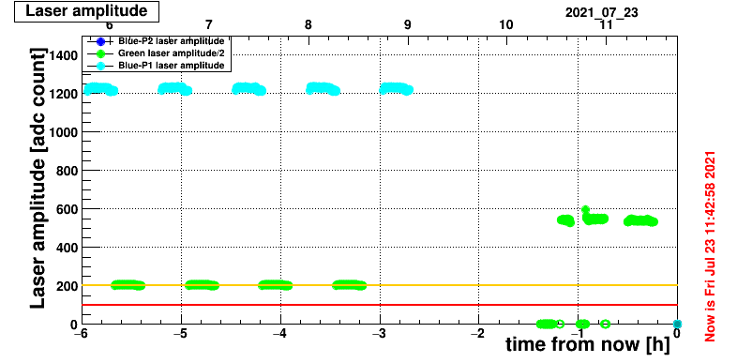
Laser status July 2021
Green Laser investigation:
Check the fibre coupling. Low power but no reference (never measured)
With full green power (I=255):
Power internal trigger mode direct output of the laser : P= 16mW
P after coupling fibre+10m fibre : P= 5mW
I Loss = 5dB
Power with external trigger mode , direct output : P=1.7mW
re-adjust NIM_DELAY: 7901 to 7893 (100ns)
3) Replace the laser controller
P(internal trigger mode) P= 83 mW
P(external trigger mode) P= 9mW
P after main coupling, P=37 mW.
I Loss = 3.5dB
NIM_DELAY can be fine tune by 12.5ns : 7885 to 7886
2) Replace the laser head with the old one from 2018 (laser replacement in 2018 because of faulty controller)
P(internal mode, direct output) P= 50mW
P(external trigger mode) P = 8mW
P after main coupling, P=21 mW.
I Loss = 3.5dB
Adjust NIM_DELAY for the timing : -200ns from fast monitoring so NIM_DELAY should be reduced from 7901 to 7885.
Pulse on the matacq better but still too low

Slide 3
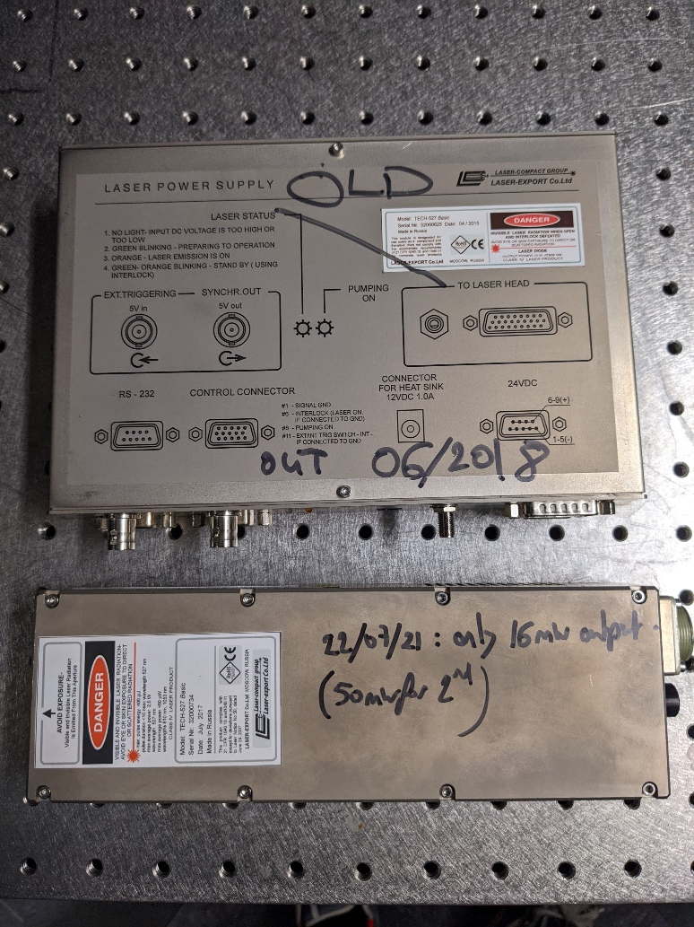
Laser status July 2021
Green Laser:
- Laser head replaced by the one in used from the beginning, before 2018 (this could explain the power lower than before)
- New laser controller. The 2nd one after 2018.

Slide 4
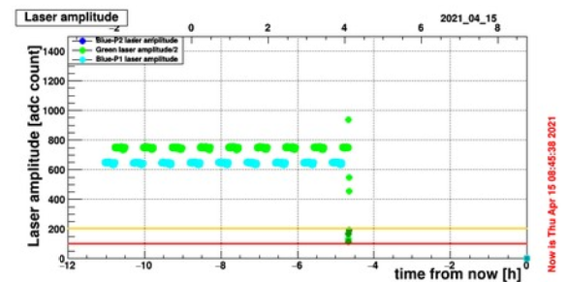
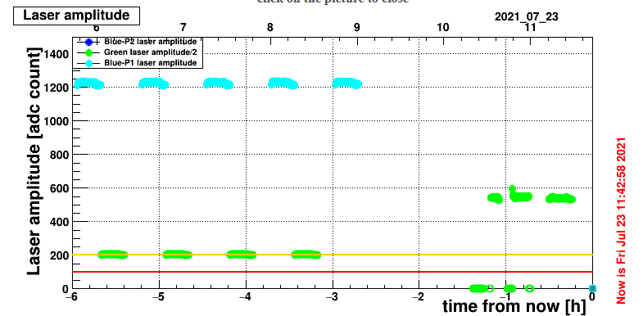
Laser status July 2021
Blue Laser DP2-2:
In APRIL
In July after the maintenance in May
In April: 35A and 50% internal attenuation instead of 35 % . That’s why maintenance was needed.
In July: 35A and 35% internal attenuation.
The remote attenuator has been changed on dBGUI to reduce the EB power : 9 to 6%
Ps: In June it was still the test with long fibre TTCci so not the same configuration

