Slide 1
Study of radiation damage and possible upgrade of the CMS ECAL Laser Monitoring system
Yana Savchenko
Novosibirsk State University
On behalf of the CMS Collaboration
Trans-Siberian school on High Energy Physics

Slide 2
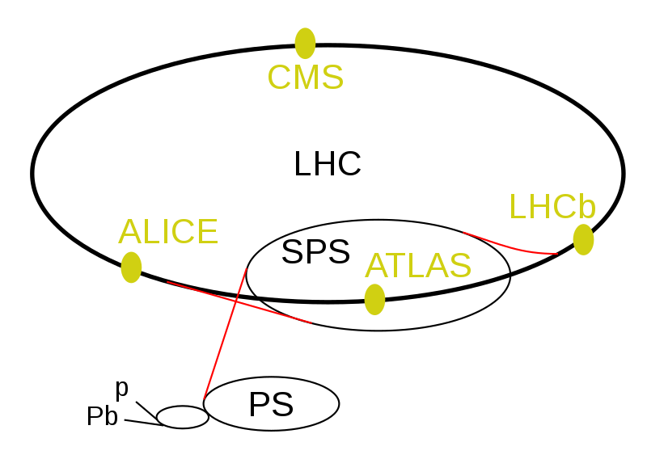
Large Hadron Collider
Large Hadron Collider (LHC) is the world’s largest (27 km in circumference) and highest-energy particle collider
Collides protons (mainly) and heavy ions (one month per year)
The design luminosity of LHC is 10³⁴ cm⁻²s⁻¹
LHC has 4 main detectors:
A Toroidal LHC Apparatus (ATLAS)
Compact Muon Solenoid (CMS)
LHC-beauty (LHCb)
A Large Ion Collider Experiment (ALICE)

Slide 3
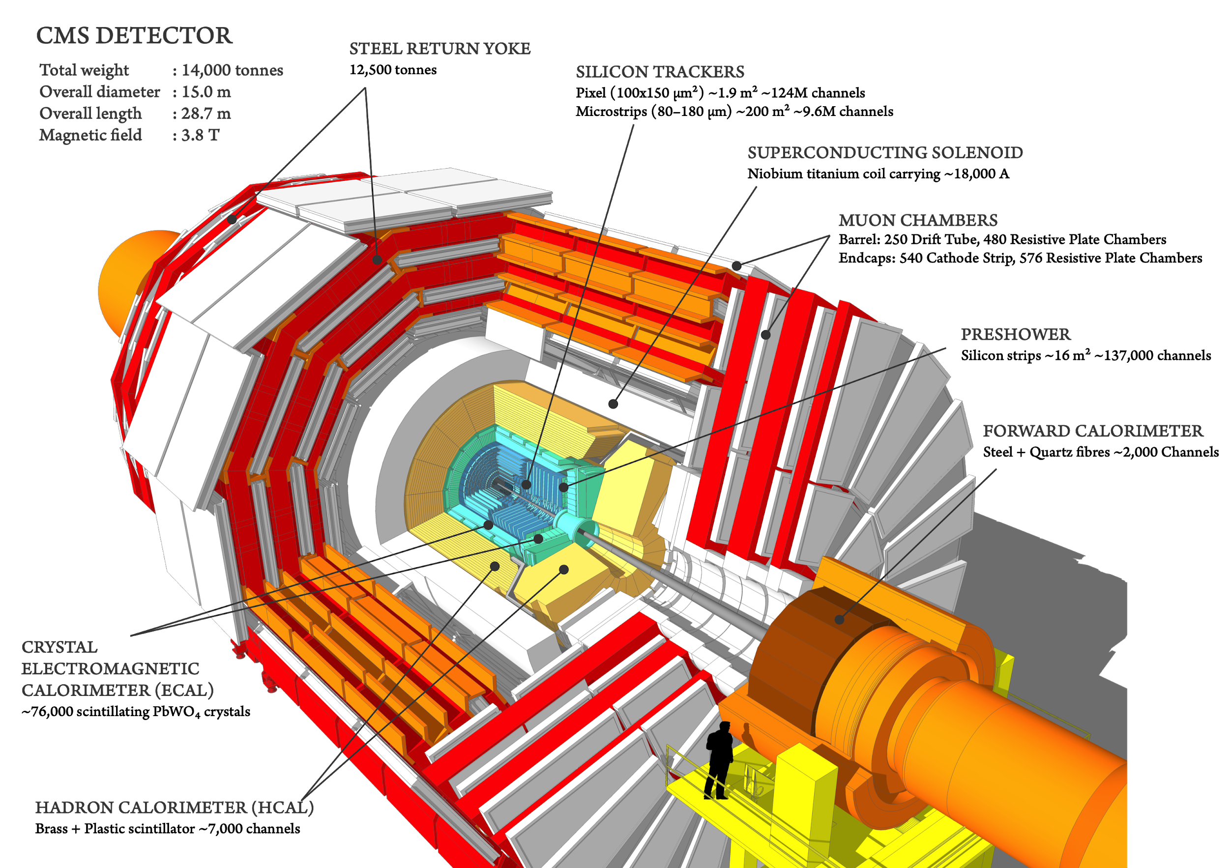
The CMS Detector

Slide 4
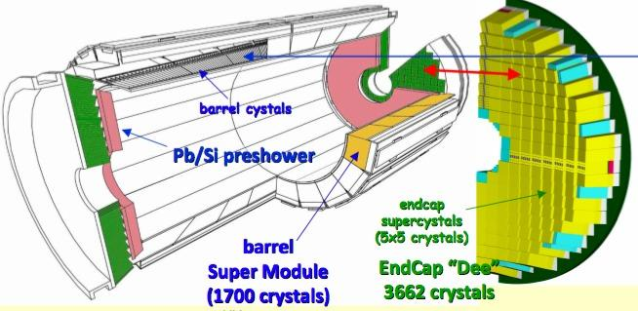
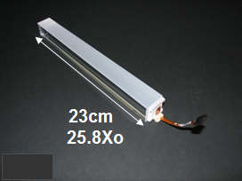
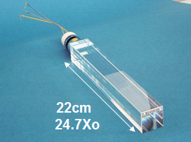
The CMS Electromagnetic calorimeter
Tapered crystals to provide off-pointing of ~ 3º from vertex
PbWO₄ crystals
Barrel crystal, tapered 34 types, 2.6x2.6 cm² at rear
Endcap crystal, tapered 1 type, 3x3 cm² at rear

Slide 5
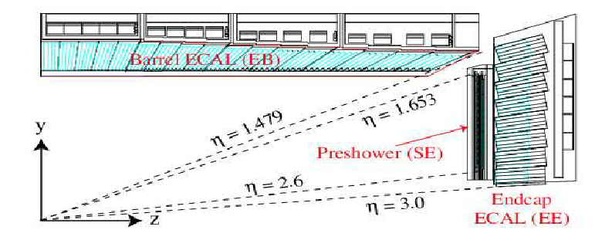
The CMS Electromagnetic calorimeter
Tapered crystals to provide off-pointing of ~ 3º from vertex
Barrel 36 Supermodules
(18 per half barrel) 61200 crystals Total crystal mass 67.4t |η| < 1.48, ~26X₀
Δη x Δϕ = 0.0174 x 0.0174
Endcaps 4 Dees (2 per endcap) 14648 crystals Total crystal mass 22.9t 1.48< |η| < 3, ~25X₀
Δη x Δϕ = 0.0175² ↔ 0.05²
Endcap Preshower Pb (2X_{o},1X_{o}) / Si 4 Dees (2 per endcap) 4300 Si strips 1.8mm x 63mm 1.65< |η| < 2.6

Slide 6
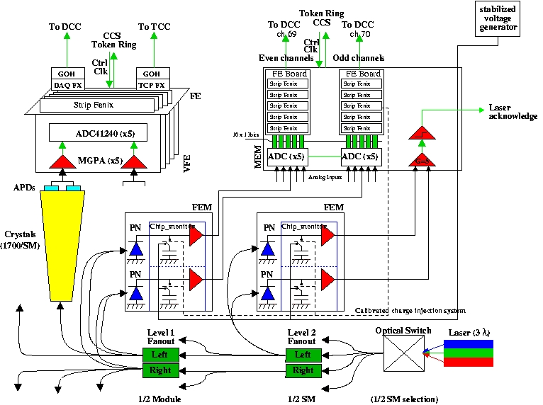
Laser Monitoring system
2 lasers are used: blue (447 nm) and green (527 nm)
Laser light is injected in each crystal every ~ 40 minutes
One half of SM is illuminated at a time (800/900 xtals)
PN-diodes are used as reference system
APD (VPT) signals are compared to PN reference

Slide 7
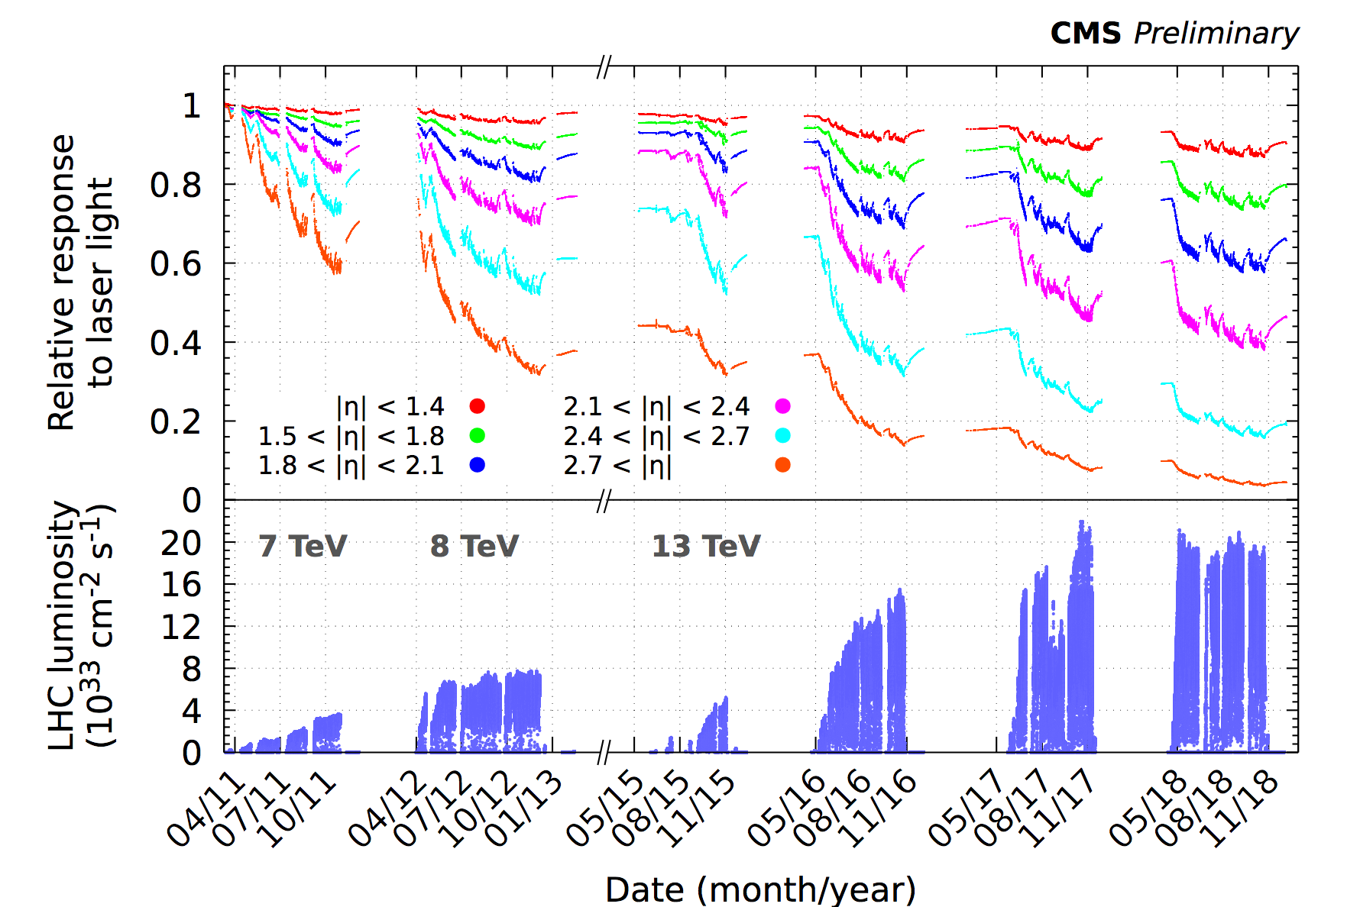
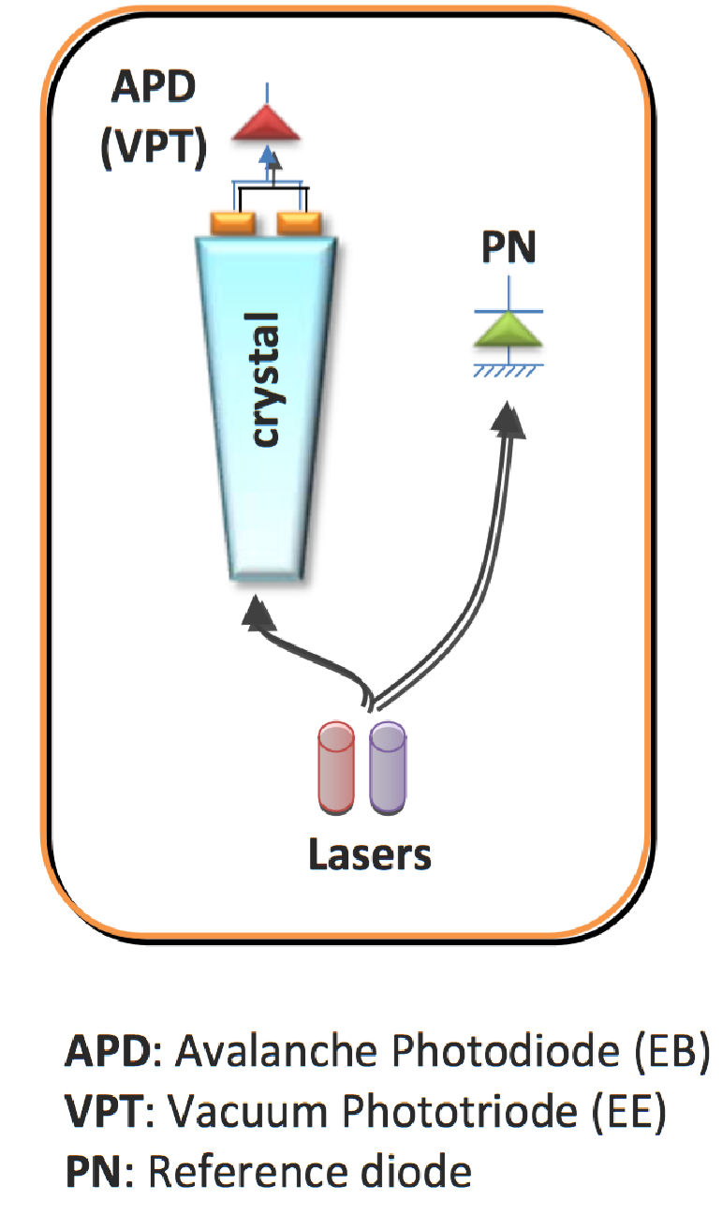
Transparency evolution of crystals
Barrel: the response change is up to 10%, Endcaps: reaches up to 50% at η ~ 2.5 and up to 90% in the region closest to the beam pipe
There is the recovery of the crystal response during the period without collisions
Current precision in transparency measurements is 0.2%
Response is monitored with the laser system injecting light in each crystal

Slide 8
HL-LHC upgrade
HL-LHC: collider upgrade in LS3 to increase the integrated luminosity of the LHC
 | inst. lumi (cm⁻²s⁻¹) | peak pileup | integr. lumi (fb⁻¹/yr)
2018 | 1.7x10³⁴ | 50 | 40-50
HL-LHC (baseline) | 5x10³⁴ | 140 | 250
HL-LHC (stretch goal) | 7.5x10³⁴ | 200 | 300
The required precision for Phase-2 is 1% due to a significant difference in luminosity and the possibility of calibration on physical events

Slide 9
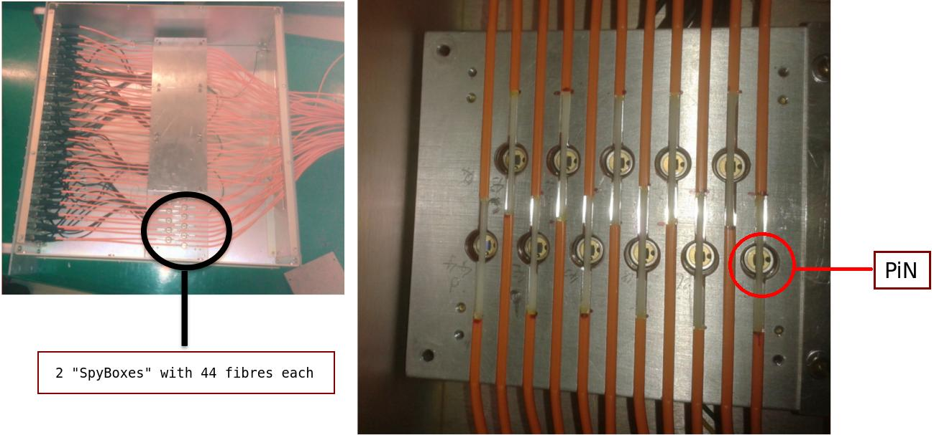
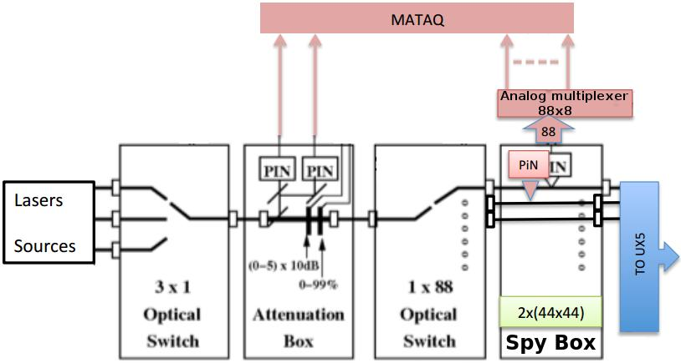
Proposed upgrade of the LM system
HL-LHC upgrade will lead to higher radiation damage in all the components of the CMS detector
The proposed upgrade for the LM system (not a baseline, needs final approval):
Measuring the injected light at the source rather than with PN diodes in supermodules
Put spy PiN diodes on master fibers after optical switch
The ageing of the light distribution system itself will no longer be included in the measurement

Slide 10
Proposed upgrade of the LM system
There are 2 SpyBoxes, each with 44 fibers going to SMs and Dees
Only 11 are equipped with PiN diodes at the moment
The new system has operated parallel to the legacy system since Run-2
Study of the prototype for the LM system is ongoing

Slide 11
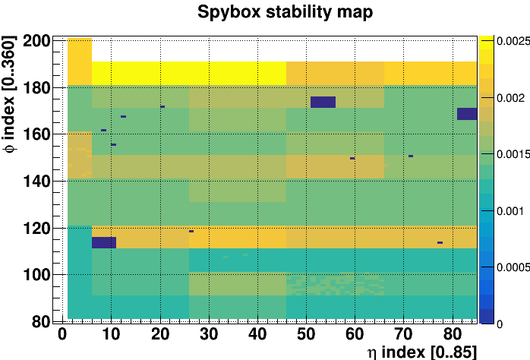
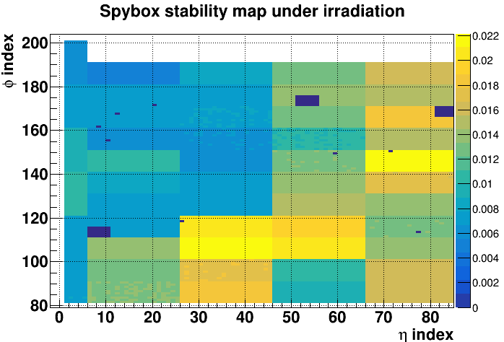
Prototype monitoring test results
Legacy system uses APD/PN ratio to compute crystal transparency, while the prototype system uses APD/PiN
For consistency between these systems, the PN/PiN ratio should be stable
To test the prototype LM system, the comparison of APD/PiN ratio (computed with PiN diodes) and APD/PN ratio (computed using legacy LM system) were performed using the 2016 data:
in LHC beam-off periods, using 10 days of data (left plot)
during LHC beam on periods, using the whole 2016 period (right plot)
Stability is around 0.1-0.2% (similar to the performance of legacy system)
RMS of the (APD/PiN)/(APD/PN) ratio
RMS spread is 1-2%

Slide 12
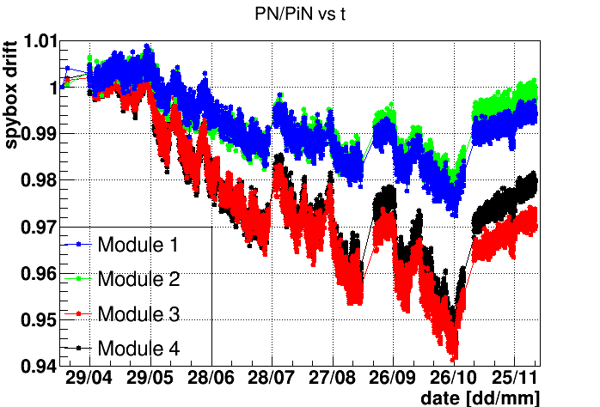
Prototype monitoring test results
The ratio of PN/PiN is sensitive to differential ageing of the fibers. This effect is absent in the legacy system since both APD and PN photodetectors are located at the same place in the supermodule
There is a drift of the PN/PiN ratio versus time correlated with the instantaneous luminosity of the LHC
Because of this drift, the PN signal cannot simply be replaced by the PiN signal

Slide 13
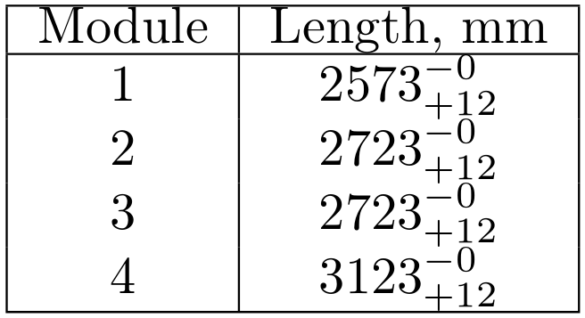
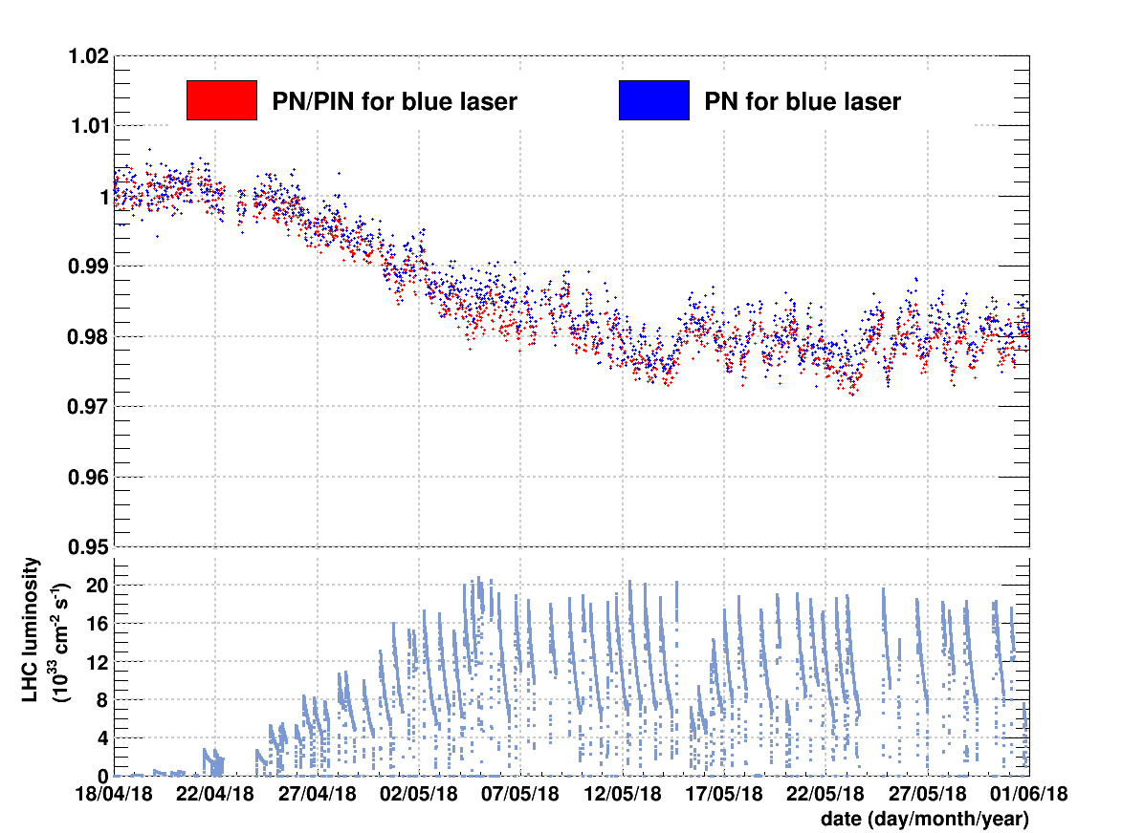
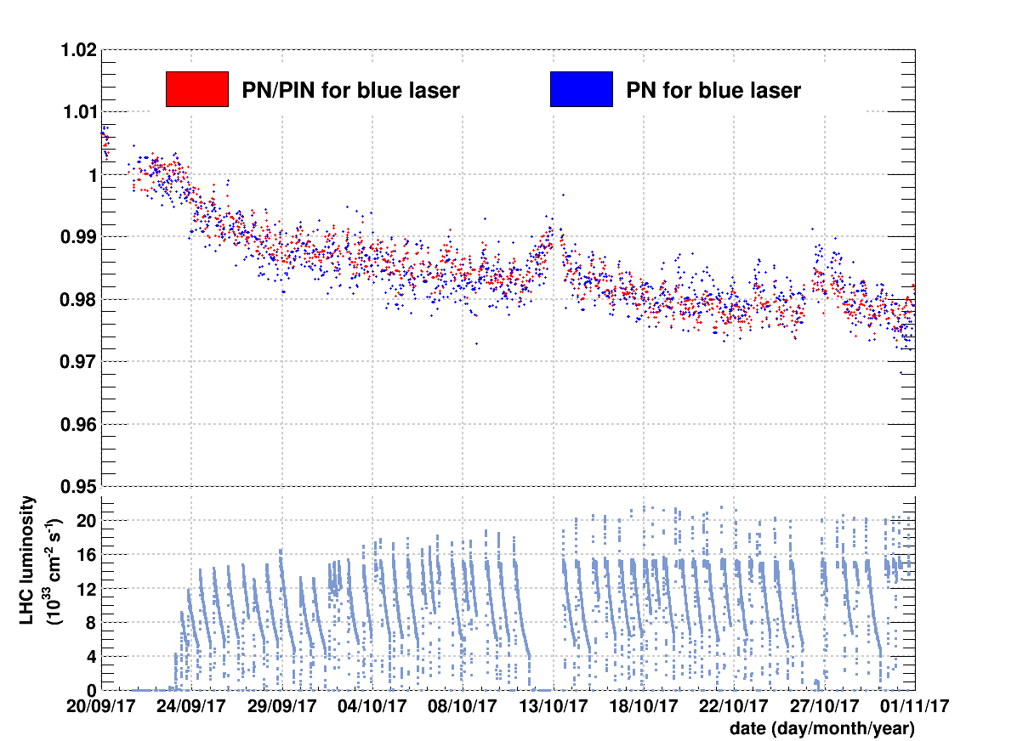
Prototype monitoring test results
Ways to account for the drift of PN/PiN ratio with time
Normalize crystal transparency to a reference crystal (APD/APD_{ref} )
Normalize crystal transparency to a reference crystal within one monitoring region
Intercalibrate different monitoring regions (72 for EB) using physics events
Provide corrections over short periods of time
PN/PiN signal is reduced by 1% in a couple of days at the beginning of LHC Luminosity and in about 2 weeks at L≈2x10³⁴ cm⁻²s⁻¹ (see lower plots)
The difference between PN/PiN and PN is less than 1% for most of the intervals
PN signal can be replaced by PiN signal over short periods of 1 to 2 weeks
Any residual drifts over this time period can be corrected by calibration with physics events
Simulate differential loss between fibers and correct for it
Get parameters for the model reducing the discrepancy between PN and PiN signal
Check the performance on the different dataset

Slide 14
Conclusions
The CMS ECAL has efficiently operated during LHC Run-1 and Run-2
Laser Monitoring system is very stable
Further study to meet the designed precision with the SpyBox is ongoing. Possible actions with the SpyBox data:
Provide corrections over short periods of 1 to 2 weeks
Differential loss between fibers can be modelled and corrected for
Normalize crystal transparency to a reference crystal (APD/APD_{ref})
The excellent ECAL performance was crucial for the Higgs boson discovery made by CMS and remains very important for precision measurements and for searches of new physics

Slide 15
Backup slides

