Slide 1
Laser maintenance 12-16 August 2019
D.Bailleux
L.Zhang

Slide 2
Laser maintenance
Aim:
1. replace the diodes of DP2-1.
No degradation observed but long operating time (35khr) since 2013 !
Need reliable spare laser for the next 4 years
(Even if laser is not online, as a spare, the current is set to 35A)
2. Regular issue with water flow/dust. To be solved.

Slide 3
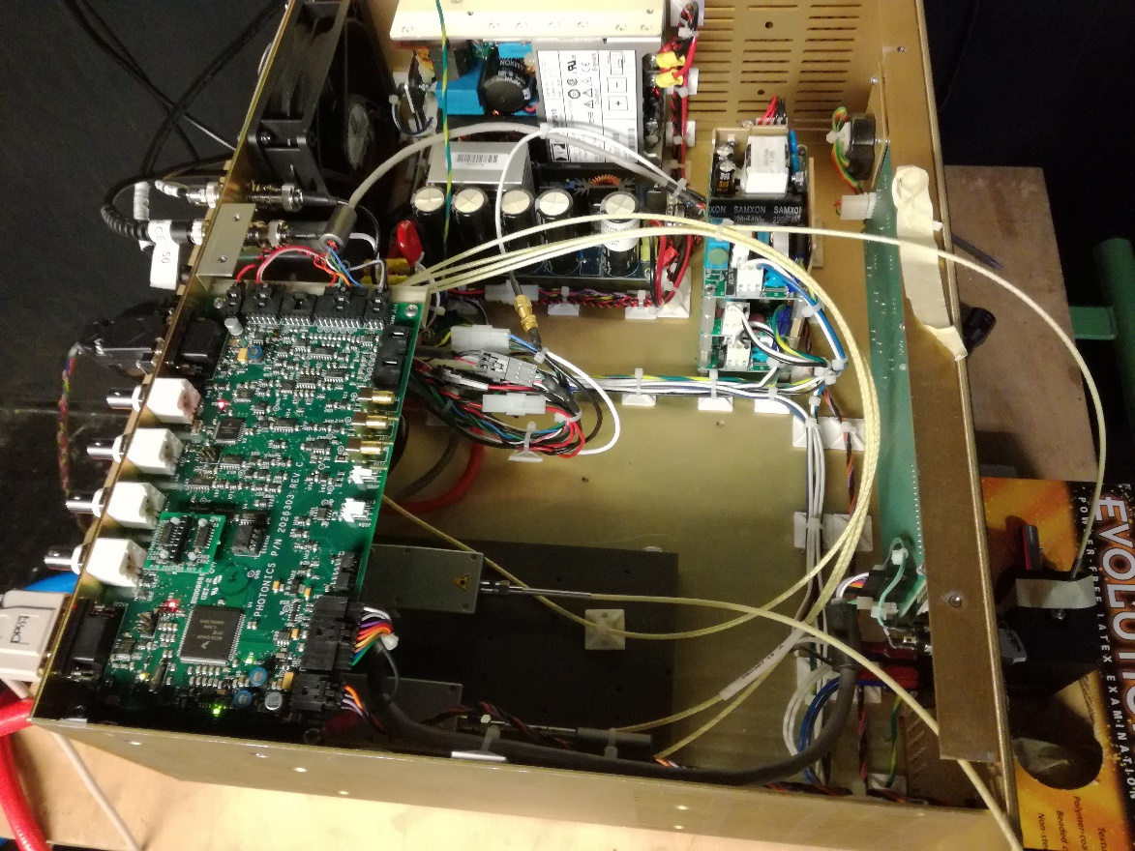
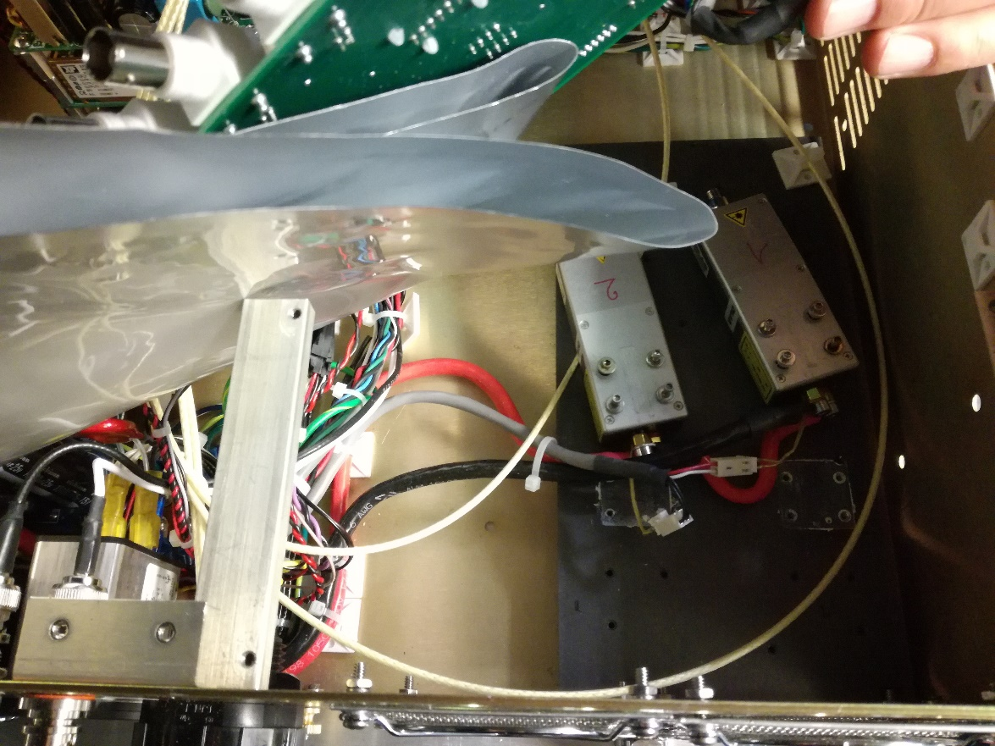
Laser maintenance
Operating procedure:
DP2-1 power measurement, calibration
Opening the laser controller
Diodes measurement : power and wavelength for each diodes
Diodes replacement
Repeat step 3.
Repeat step 1.

Slide 4
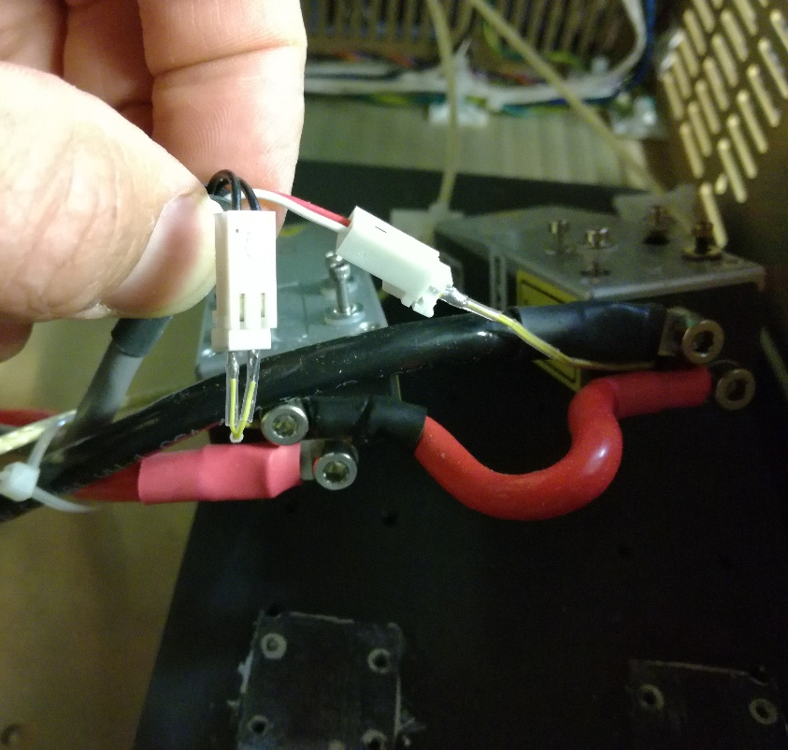
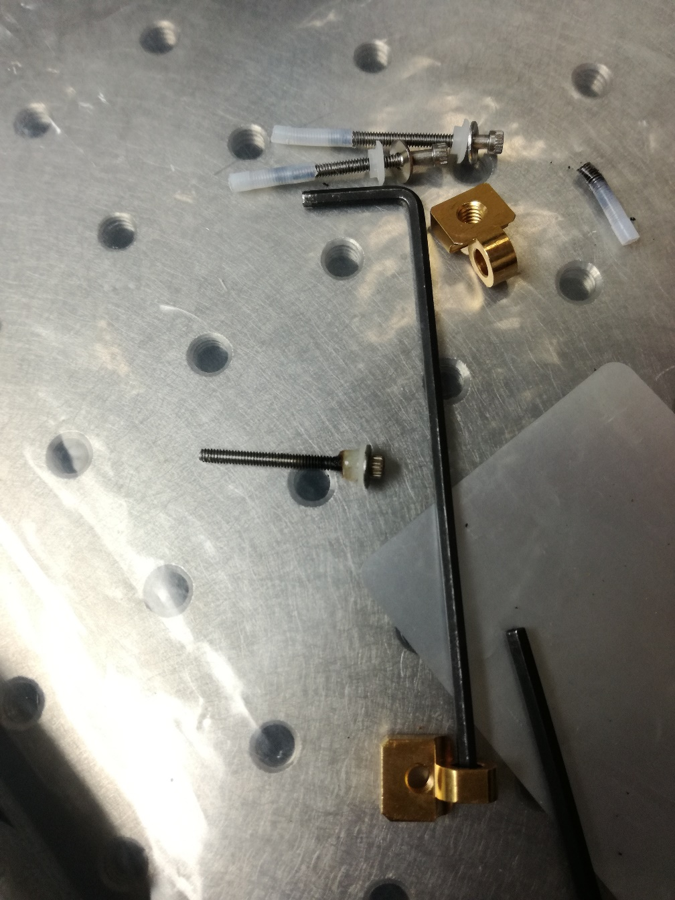
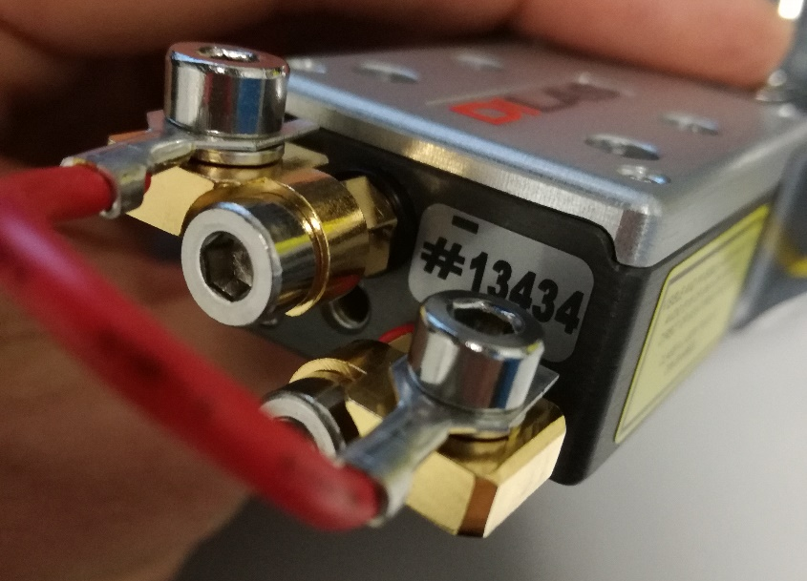
Laser maintenance
Diodes replacement:
Install new temperature sensors on the new diodes
Use the same plastic insulation for the screws
Put the thermal grease
Check the electrical insulation
Found 2-3 screws with hot stop
-> washer in plastic melted .

Slide 5
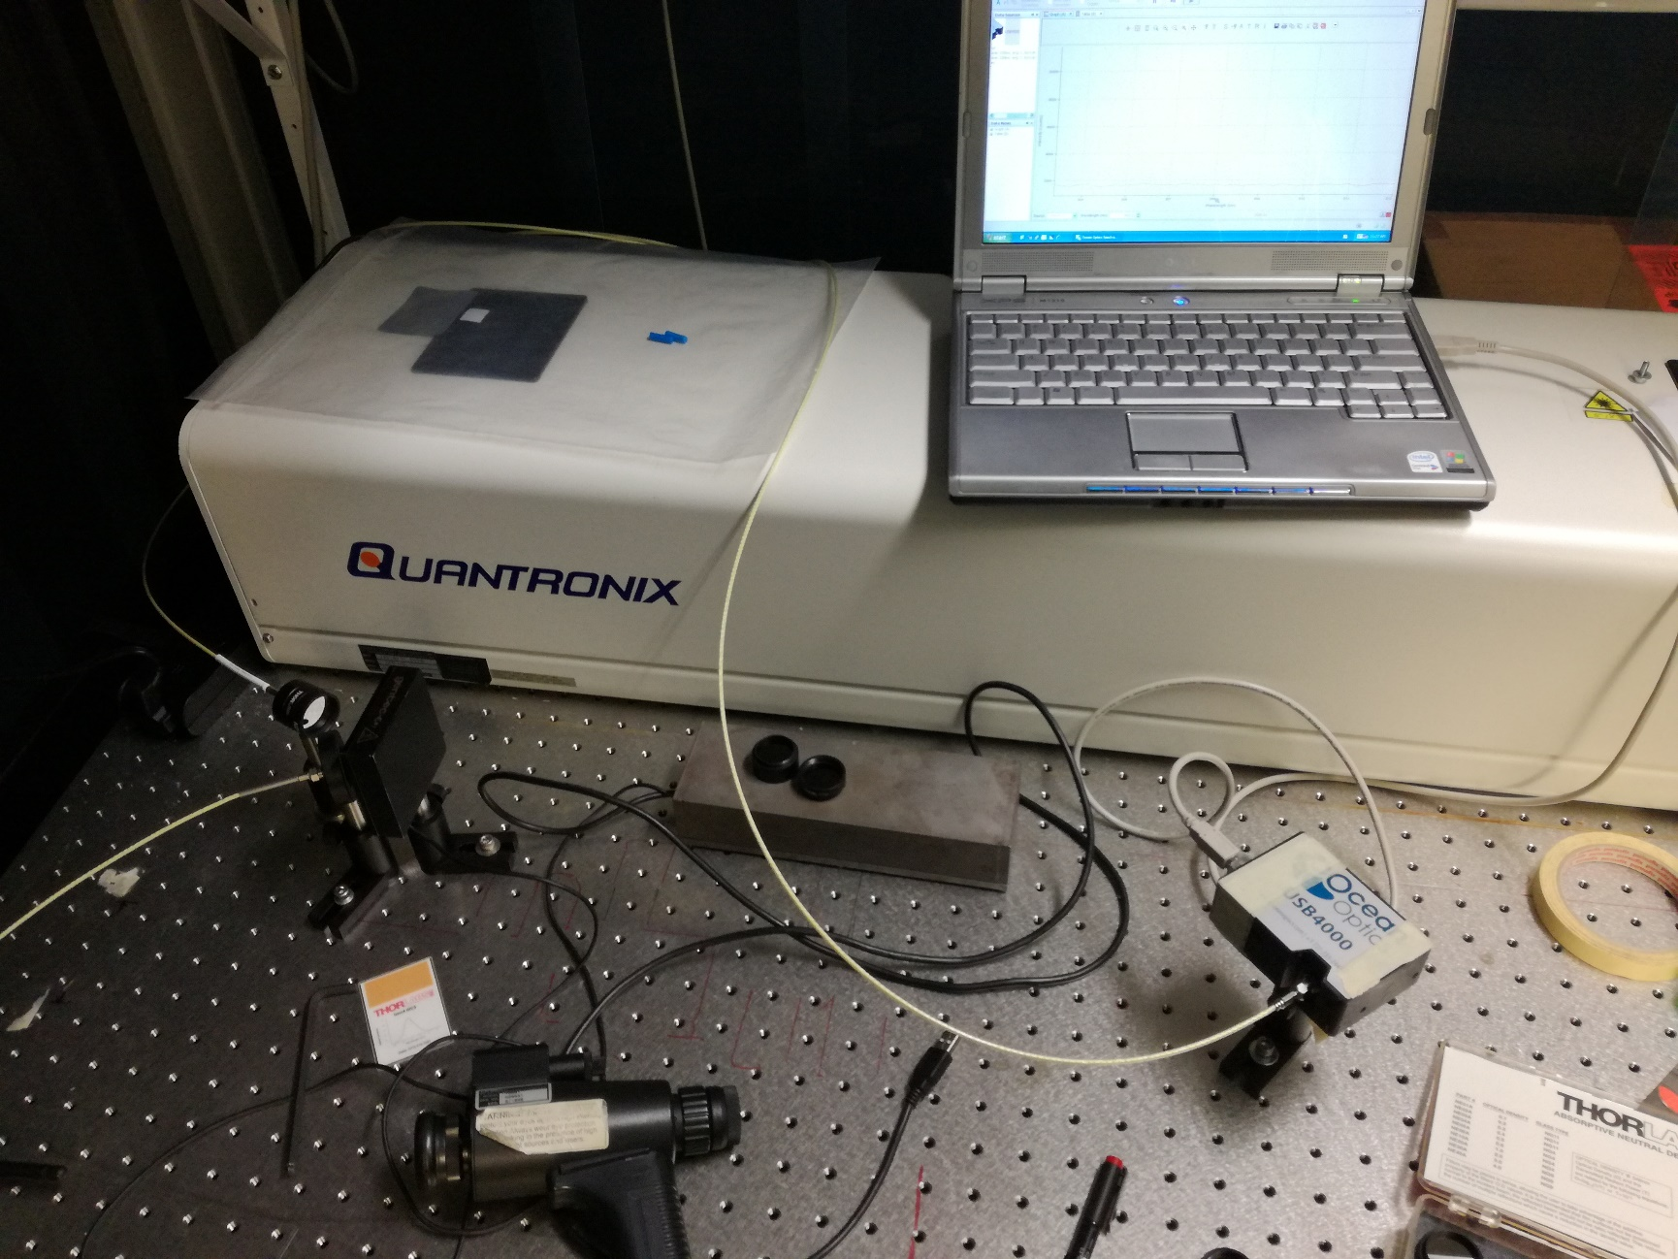
Laser maintenance
Setup for power and wavelength diodes measurement.
Use beam dump for the fibre disconnected from the diode (back reflection from 1st diode)

Slide 6
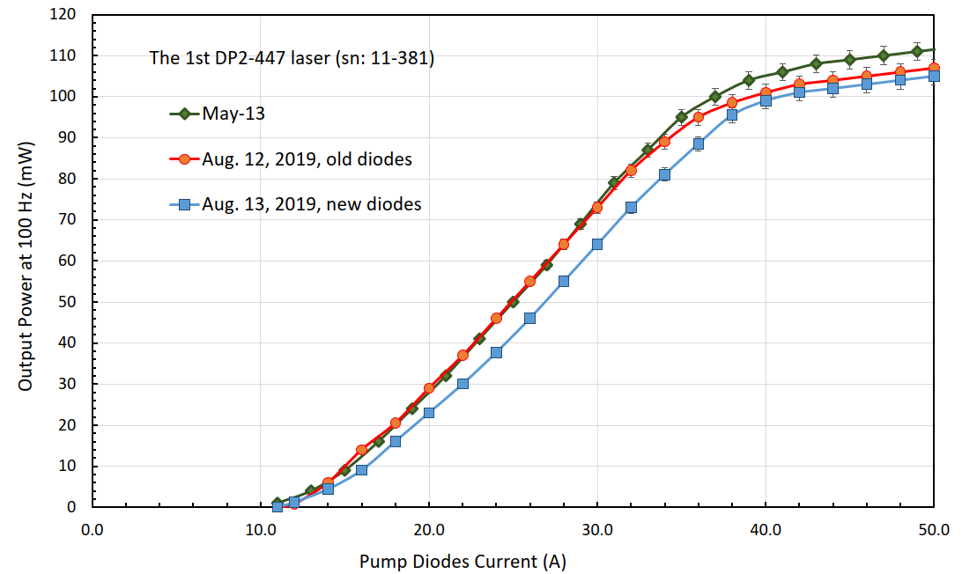
Laser maintenance
Measurement result:
1. Diodes power are lower than the old one: one ~10% and other 5% lower
2. Both new diodes have a peak of about 806 nm at 50 A, which is about 2 nm shorter than that of old diodes.
3. The output BLUE power with the new diodes mounted is lower than before.
Next step:
Optimize the pump diodes temperature, SHG temperature and THG temperature.
⇨ Photonics contacted.

Slide 7
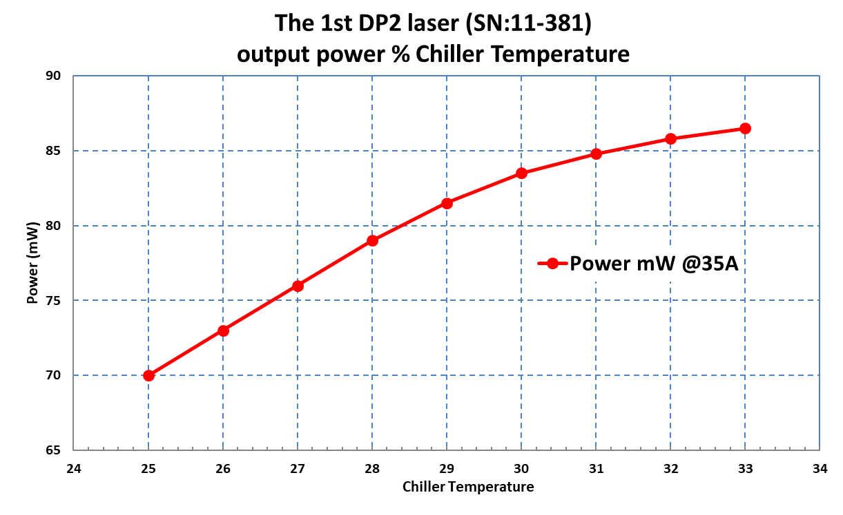
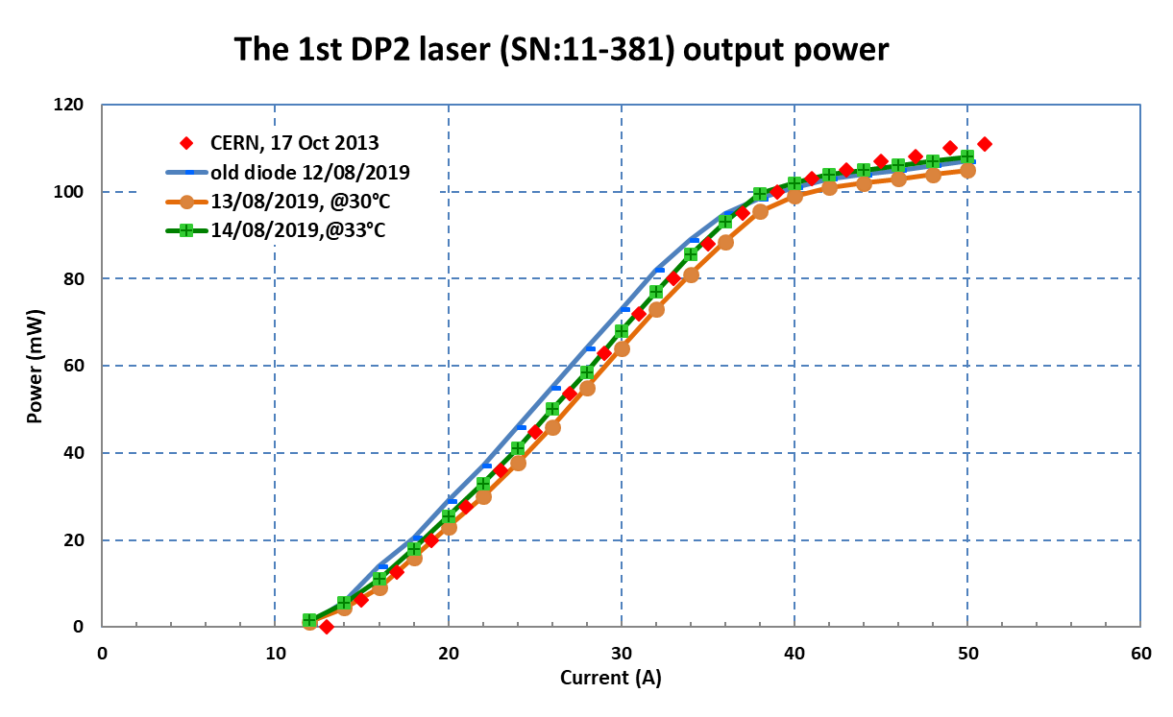
Laser maintenance
Photonics advice:
“The older diodes are performing well enough to continue to be used. The difference in power is less than 10% and that may even be recovered through current and temperature adjustments. It is possible that there is some optical damage that could cause a similar drop in power but that cannot be determined without further inspection.
The difference with the newer diodes is explained by the differences in pump wavelength.”

Slide 8
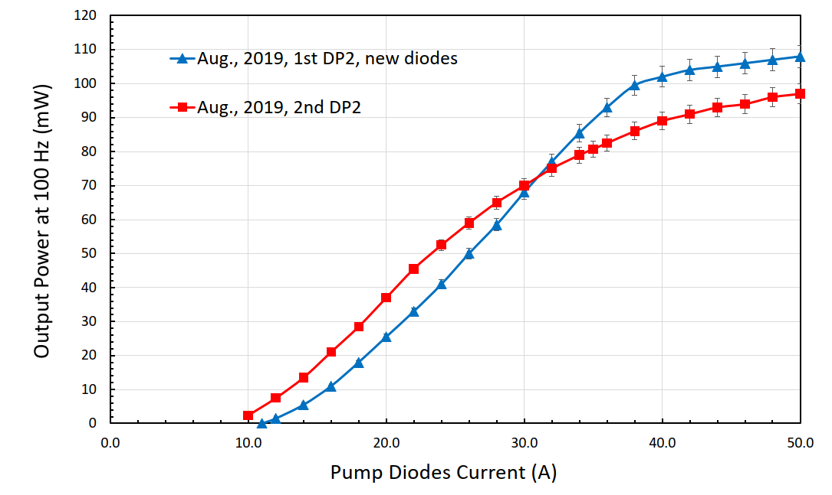
DP2-1 and 2 comparison

Slide 9
Laser maintenance
Issue with the water flow:
This laser suffers from the beginning about drop of the water flow → alarm triggered , laser stopped.
Threshold is 2.6 l/min. We have changed it to 2 L/min . Second laser is the same since the beginning, 2 L/min
From Photonics it is not good to lower it (while in the past they give us instruction how to change it !!!)
Historical :
In 2013: email from Photonics mentioning that the flow should be around 4 L/min.
Oct 2013: low flow: change the water pipes connection from parallel to serial link: flow jump from 2.2 L/min to 4.3 L/min
Sept 2014: flow was 3 L/min
Feb 2015: flow was 2.5 L/min → flushing pipes : 3.4 L/min
Nov 2016: flow was 2.8 L/min → flushing pipes : 3 L/min
Feb 2017: flow was 2.6 L/min → with new pipe with new sensor : 3.2 L/min
April 2018: flow was 2.3 L/min → new pipes with new sensor: 2.8 L/min
Today: flow is 2.7 – 2.8 L/min.

Slide 10
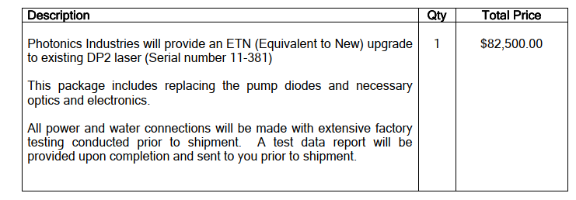
Laser maintenance
Conclusion:
Following our expertise, we are not going to ship the laser for maintenance:
=> No sign of degradation. Photonics suggested to put back the old diodes !
=> Basic inspection is $1000 : no more things than we have done.
=> ETN: Equivalent to New upgrade with warranty: $82’500.
This is good to know for future.
The 2nd DP2-447 laser is measured and found no evident degradation since last year.
4) Since the two swapped diodes are still usable, we can keep them as emergency spare and don’t need to buy new diodes until the 2nd DP2-447 laser shows some significant output loss.
Water flow issue DP2-1:
Opposite statement from Photonics to change the flow rate threshold: instruction how to change it in the past but now they said it is not a good thing.
=> We cut the water pipes to have shorter length. We decrease a bit the threshold.
Questions:
a) Why temperature of the diodes is lower than the chiller ?
For DP2-2, temperatures are the same. It should be equal or at least T.diode higher than the chiller, not colder.
b) We have 2 options to keep the same power:
Running at same current but with Tchiller =33°C
Running at higher current but with same Tchiller=25°C
Ideally need to get the same wavelength for both lasers

