Slide 1
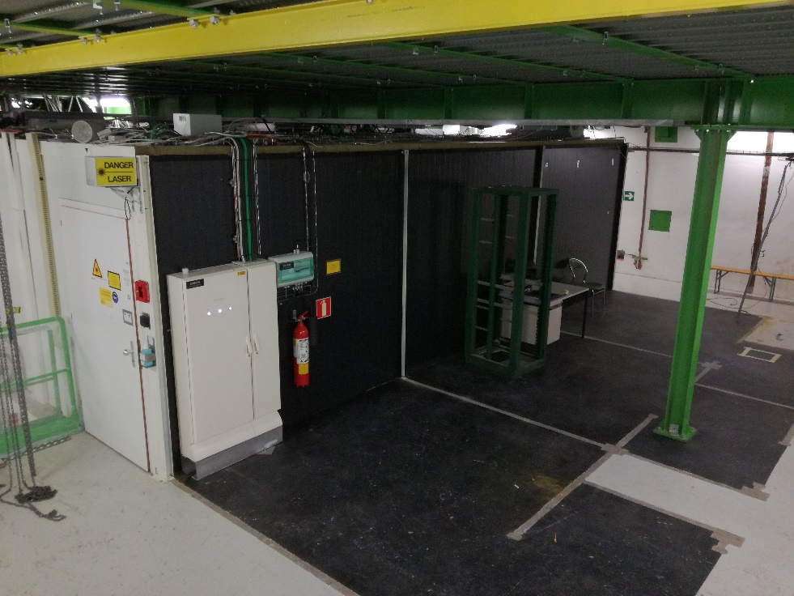
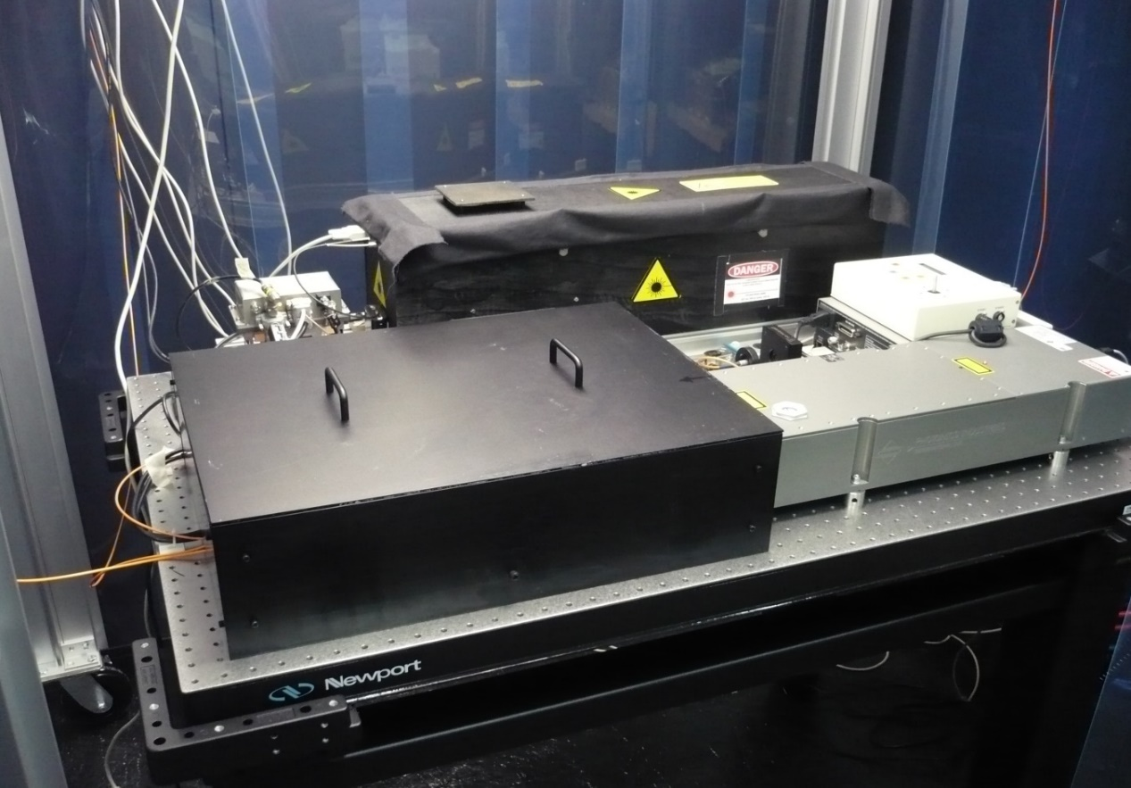
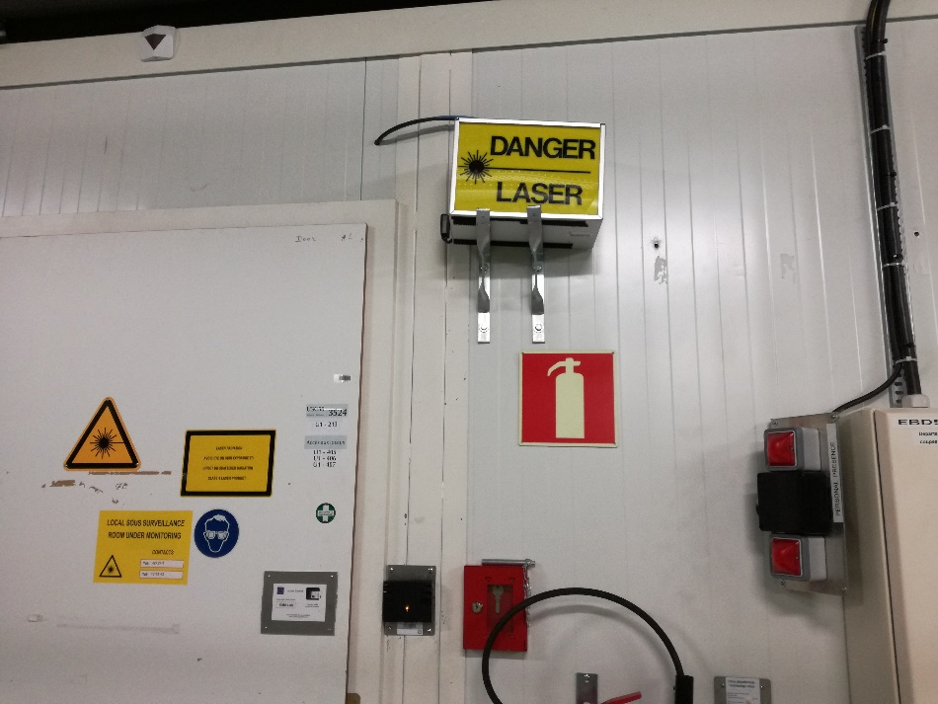
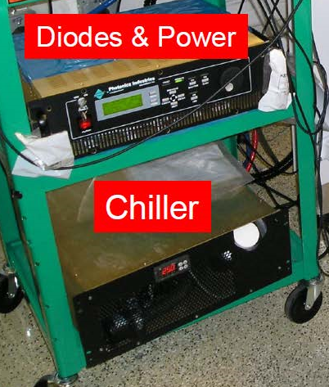
2 BLUE diode lasers
1 GREEN laser
1 RED laser to be ordered during LS2
2nd GREEN as spare
Attenuation controller SHOT102, shutter
Green laser
Shutter + attenuator
DP2-447 blue
1 optical table, 2 lasers

Slide 2
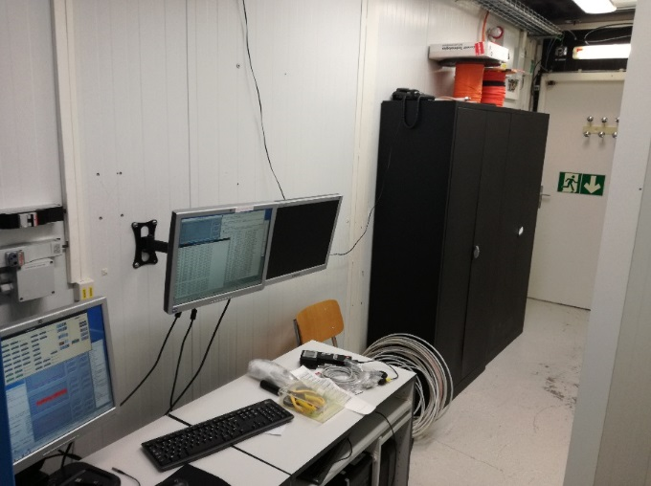
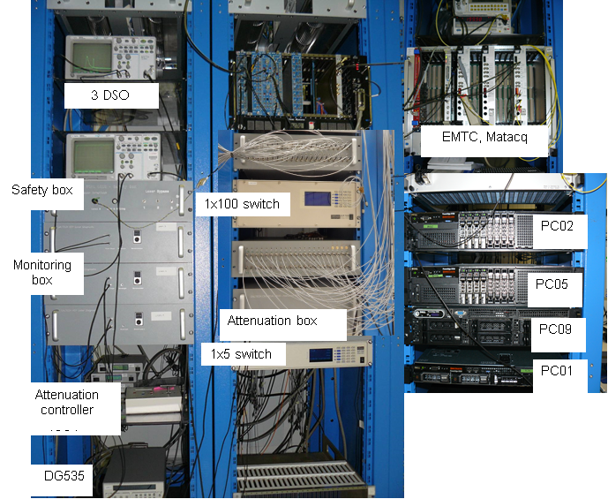
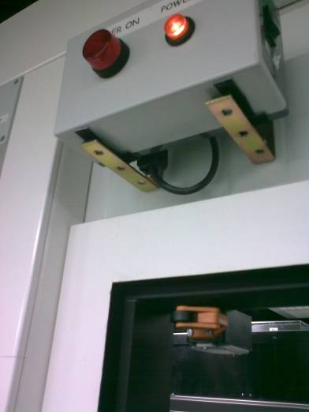
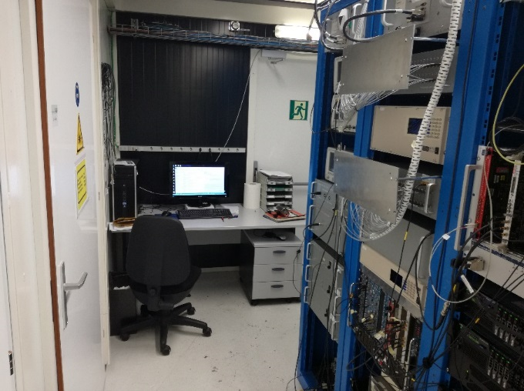

Slide 3
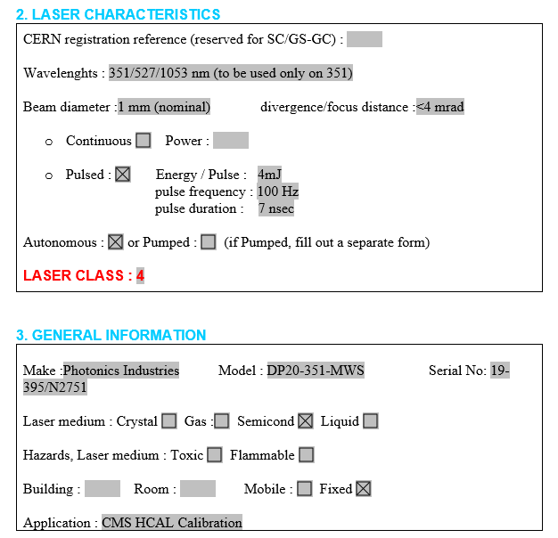
ECAL LASERS
HCAL LASER

Slide 4
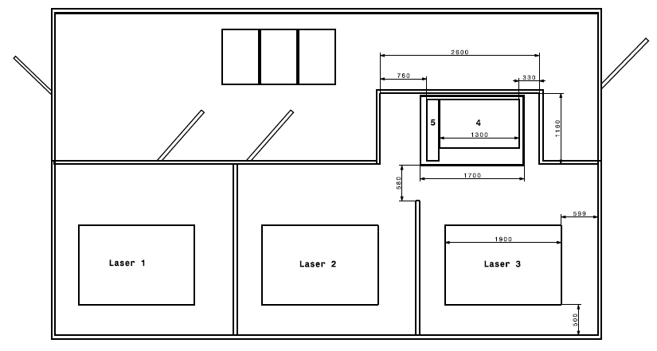
Sign1: automatic ON/OFF control with lasers ON/OFF . ? Laser signal ?
Sign2 : manual ON/OFF operation : inform users in case of maintenance on ECAL racks
Sign2 : Maintenance ON/OFF
Safety Door
interlock
SAS
Door 1
interlock
ECAL fibre
Door 2
interlock
3500
3500
Sign1 : ON/OFF
Laser 5
Laser shutter
Door 5
Door 4
Laser 4
DP2-447
1270
HCAL
ECAL
1700
3900
Laser shutter
Laser shutter
Laser shutter

Slide 5
Door interlock system with Laser shutters
Sign1
Main
Door
1
1
4
4
Sign2
2
4
2
3
3
4
Sign2
4
Laser shutters
(x1 HCAL, x3 ECAL)

Slide 6
Door interlock system with Laser shutters
Sign1 at the entrance: automatic ON/OFF control with lasers ON/OFF possible if we have laser power ON/OFF signal
→ Add one extra safety logic plus
AND gate
1
4
OR gate
ICS
2
ICS: connection to all shutters
3
Sign2
SAFETY LOGIC PLUS

Slide 7
BACK UP

Slide 8
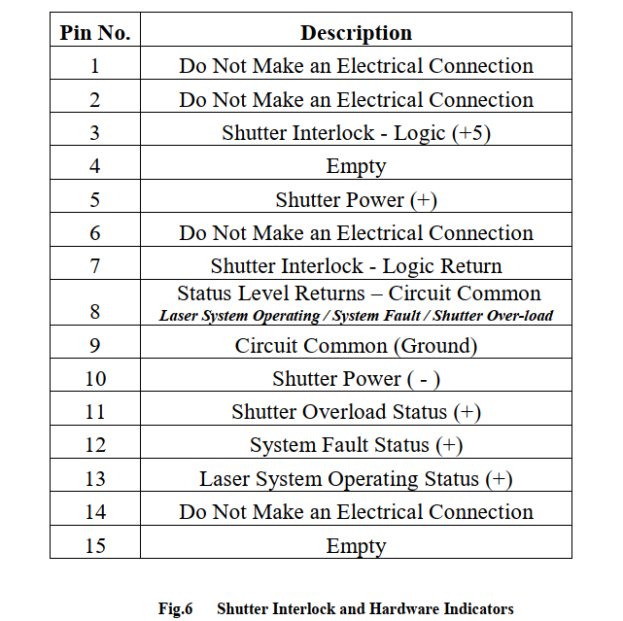
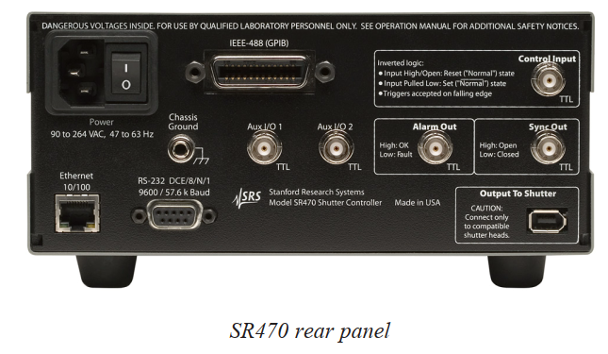
Laser shutter on the main beam:
Shutter interlock on the laser itself:

Slide 9
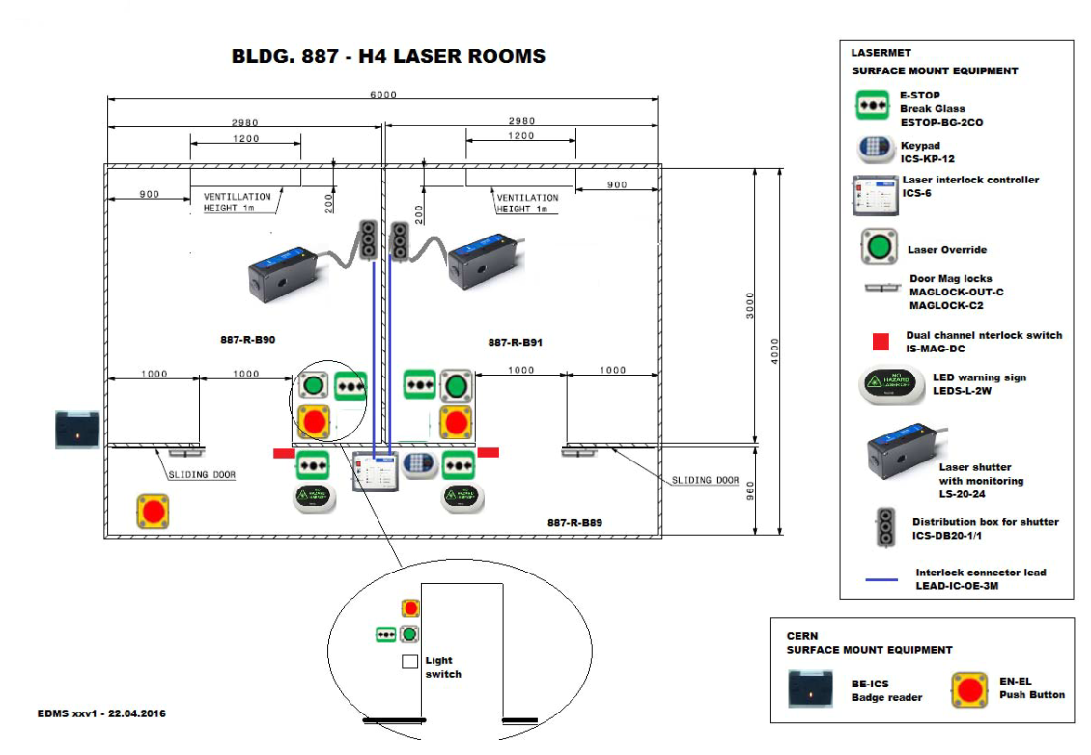
H4 installation 2016

