Slide 1
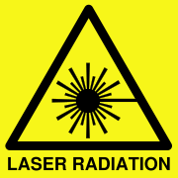
USC laser barrack
3524 – U0 – 213
Review of the safety system
D.Bailleux (DLSO G. Martinez)

Slide 2
CERN rules
Regarding interlock and safety system, for Laser class 3B and 4
https://hse.cern/content/nir
CERN follow the international standard for the Safety of laser products : IEC 60825-1
Designated Laser Area (DLA)
Where exposed beams of Class 3B and 4 lasers shall be operated, this must be in Designated Laser Areas as described in IEC 60825-1 Annex A. Where any of the conditions for an enclosed and interlocked area are not possible, compensatory measures are to be agreed with the LSO and HSE, recorded in the safety documentation and put in place. The main points for a suitable DLA are:
Closed area having access limited to authorised persons.
Contact details of the responsible person and authorised users clearly posted at the access points.
PPE must be available in an area not exposed to direct or indirect laser beams.
Interlocked access with laser output (shutter or power).
Interlocks on any openings: windows or emergency exits.
No hazardous beam may exit the area (i.e. opening doors for access while laser is operating).
Easily accessible emergency stop for the laser output within the area.
Easily accessible local emergency stop to cut power to other hazards in the area.
Safe emergency access procedure for first aiders and emergency services.
Illuminated warning signs at the access points to the area when laser is in use.
Audible or visual warning sign within the area when laser is in use.
If laser output is tripped by an interlock, a positive reset must be made by the operator to cancel the fault: no automatic restart.
The interlocks, Interlock control and access system are all safety control elements and must be designed as fail safe instrumented systems with a reliability suitable for the hazard they are controlling, following the methods of EN 61508 as required by the Machinery Directive EC 2006-42 (harmonised standard with EC 2006-25 Artificial Optical Radiation).

Slide 3
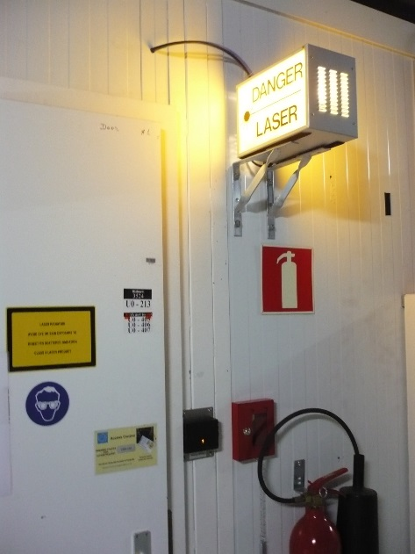
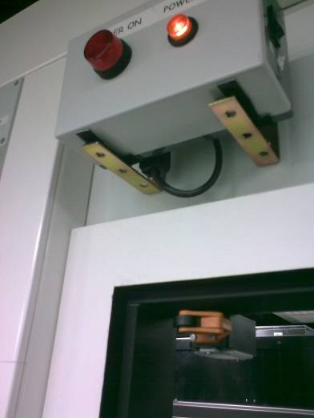
Current safety system
Access and the DLA (Designated Laser Area)
Access procedures 3524 – U0 – 213:
1. Need to follow the laser training session (user or expert)
2. Special access request through EDH
Hardware from 2008:
1. Flash lamp outside
2. Flash LED inside in front of each door
3. Door interlock on all doors
4. Safety box (Caltech design) to control the shutter with door interlock. Shutter is inside the laser itself for the DP2. No remote control once it has been closed (need intervention)
Safety logic :
If the outer door is opened at the same time of the inner door → shutter is closing.
This prevent visible light in case of maintenance.
Modification was done in 2012 to accommodate the new lasers

Slide 4
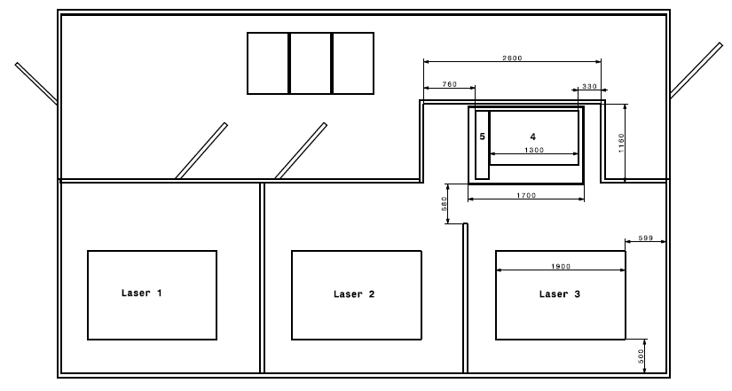
Access and the DLA (Designated Laser Area)
Not optimal:
1. Flash lamp not linked with laser : manual ON/OFF operation
2. ECAL and HCAL users:
in case of maintenance of ECAL laser or HCAL , nothing will prevent other users to enter the room. Only rely on people communication.
3. Safety box and interlock control:
Not EN 61508 certified
Safety
box
Door
interlock
3500
3500
Laser 5
Door
interlock
Door
interlock
Laser 4
DP2-447
1270
Laser shutter
1700
3900
HCAL
Laser shutter
Laser shutter
IEC 61508 is an international standard published by the International Electrotechnical Commission consisting of methods on how to apply, design, deploy and maintain automatic protection systems called safety-related systems
Clean room : 127x170 cm outside dimension
Optical table : 76 x 121 cm

Slide 5
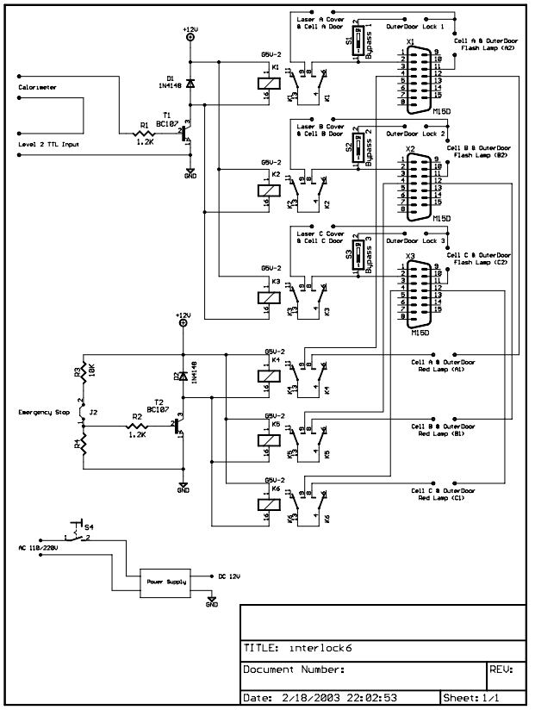
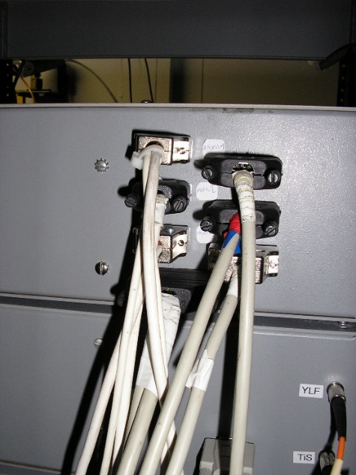
Safety box
Original drawing for Quantronix 2001.
Then modification to keep only the door interlock
(level 2 TTL, emergency stop remove)

Slide 6
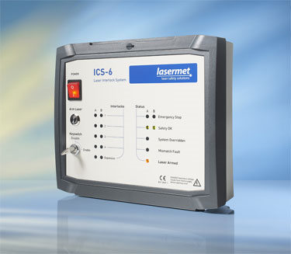
Proposal solution
From 2014, CERN standardising on the LASERMET access system for laser rooms, this is the one we have at the training centre. It is a European product, highly reliable and cost effective, there are few comparable systems in the world.
https://www.lasermet.com/laser-interlock-operating.php

Slide 7
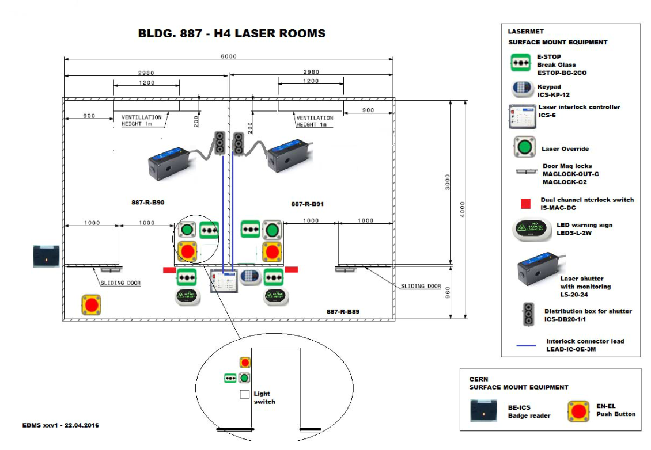
H4 installation example, 2016
ICS system lasermet: 5300 CHF
Cost installation by Actemium: 3800 CHF
Installation supervision by :
Miriam Munoz Codoceo, BE-ICS group
LSO <-> HSE, TSO
BE-ICS
EN-EL
Actemium

Slide 8
Lasermet solution for USC
1. Cost in 2016 as reference:
ICS system lasermet: 5300 CHF
Cost installation by Actemium: 3800 CHF
2. Difference: request 2 separates system , 2 ICS boxes control OR none of them ! → already card reader outside.
in H4: only one box controlling the 2 laser rooms. If we close one room, the other one is closed as well.
For USC: need to separate the ECAL and HCAL :
→daily operation, maintenance and access not at the same time!
→ for the future: for LS3 if we want to separate laser rooms we can keep the same hardware for each rooms.
Impossible if we have only one ICS control box (need to buy device again)
3. Access:
I think we need to keep the control card reader on the main door → light is coming on the racks. Danger still present.
Access the laser room inside : key pad (code) to unlock the door in operation (person inside or not, same thing)
or free access if laser are OFF.
4. Schedule/question:
If we go to a such solution -> need to be ready few months before end of LS2 (when detectors are in operation)
In LS3: new laser room move upstairs → need to be sure this hardware can be reinstalled

Slide 9
Laser Classification: Accessible Emission Limit
Class 1-1M : 0.39 mW in visible range (large beams..)
Including all lasers units where no laser light comes out, eg laser printers.
1M: This class is safe for viewing directly with the naked eye, but may be hazardous to view with the aid of optical instruments. binoculars, telescopes, microscopes, focusing lenses, magnifying glasses..
Class 2-2M : <1 mW in the visible range
Protection via “aversion response” 0.25sec. Blinking (2M as for 1M)
Class 3R : <5 mW in the non visible range
Many laser pointers are sold at this level, but illegal in some countries.
Class 3B : <500 mW in the visible range
Laser “Expert” training, enclosed room, key, interlocks. Skin hazard, diffuse reflection ok.
Class 4 : > 500 mW in the visible range
> 5 mW in the non visible range
Laser “Expert” training, enclosed room, …fire risk…..reflections not ok.

