Slide 1
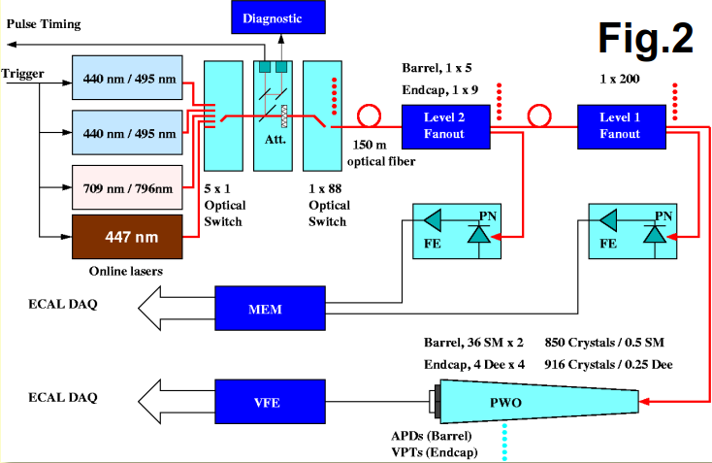
Long fiber test March 2018
Spare bundle ~105m: add FC connectors on each ribbon.
1)
1)Test the attenuation of each fibers with new new connectors:
200m after DP2-1 output (2 fibers of 100m connected together): lost= ~6 dB
2) Compare pulse with no fiber, with 100m and with 200m, using the slow monitoring
1
2
3
1
DP2-1 | NRJ (not calibrated) | FWHM (ns) | Pulsecenter(ns)
original | 50.5 | 21.8 | 86487
+100m | 17.2 | 22.2 | 87036
+200m | 9.8 | 22.55 | 87585
Overall ∆T=1098ns
2
Connect 200m after the 1x5 optical switch in order to tune the overall timing with the Matacq
After the 1x100 switch it is not possible to see and adjust the timing with Matacq
Adjust Blue laser timing from laser side. Delay A= 12.56us → new Delay A(200m)= 11.46us
Adjust Green timing with nimdelay : nimdelay= 7887 to nimdelay= 7800 → =-1087.5 ns
Pulse power can not be tuned with Matacq at this stage (only DQM) -> linear attenuator is AFTER the pin diode.
Only for the weekend : tune the remote attenuator from 9% to 25% by looking the DQM

Slide 2
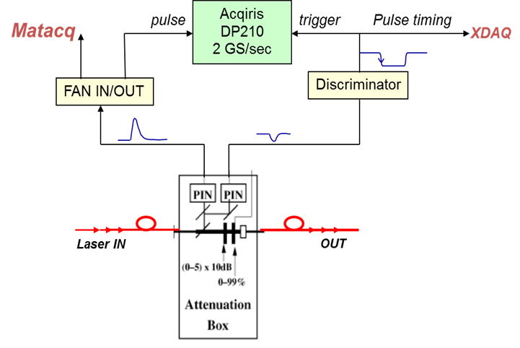
Long fiber test March 2018
Remote attenuator is placed after the pin diode of the Matacq.
(no effect on LightChecker when moving from EB to EE with #attenuator)
Tuning the attenuator of the laser itself is not enough (99% not sufficient)
3
Connect 200m on 3 Light Monitoring region LM as defined with Saclay. LM 69-72-73
For only 3 LM : need to adjust the delay and attenuation individually.
Table on dBGUI laser correction
1) The delay correction is low, can not remove 1087.5ns else negative value !! so we keep new delay A(200m) on blue laser and add 348 to all LM delay excepted the one with 200m.
348 because 348x(25/8)=1087.5ns
But not possible to see the pulse… need to go step by step ?
Max value that can be add on LM ? 348 ok ?
2) attenuation: LM attenuation = new/old= 1 for all EB, = 8 for EE
New LM attenuation = 3 for EB(200m) channel (attenuator from 9% to 27)
For EE not possible: 8x3=24, factor 24 of 9% = 216%.
But DON’T need to test EE !!!
3) For the Green: nimdelay= 7800 only for the 200m LM region.
LM to be tested : LM 69, 72, ? Propose 69-70 (FULL SM EB+17) + LM 71
# Revisions:
# July 31, 09: change fiber length delay correction.
# LMs 76,77,78,79,84,85,86,87 needed to be 1bx ahead:
# delay of 1bx added to every other LM.
#Fiber length delay corrections (in 1/8th bx unit):
# EB-
# LM1 LM2 LM3 LM4 LM5 LM6 LM7 LM8 LM9
68 68 68 68 68 68 68 68 72 \
#LM10 LM11 LM12 LM13 LM14 LM15 LM16 LM17 LM18
71 72 72 71 71 72 72 70 69 \
#LM19 LM20 LM21 LM22 LM23 LM24 LM25 LM26 LM27
70 70 72 72 72 72 68 68 68 \
#LM28 LM29 LM30 LM31 LM32 LM33 LM34 LM35 LM36
…
…
…
#EE+
#LM73 LM74 LM75 LM76 LM77 LM78 LM79 LM80
21 21 20 15 15 15 15 20 \
#EE-
#LM81 LM82 LM83 LM84 LM85 LM86 LM87 LM88
19 19 18 11 12 12 11 19
# Laser power correction per monitoring region (LM):
# EB-

Slide 3
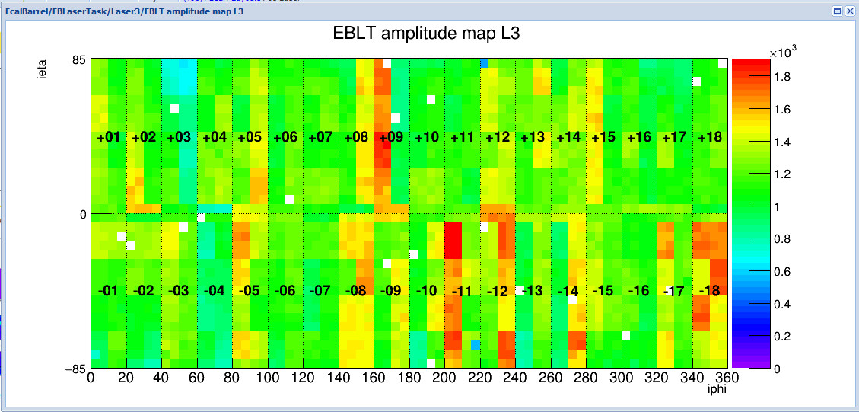
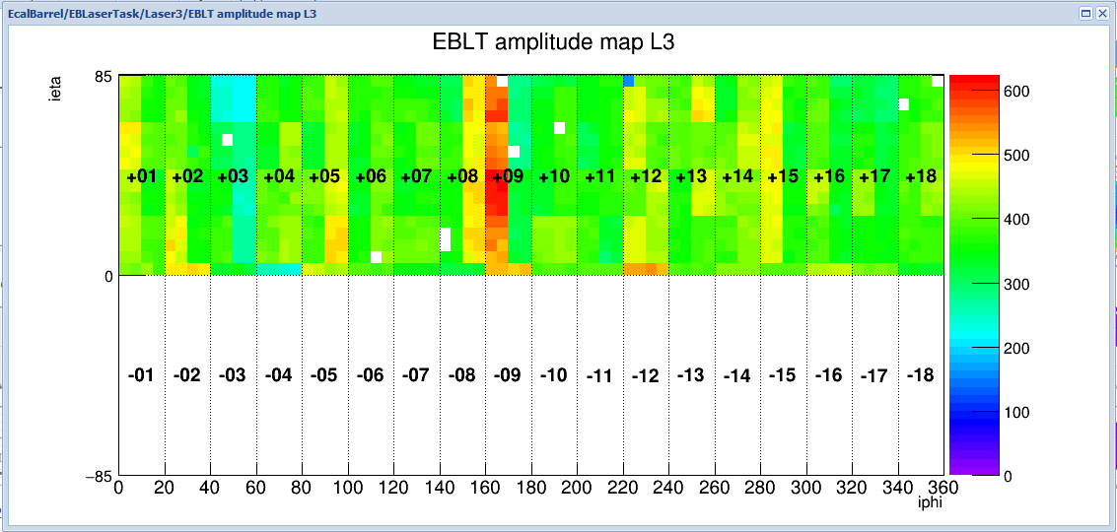
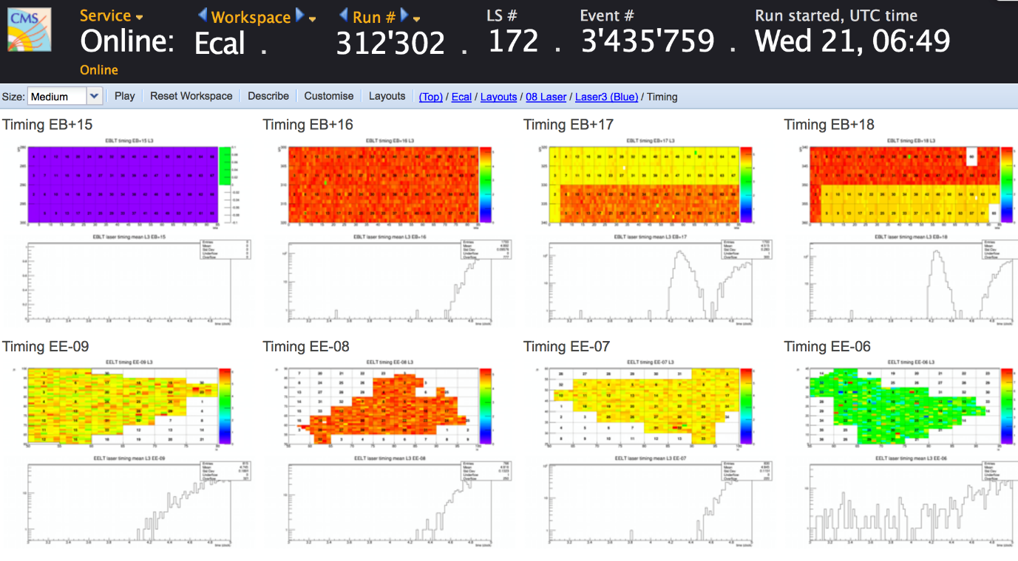
Long fiber test March 2018
* run 312003 avant l'ajout de la fibre supplémentaire. L'amplitude est autour de 1600/1800 pour EB+8/9
* run 312059 dernier pris cet après midi. L'amplitude est autour de 500/600 pour EB+8/9
Donc je propose de diminuer l'atténuation d'un facteur 3 pour voir ce que l'on obtient.
Hi All,
In fact, the light on EB+17 (LM69) and EB+18 (LM72) where 200m fibre connected is pretty much abnormal.
There exists a quite oddly post pulse in about 50% of cases. I attached timing from DQM for runs 312302
(the same as for David’s plots) and the old run 295463 without 200m fibre.
Cheers,
Serguei

Slide 4
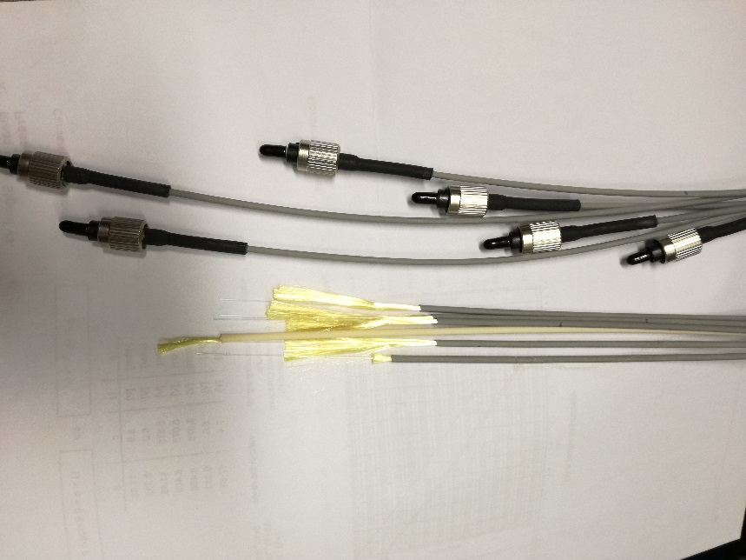
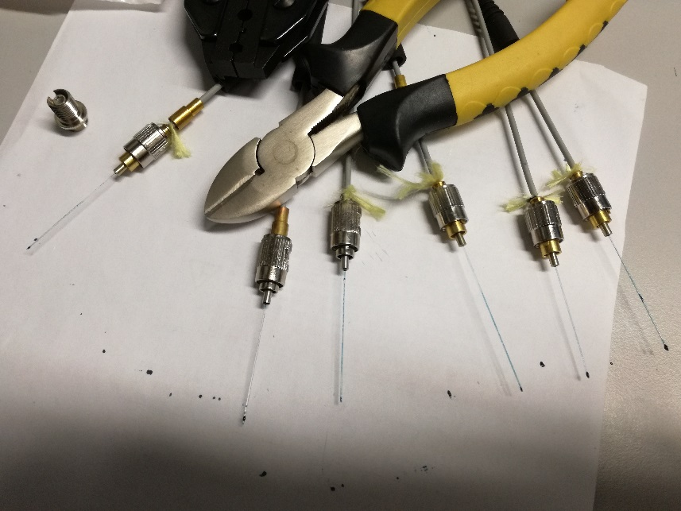
Annexes
The main delay of the calibration is done by:
delay = WTE_2_GREEN_LASER * 25ns + GREEN_LASER_PHASE * 3.125ns + delay Reg.28 * 12.5ns
The value WTE,ect are stored on the DBGui.
WTE=21 and green laser phase: 4
There is one setting called “nimdelay” = delay Reg.28 , on ~ecalpro/.lasercfg :
The registerd “28” for green timing is resetting after each new run to 1ED( (7897)
Last good value : write 28 4 0x1EDC (7885)
Making new connectors

Slide 5
Long fiber test: Dec 2018

