Slide 1
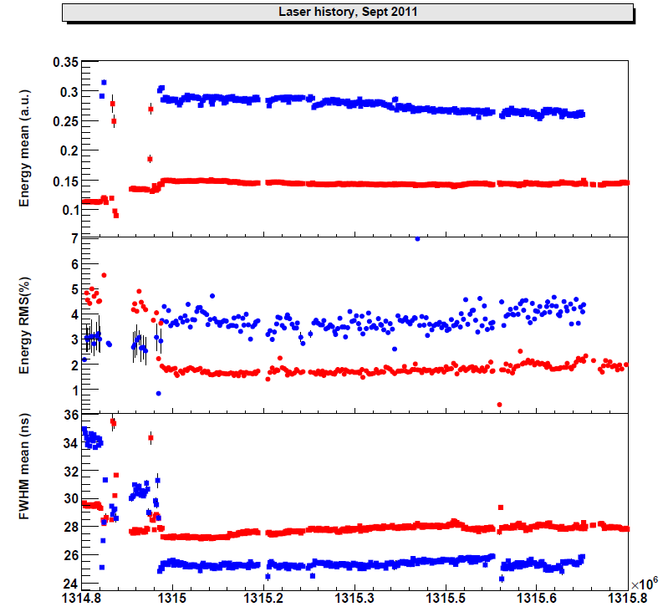
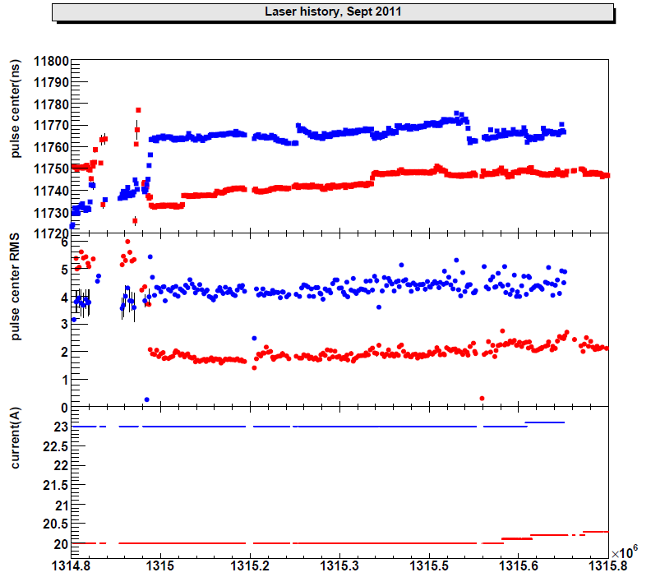
Lasers plots from slow monitoring
1 Sept
6 Sept
12
Sept 9am
1 Sept
6 Sept
12
Sept 9am
Laser1 and Laser3
13 Sept 2011 David BAILLEUX 1

Slide 2
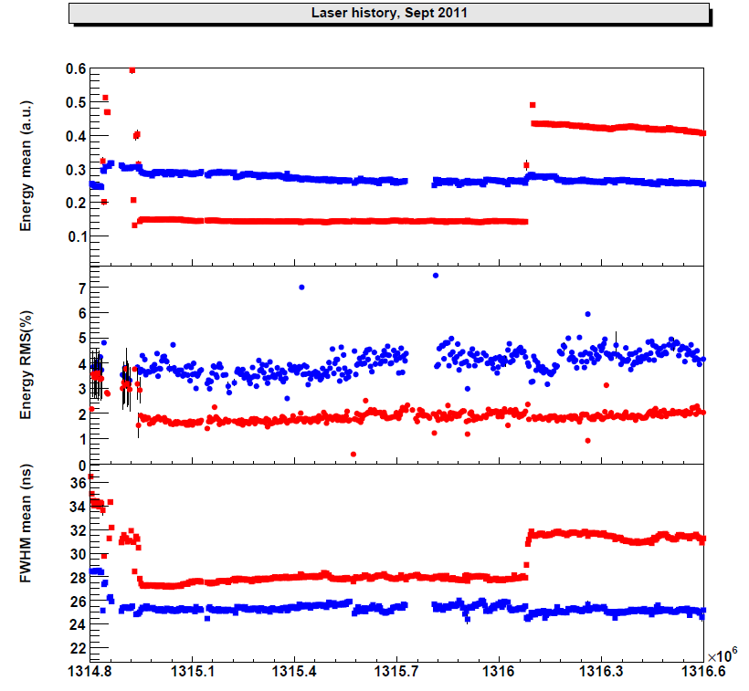
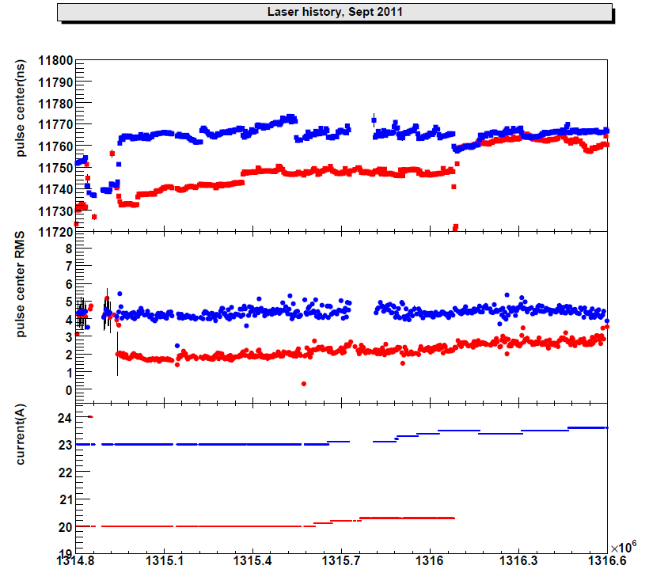
Lasers plots from slow monitoring
1 Sept
15 Sept:
RED PLOTS = LASER2 ONLINE
21
Sept 9am
1 Sept
6 Sept
21
Sept 9am
15 Sept:
RED PLOTS = LASER2 ONLINE
13 Sept 2011 David BAILLEUX 2

