Slide 1
Laser Monitoring System
Plots from laser monitoring
☞ Number of interventions
☞ Slow – Matacq correlation
APRIL – 6 DEC 2010
David BAILLEUX
On behalf of the Caltech group

Slide 2
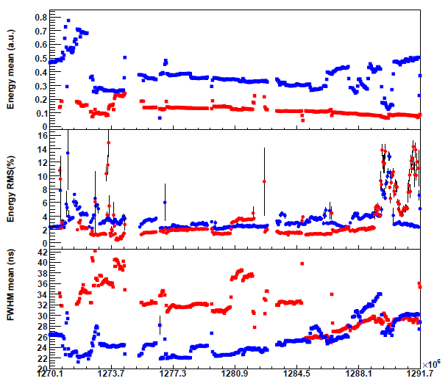
RED and BLUE laser history
Laser maintenance usually done during the TC, technical stop of CMS so invisible interruption (for RED laser).
When laser is ONLINE , data taking, laser values are inside the limits all the time else there is intervention ! (few minutes or few hours)
Not the same scale as the Light Checker
(#limits)
data not uploaded end of May but Laser OK.
April
May
June
July
August
Sept
Oct
Nov
Laser 2
Laser 1
L.2
Laser 1
Laser 2

Slide 3
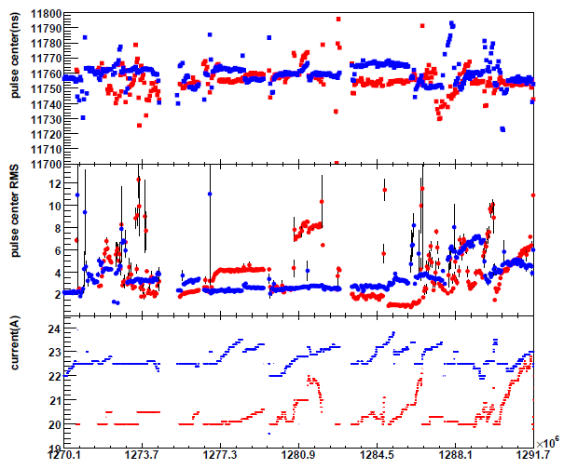
RED and BLUE laser history
Current evolution show any laser interventions of adjustments:
when it’s get high something wrong;
when restart from low current, working point, mean tuning;
when current goes to decrease it’s not so well, current should increased to compensate lamp aging. But this is theoretical because feedback is set on TIS timing now, not on the YLF energy
Blue laser intervention
Red laser intervention
April
May
June
July
August
Sept
Oct
Nov
Maintenance
Laser 2
Laser 1
L.2
Laser 1
Laser 2
Services

Slide 4
Statistics of interventions
Not take into account small tuning of laser optics of delay adjustments.
Months | Usual maintenance or services ( laser failures) | Number of switching time with spare laser
April | 3 | 1
May | 3 | 1
June | 2 | 1
July | 1 | 0
August | 2 | 0
Sept | 1 | 0
Oct | 2 | 1
Nov | 1 | 1
Replacement parts Since April | Nb. of items
Lamp | 12
Flow tube | 3
YLF Crystal | 1
Solenoid valve (cooling) | 1
ICS box (RS232/GPIB) | 1
Blue HV Pulser | 1

Slide 5
Statistics of interventions
Interruption RED laser:
Monday 15 Nov so mostly failed weekend . : 2 days
8 Oct : power decrease. New lamp: 1/2 day
Monday 20 Sept: YLF died, weekend : 3 days
23 August, new lamp : ½ day

Slide 6
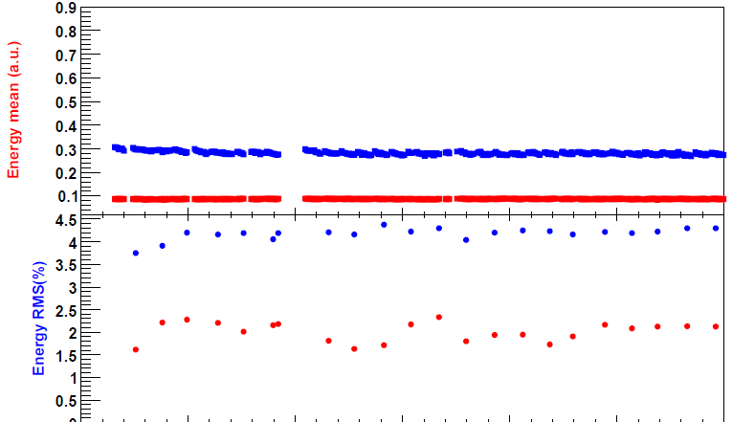
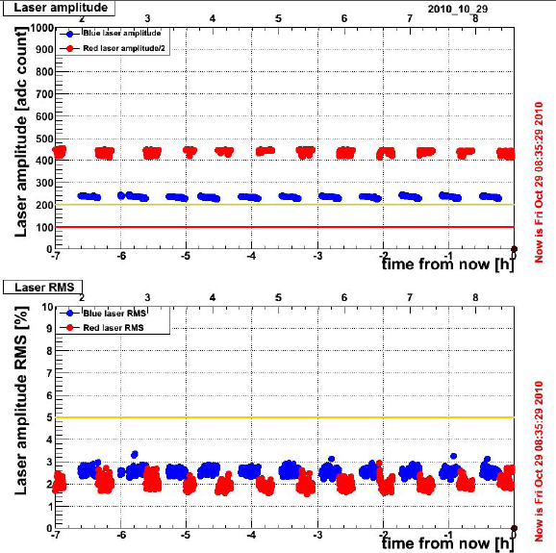
Normalization with Matacq data. Plot: 29Oct2010.
SLOW monitoring
Matacq
Over 24hrs
Power: x733 and x 4500 factor
But internal attenuation : red = 7%, blue=40%
Thus consistent.
RMS blue NRJ: 4% → 2.8%
RMS red NRJ: 2% → 2%

Slide 7
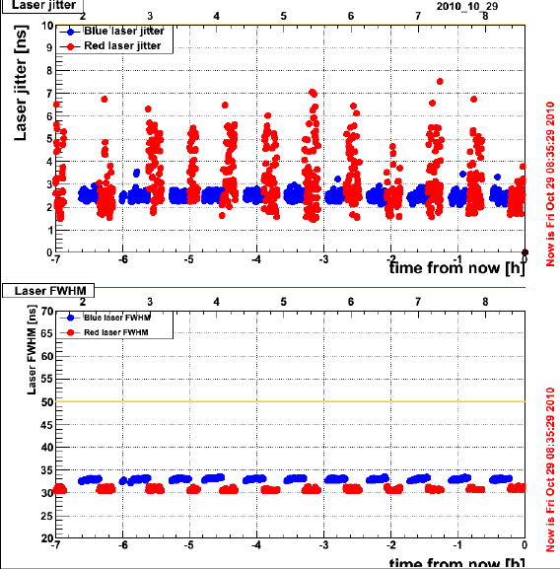
SLOW monitoring
Matacq
Over 24hrs
Over 24hrs
FWHM higher on Matacq because of setup (longer BNC cable..)

Slide 8
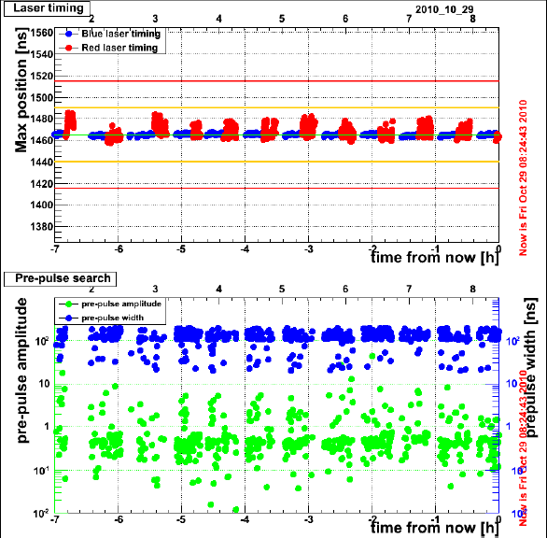
SLOW monitoring
Matacq
Over 24hrs
Limits on Matacq are:
1440 ns < 1465ns < 1490 ns
Limits on slow monitoring should be :
11730 ns < 11755ns < 11780 ns

Slide 9
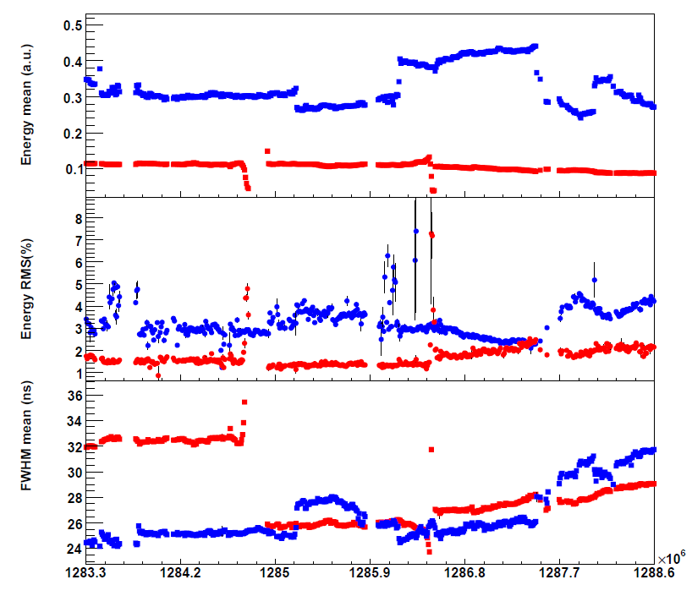
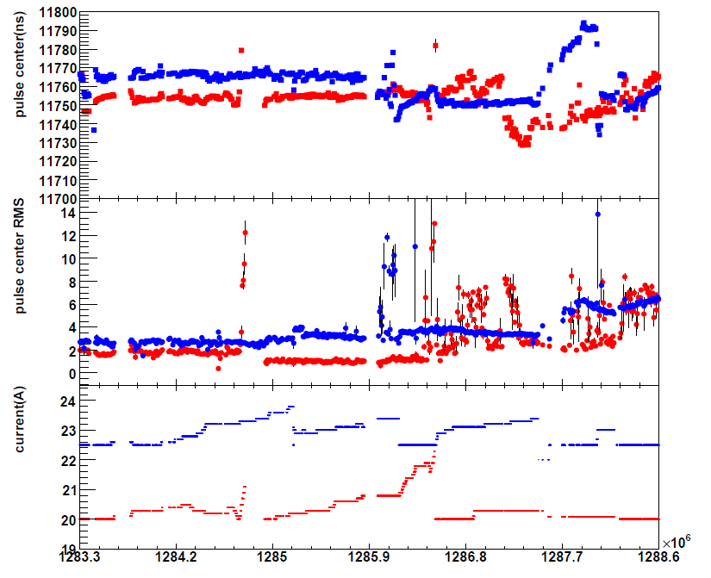
Fast Acqiris plot for critical period
Sept
Oct
Sept
Oct
20 Sept: RED laser services.
22 Sept: No hand-shake mode → switching time reduce 8sec to 4sec
5 Oct : laser1 to Laser2
8 Oct: Laser3 change the lamp (power decrease)
20-27 Oct: Laser2 services. Still online.

