Slide 1

Laser Monitoring System
● Overview
● Laser control
● Requirements
● Performance
● Documentation
- Electronics review 20 March 2009 -
David BAILLEUX
US CMS on behalf of the Caltech group

Slide 2

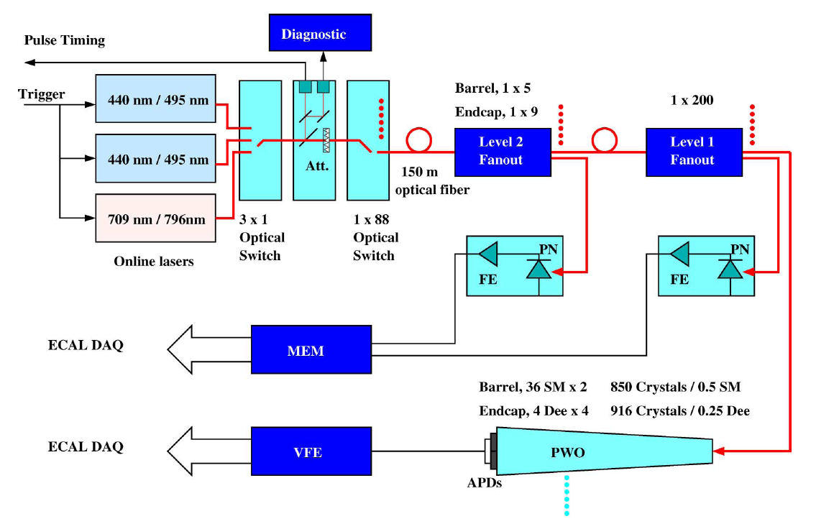
Overview

Slide 3
Laser control
Ecal-laser-room-01.cms → fast monitoring (Acqiris PCI board).
Ecal-laser-room-02.cms → laser hardware control, slow monitoring
Ecal-laser-room-04.cms → laser PC Xdaq supervisor, for Matacq and EMTC.
LTC or GT monitoring runs
4 TTCci’s partitions for ECAL : EE-/+, EB-/+
Predefined sequence load into TTCci before run
EMTC: Ecal Monitoring Trigger Card receives the trigger and clock signal issued from the TTCci’s
NIM signal to trigger Laser and Matacq
DCC
Laser pulses → injected during 1% of the 3.17us gaps foreseen every 88.9us

Slide 4
Laser control
Laser parameters under control:
Ecal-laser-room-02 = slave mode
WAVELENGTH: 440-495-709-796nm. For 440nm: the online laser is automatically selected.
LINEAR ATTENUATOR: 1-99% of laser power, in 1%step.
LOGARITHM ATTENUATOR: 0-10-20-30-40-50 dB.
SWITCH CHANNEL: 1-87 (1-36: EB- ; 37-72: EB+ ; 73-87: EE)
Laser parameters set by expert: (not yet recorded)
CURRENT: operating current of the YLF laser
INTERNAL ATTENUATION: 1-99%
DELAY: 3 delays for laser adjustments and for pulse center (if bad→ pulse not visible)
FEEDBACK to compensate lamp ageing.

Slide 5
Requirements
Main requirements:
Pulse energy: 1mJ @ 440nm
Pulse intensity instability: <10% of pulse energy
Pulse jitters: <4ns, <2ns for long and short term
Pulse width: <40ns
Quantronix lasers specifications:
YLF* Ti:S 1 Ti:S 2
λ (nm) 527 440 495 796 709
Pulse energy (mJ) 20 1 0.5 1.5 0.42
Pulse width (ns) 100-170 25-30 40-50 25-30 30

Slide 6
Performance
Software feedback (since 2006):
Compensate degradation by adjusting YLF current with 0.1A step.
Overall stability of Ti:S laser pulse much better than the 10% specifications.
Ti:Sapphire laser pulse timing as
the software feedback parameter.

Slide 7
Documentation
Laser web page: all doc., reports, plots, calibrations, lasers interventions, ect.
http://laser-caltech.web.cern.ch/laser-caltech/
SharePoint for documentation:
https://espace.cern.ch/cms-ecal-electronics-systems/
/ light monitoring system/ light distribution
/ light monitoring system/ laser system
Draft : Laser system overview
Laser operating manual

Slide 8
Documentation
Publications on SharePoint:
● Monitoring light source, IEEE TNS-48 (2001) 37, 2001
→ Design of monitoring light source, choice of the wavelength, laser performance,discussion on crystal.
● Installation of ECAL monitoring light source, CMS IN 2001/008R 2001
→ Installation of the first laser in H4
● Red laser for monitoring, April 2002
→ History of RED laser discussion, specifications, results of market survey
● ECAL monitoring light source at H4, CMS IN 2003/045, Sept. 2003
→ floor layout, safety implementation and protocol of communication wit H4 DAQ. 3 LASERS.
● Laser requirements at P5, CERN, Oct. 2004
→ Hardware requirement for USC55 barrack
● Performance of the monitoring, IEEE TNS-52 (2005) 1123, Aug.2005
→ Lead Tungstate crystal radiation damage, laser specifications, design and performance.
● Laser monitoring system, CMS note 2007/028, Nov.2006
→ Full description of monitoring system including laser: OFF and ON detector fibre and electronics.
● The CMS ECAL laser: data generation acquisition and processing at LHC, CMS IN2007
→ Communication protocol between the components implied in the monitoring system:
TTC, CCS, DCC, SRP, Laser. Laser tasks during LHC running period.
● Software feedback Control, IEEE TNS-55 637, Feb. 2008
→ Implementation of the software feedback and performances.

