Slide 1
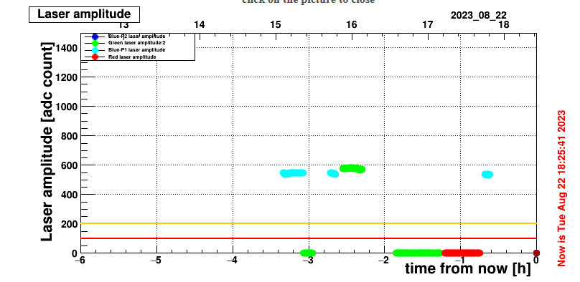
New green laser 22 August 2023
Delay :
New green laser delay = 600us.
Blue laser= 88us. Max WTE=100us so cannot use WTE .
The triggers are sent in bursts with a delay of 89*112 μs between two triggers => delay the trigger you receive by this amount minus 600 μs: we will miss the first pulse of the burst and have an extra one
Start trigger at 10ms minus 600us.
Delay A= 9.4 ms on laser side
Laser code: choice of the control command
Either we add it under “IR” but then we have to change the Matacq:
Matacq is expecting red color in that case and it is different settings (scale is not the same for amplitude). Test of yesterday
2. Or we replace with the legacy one : in that case the control should be reviewed, because it is done via the EMTC now. Maybe more complicated and difficult to reverse ? (If legacy green become the spare. ) .

Slide 2
DAQ command from 2003:
New green laser 22 August 2023
Today (on my side)
Wavelength(int) are (should be !)
0: 440nm (old blue laser)
1: green
2: DP2 laser new blue laser
3: 709nm
4: 800nm
Sequence configuration
- It is mentioned Phot-2 and Phot-1 but the choice between phot-2 and phot-1 is done on laser side only.
And for the configuration, is the same on DAQ point of view if it is Phot-2 or 1 !
I think the previous name was 440nm or TiS-blue . Only one Phot laser should appear.: “Phot-blue”
IR for infrared remain but 800 disappeared.
➔ last changed in 2014 for supporting the second blue laser , next slide

Slide 3
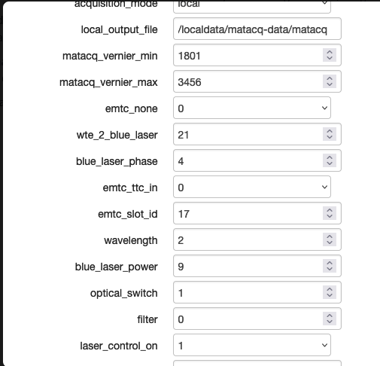
Philippe G, November 2014
Suggestion new laser codes:
0: not used
1: legacy green
2: Blue (Phot 1 or 2)
3: new green
4: not used
wavelength code
DAQ setting

Slide 4
Philippe G. March2012 for new blue laser

Slide 5
New green laser 23 August 2023
Put the new green laser instead of the blue one : better for Matacq, and easy way before Saclay modification on green control..
Connect fibre green instead of blue: change channel_map2 files:
1 1
2 3 laser 2 selected choose fibre 3 where green laser is.
3 2 laser 3 which is nothing… put switch ch 2
4 4
5 5
2. Change laser_h.cfg : else the shutter of green laser will stay closed
Bypass the line
*SR470 2 SR470-2 2 7
Change the line :
SR470 3
by

Slide 6
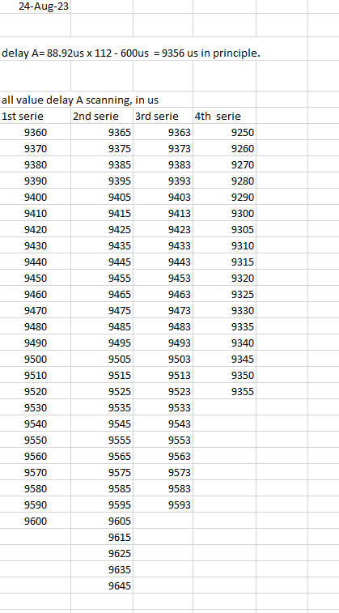
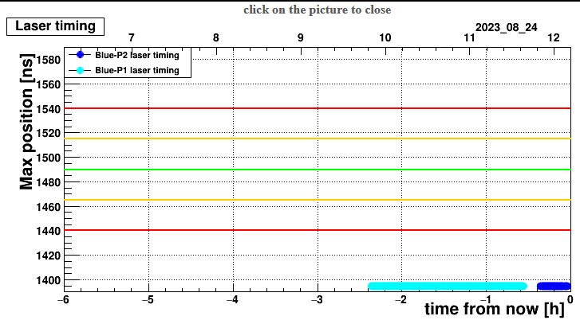
New green laser 24 August 2023
Test only with Matacq :
Scan all those value: no pulse on matacq..
2) Run in global: other solution by lookign the data .
But:
New feature : it was well but --n phot2 600 => DP2-1 is selected !!! How it can be ?
It is confirmed with Matacq, wrong blue.
Try to put DP2-2 on laser control, but move to DP2-1 immediatly..
Giacomo confirmed it is the same setting betwen mini daq and global..
Try –n phot-1 600 => OK ! So there is investion of the laser code behind… ?
Test localy: laser code = 2 => DP2-1
laser code = 4 => DP2-2

Slide 7
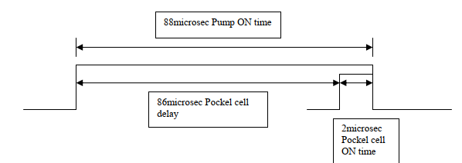
New green laser 24 August 2023
1st test in Global with DQM :
Delay A= 9450 us : Nothing. Nothing in physics.
After lunch :
Ask new trigger rate 50kHz then 100Khz.
- Delay A= 0 us : something at 2250 bx.
Move by 850x25ns .
- Delay A= 21us : something at 3000 bx.
Add 450x25ns :
- Delay A= 35us. : too much
- Delay A= 33us.
- Delay A=32.125us : ok best but still in physic !? Bx is 3490bx for the physic
Delay A=34us
Delay A=36us . Result is the same, see 2 peaks separate by 1us (bx difference)
Delay A= 32.275us , 15h35. shooting at BX=3496
Delay A=9391.3 us (Amina) : 112 x 88.92 – 600 + 32.275. shooting at Bx=810-850
A=111x88.92 + 32.275 = 9902.395. still in physics
A=112x88.925 + 32.275 = 9991.975
Blue delay is :
A+B= 12.56 + 88us = 100.56 us

Slide 8
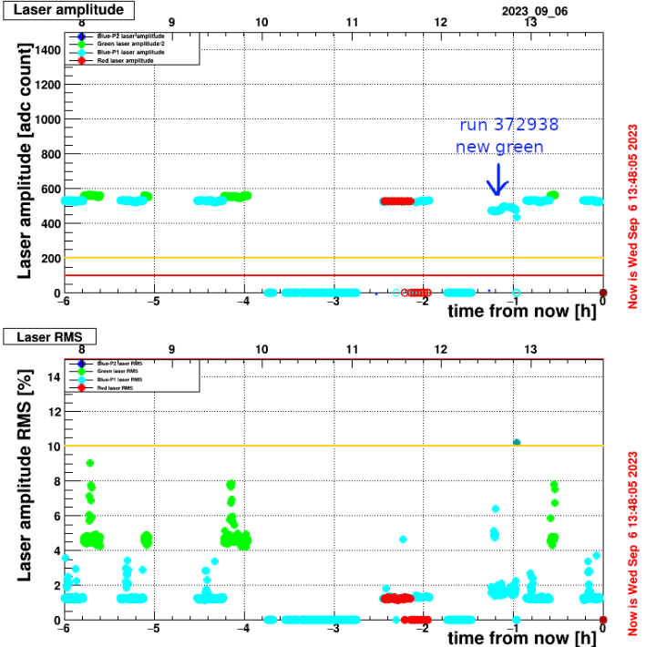
New green laser 6 Sept 2023
No beam for the day: new test.
1) delay A= 9415,845us
2) delay A= 9416.0uu
3) delay A= 9468.65us
4) Delay A= 9457.25us
Choose IR code : not working with dp3n. Switch not moving. OK with dp2n.
Use the legacy code dp2n to select IR laser code.
Then go back to new code with only green selected instead of blue: see the pulse on matacq expect for timing .
5) A essayer :
A=2*112*88924 - ((1525050-1524931)*88924 + (327-3490)*25)
delay A + 250ns (10x25ns) = 9416,095 us

Slide 9
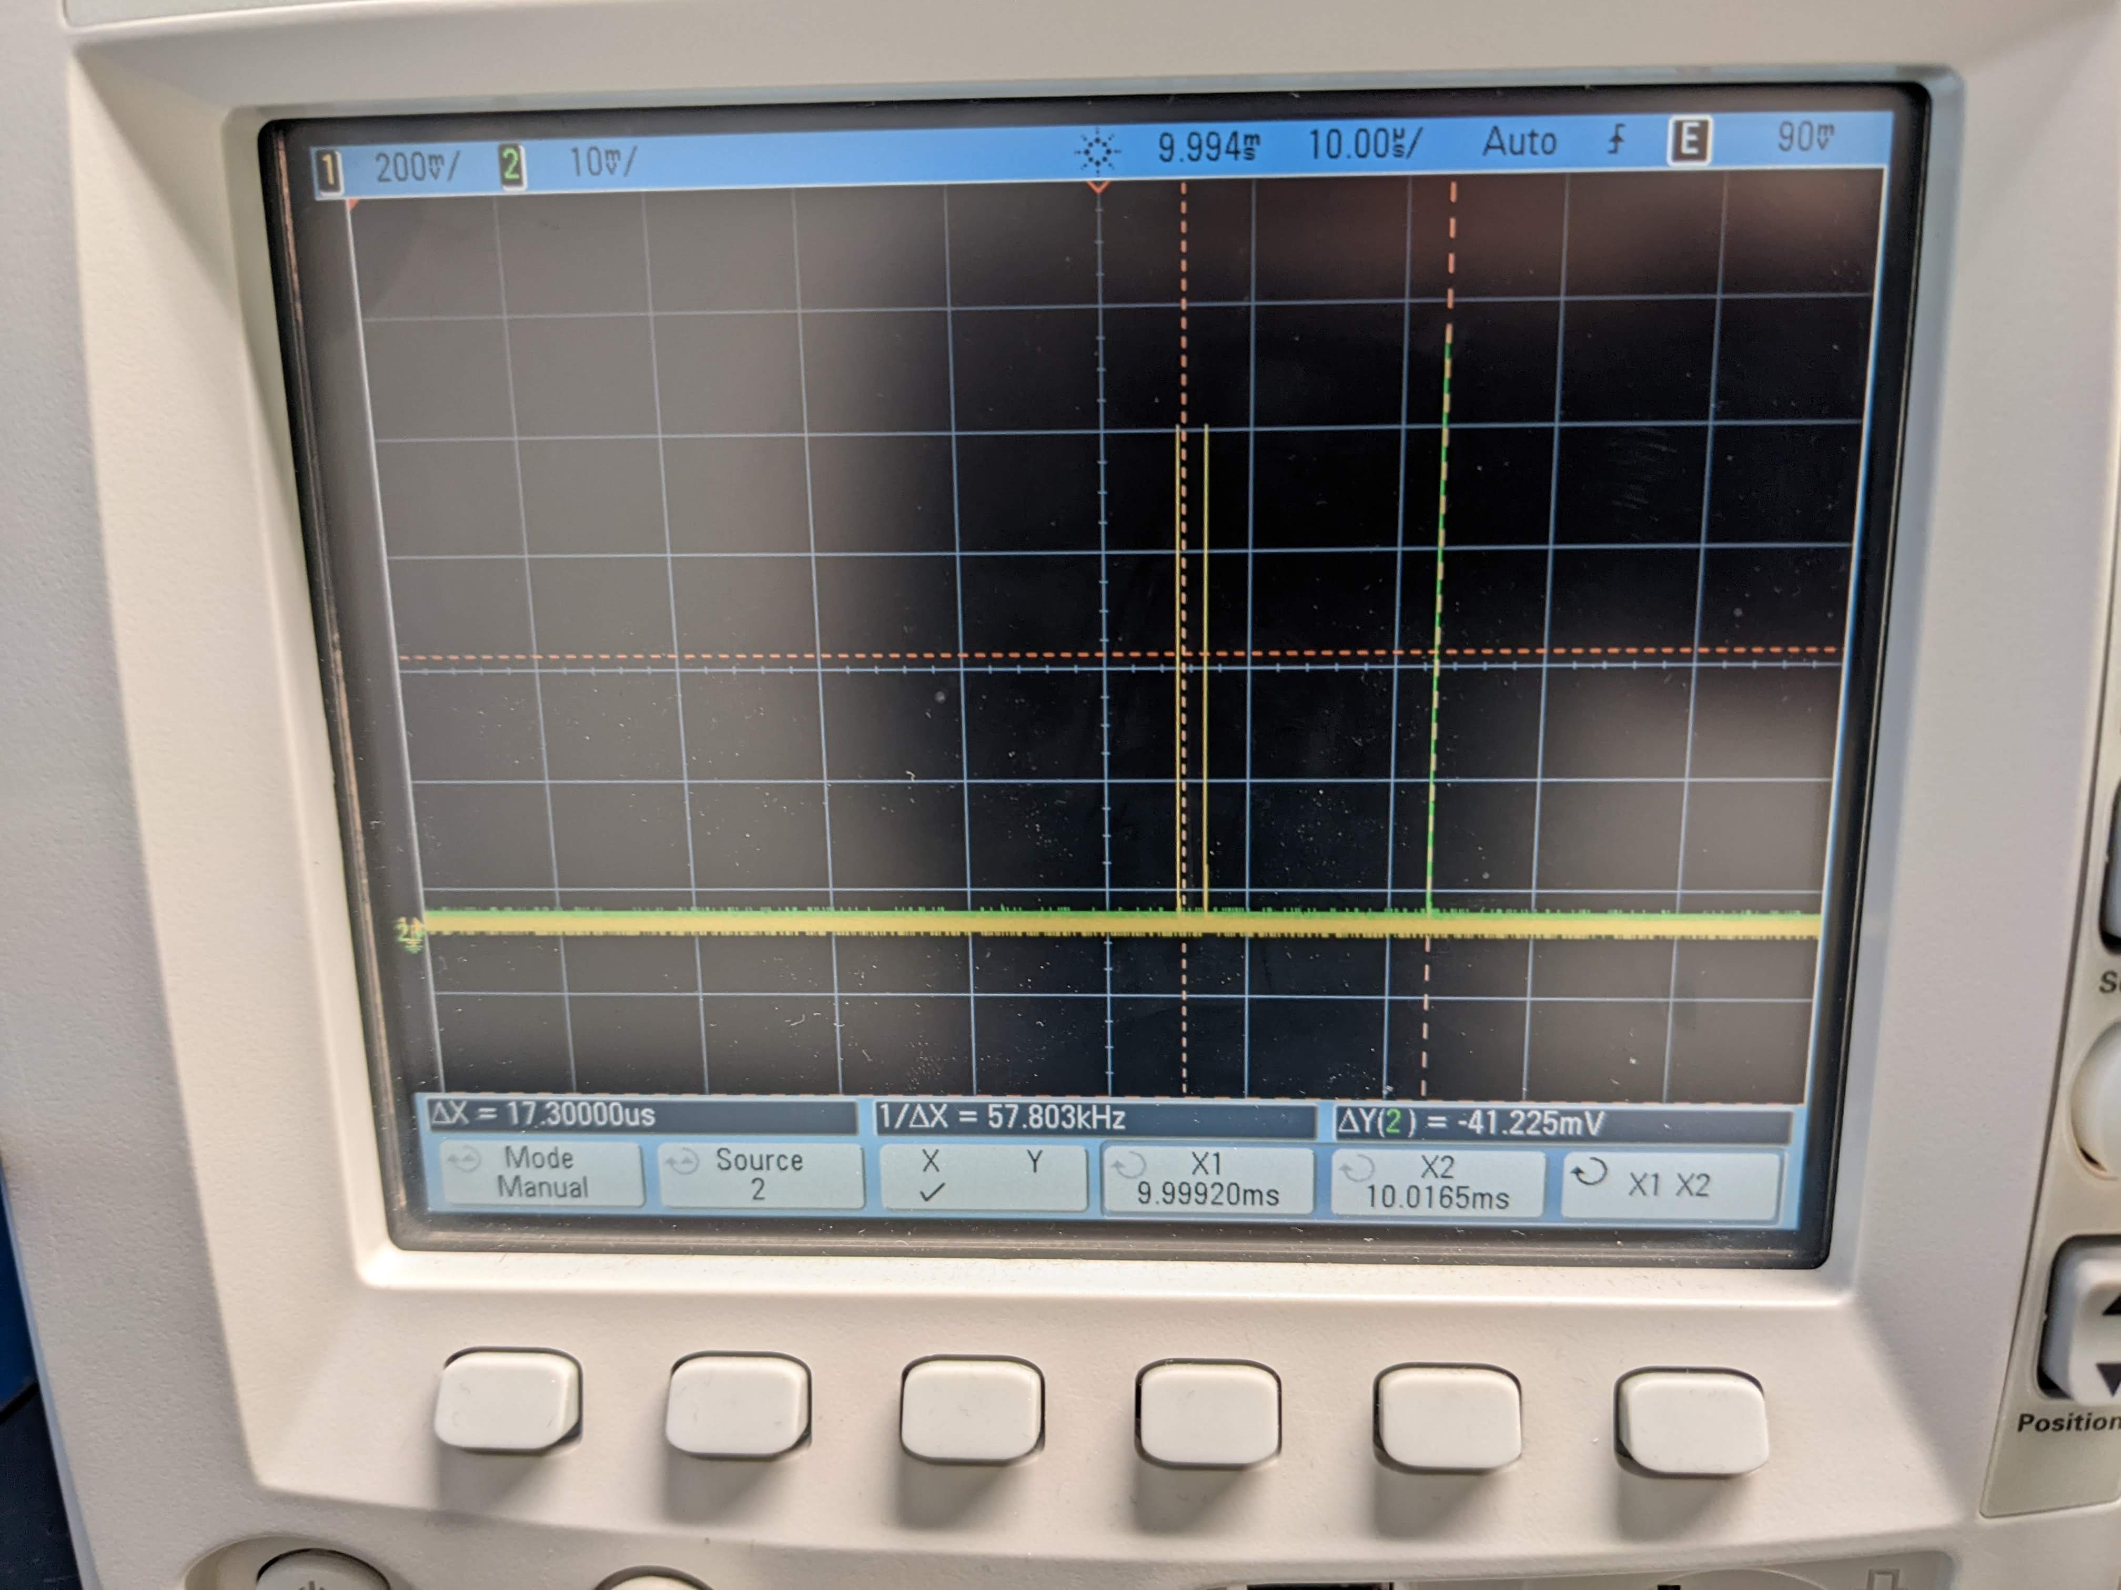
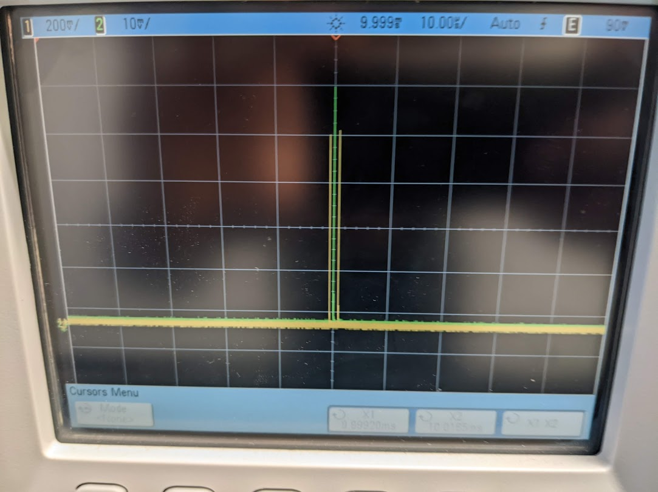
New green laser 14 Sept 2023
Test with scope :
Send trigger 100Hz to both lasers.
Try to see if green pulse is matching with blue one and adjust the delay if needed
Channel 1 for bleu
Channel 2 for new green
External trigger = trigger source 100Hz
Delay of 9399 us is more or less ok. +-2-3 us
Delay 9416us
The 2 pulses have 17us difference
Delay 9399us to have more or less the 2 pulses together

Slide 10
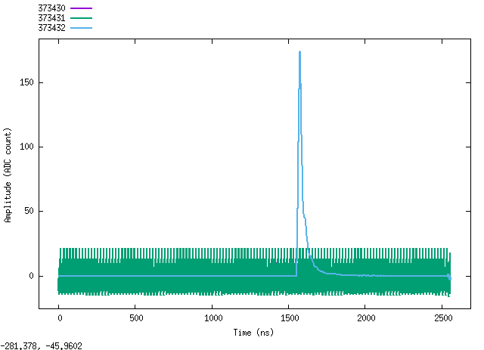
New green laser 14 Sept 2023
Put online with ECAL : not OK !
delay A=9416,095us : not OK
A= 9458.17us : OK but need fine tuning
A= 9458.03 us

Slide 11
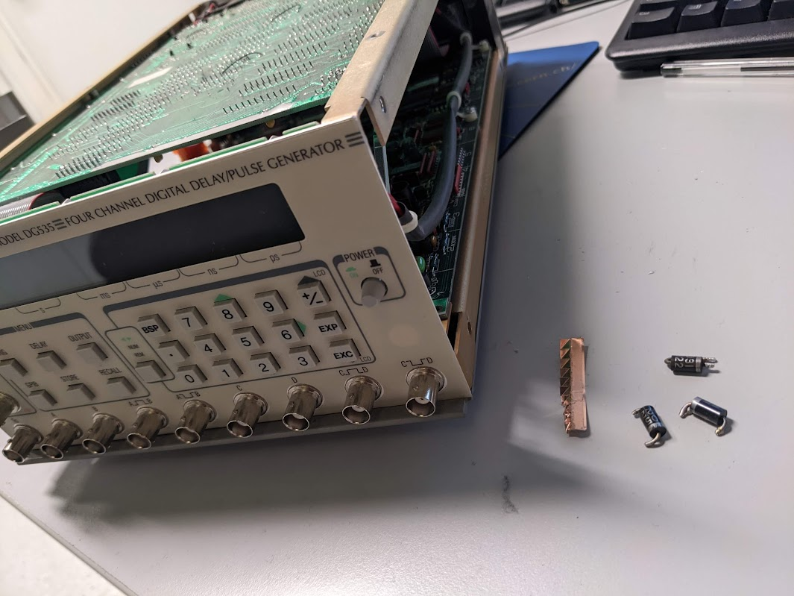
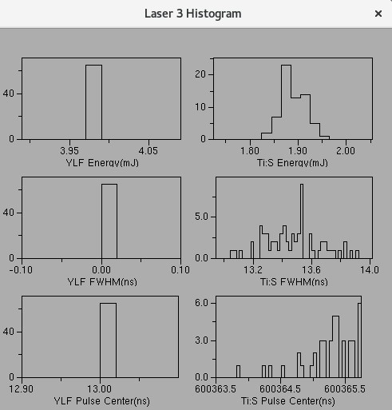
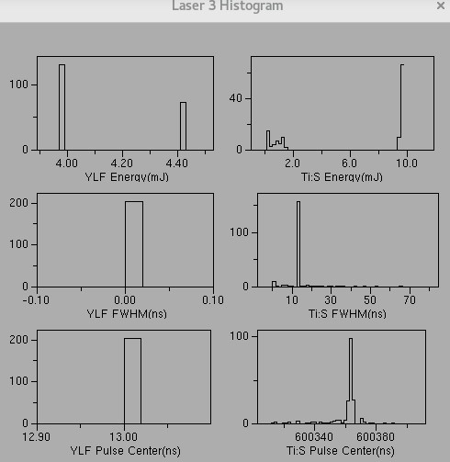
New green laser 4 Oct 2023
Delay instable online : each time we stop and start a run few days after, the delay is out of time.
Try another delay box: no improvement. During the test, one box burnt.
Investigation 4 Oct: found instability with my scope slow monitoring
=> cable between fan in/out to the input DG535 was bad ! Ok after replacement
Internal trigger
Usual external trigger (EMTC)
Usual external trigger (EMTC) after replacement cable:
Sigma NRJ = 3%. To be seen within ECAL but could be improved by increasing current.

Slide 12
New green laser trigger, 16-20 Oct
Problem observed: we have only half of the expected pulses !
Either if trigger is EMTC or using a DG535 as external trigger , 100Hz give 50Hz of pulses !
Delay A output using one DG535
To
Delay A=0
It is To which move according to A. Positive edge of A is well delay by 100us compared to +edge To.
With 100Hz , if delay A is reaching 10ms, the positive edge are inverted compared to the negative one and thus the frequency became only 50Hz.
To solve this : use external delay before going to the DG535.
To
Delay A=100us
100us
10ms
10ms
Si >10ms, > freq. 100Hz, on a 50Hz !
To

Slide 13
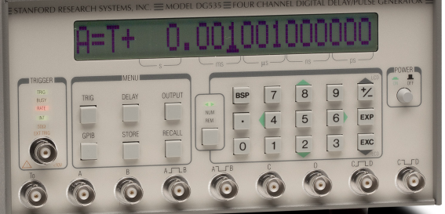
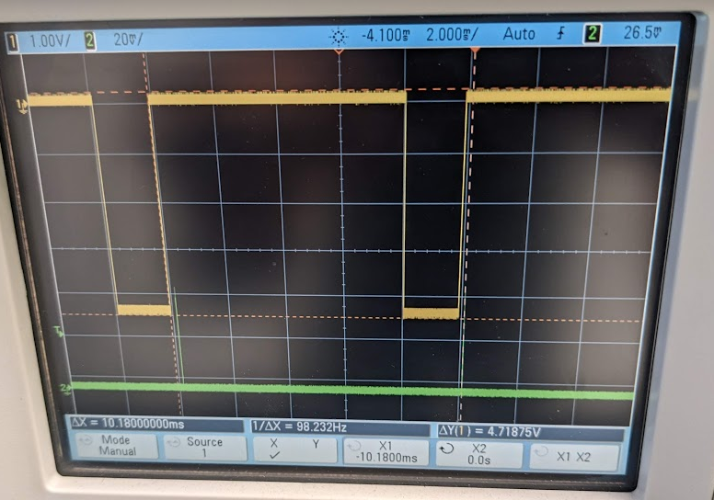
New green laser trigger
19 Oct 2023
Change the delay chain : 2 DG535 in used.
Delay A in used up to know = 9,45827ms
EMTC Trigger
From fan In/out
EMTC Calibration trigger
Delay A= To+8ms, NIM (for A and T0)
~10ms
Green pulse
Delay Ok between rising edge trigger and laser pulse
Delay A=To+1,45827ms, TTL
A to laser diode
Rate OK now, 100Hz
Delay B= A+600us, TTL
B to laser Qswitch
But pulse not OK on the Matacq. Need fine tuning of the delay, to compare this setup with the previous one.

Slide 14
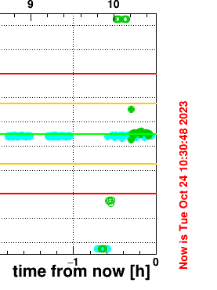
New green laser trigger
20 Oct 2023
Fine tuning of the delay with comparison of the previous configuration.
1) Pulse delay with 1st setup , only one DG535:
Pulse is at 10,058546 ms from the rising edge of ext. trigger
(A+B= 9,45827ms + 600us = 10.05827 ms and pulse arrive a bit after the delay B so normal.
2) Pulse delay with 2nd setup , 2 DG535:
With A=8ms, second A = 1.45827ms and B=600us it is not working.
Pulse with scope is at 10.16949 ms so not the same !
Tune delay to have pulse as 1) case : A=1.37137ms and not 1.45827.
24Oct 2023
measure the pulse position from the matacq Pin diode ! Compare blue and green.
Pulse blue is at 99.055us on scope, with ext. trigger Fanin/out
With A= 1.37137ms, pulse green= 99.404us so not the same.
Adjustement of A: A=1.37142ms to have same position as the blue.
Confirm with the Matacq, pulse on time !
Pulse OK on fast monitoring with same acquisition rate as the blue !!!

